Slide 1
Miss Gloria’s Science
Welcome to Spring at Amberations

Slide 2
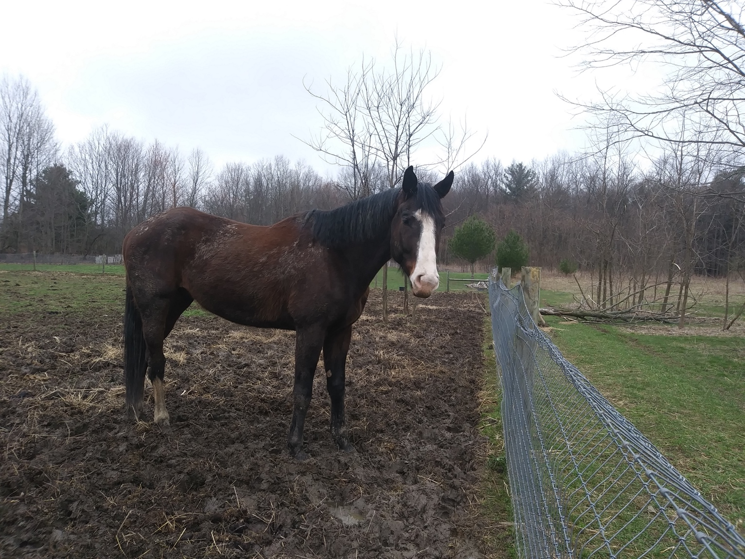
This animal used to live at Amberations, her name is Ginger. Is this Ginger a…
Donkey
Goat
Dinosaur
Horse

Slide 3
Ginger is a horse.
Donkeys’ ears are long and thick compared to a horses
A horses eyes are smaller and not as far apart as a donkeys’
A horse has a narrower forehead than a donkey
Horses have six vertebrae while a donkey has only five
A mule is a cross between a donkey and a horse

Slide 4
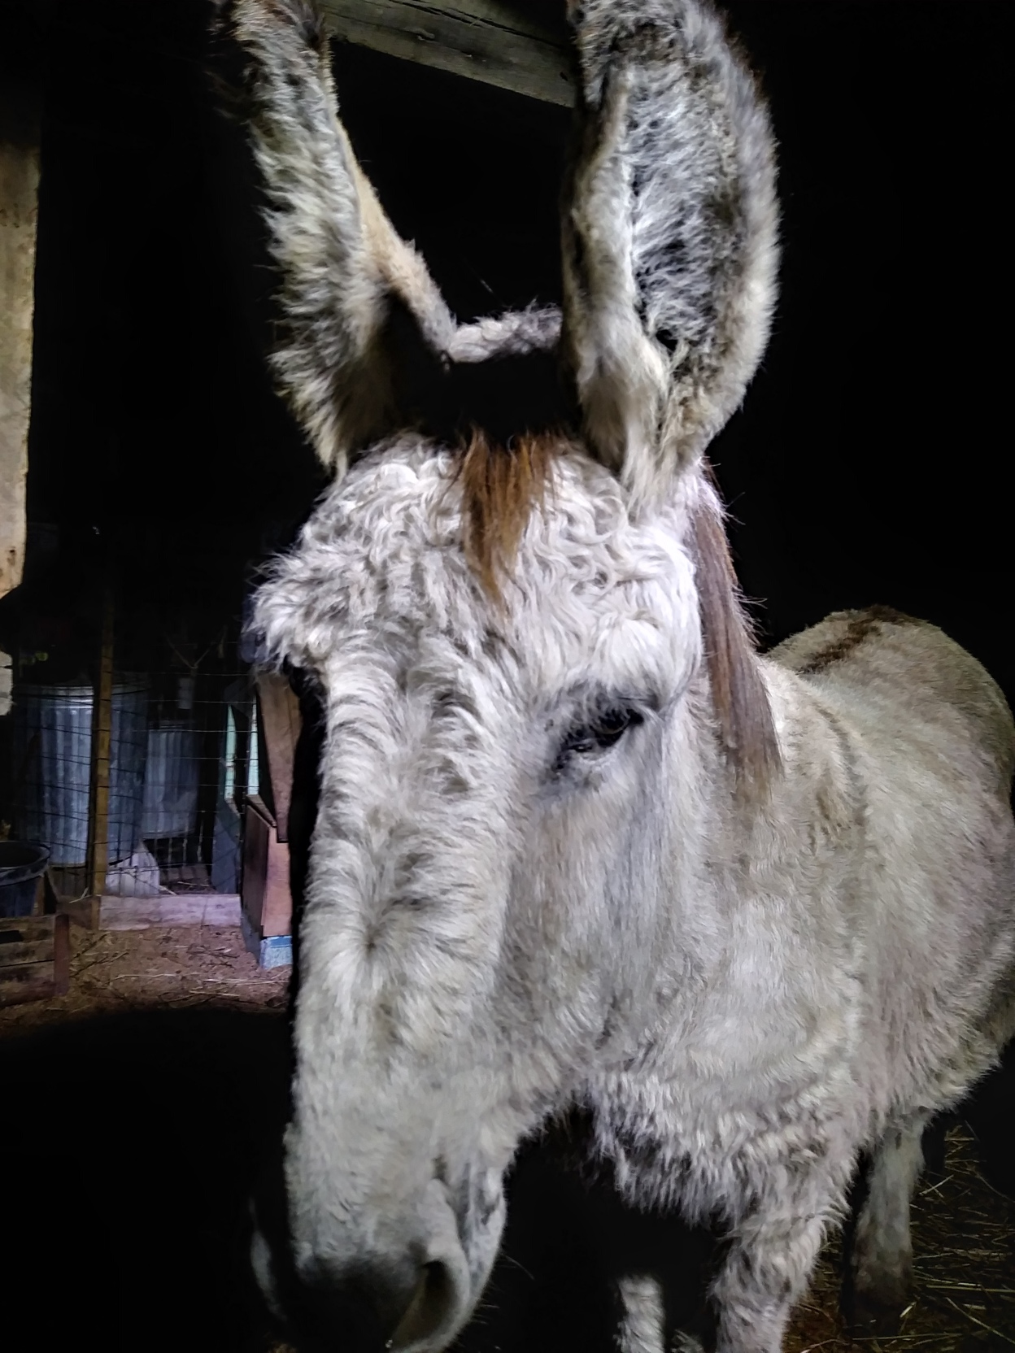
This is Big Joe, he is Amberations’ donkey
Joe likes carrots and hugs.

Slide 5
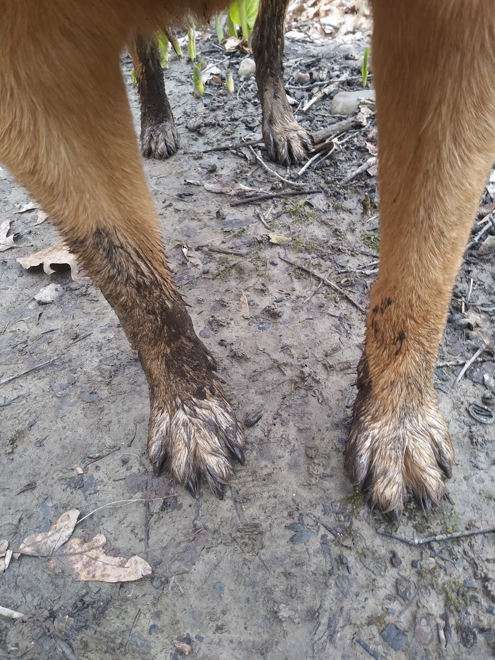
There is a lot of mud in the Spring!
These are Nero’s muddy feet
Do you like mud?
Yell - I love mud
if you do
( not too loud)

Slide 6
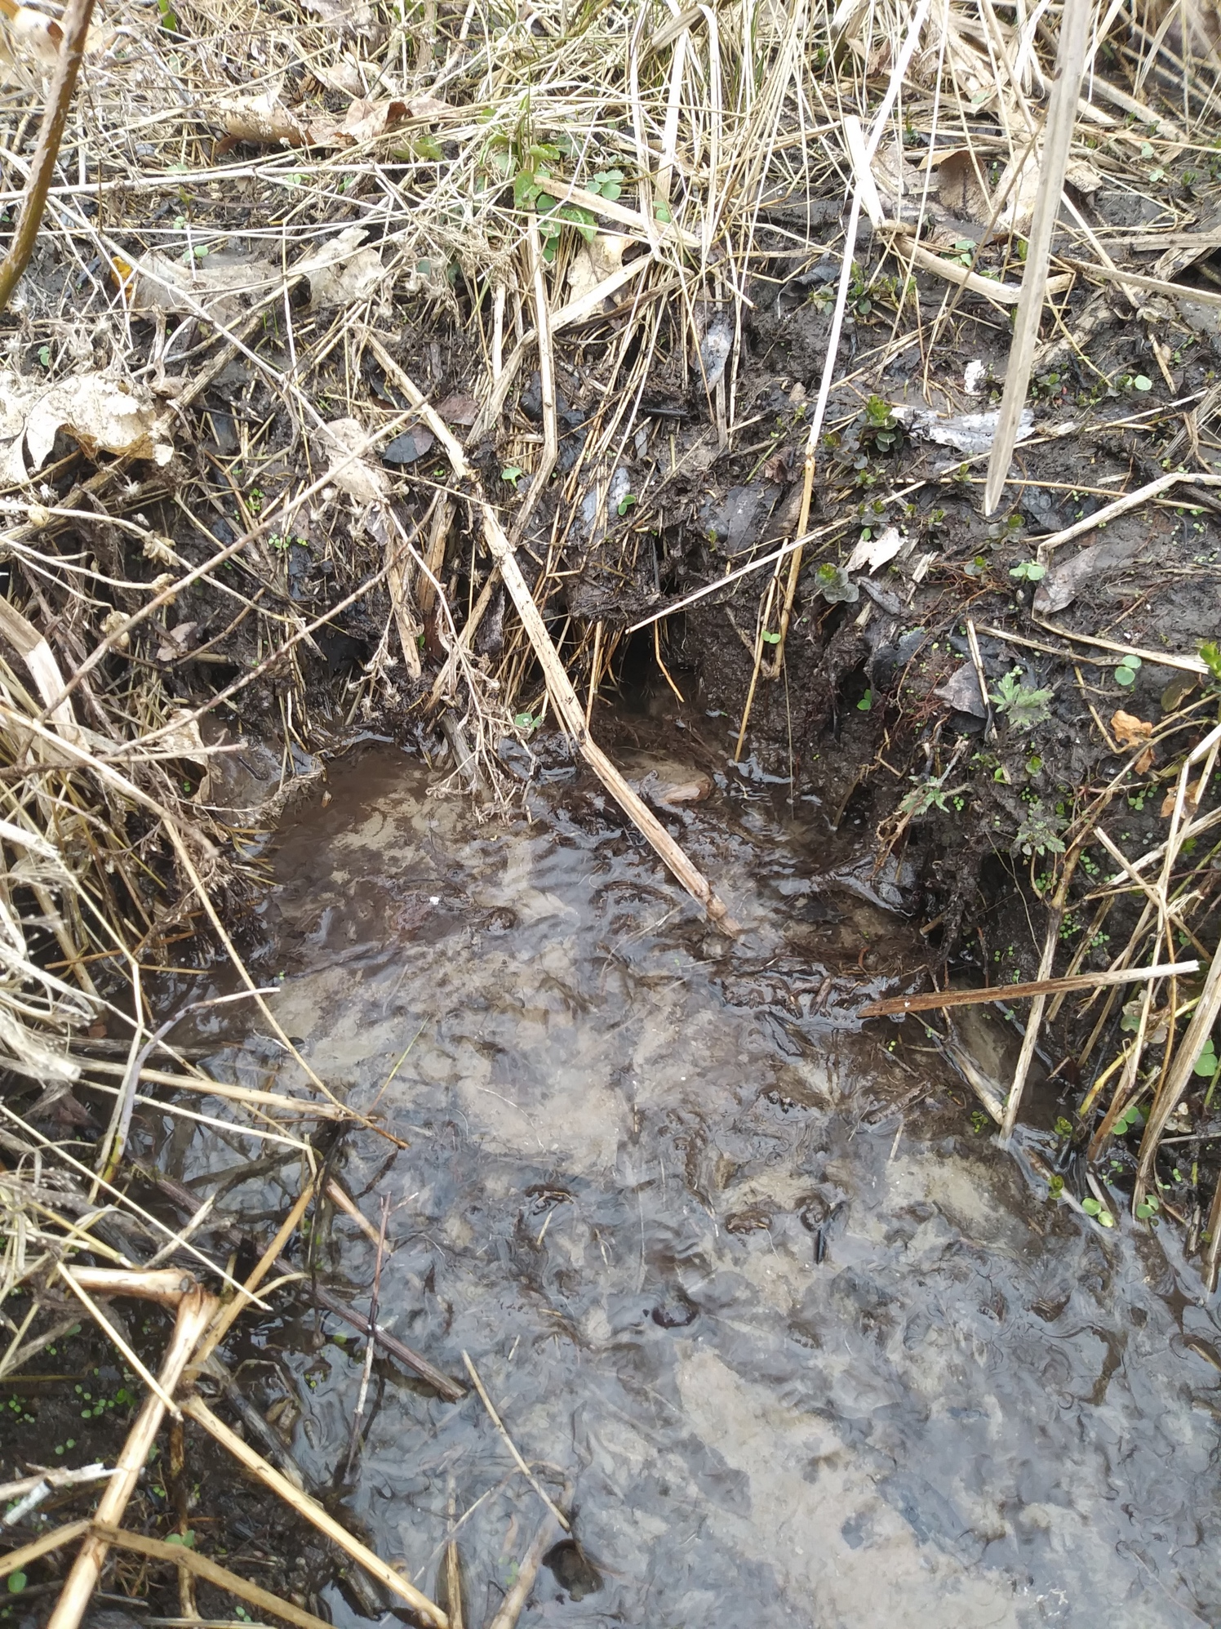
This water is coming right out of the ground.
It is coming from an underground spring. There is water underground and springs are where that water comes to the surface.
(water + dirt = mud)

Slide 7
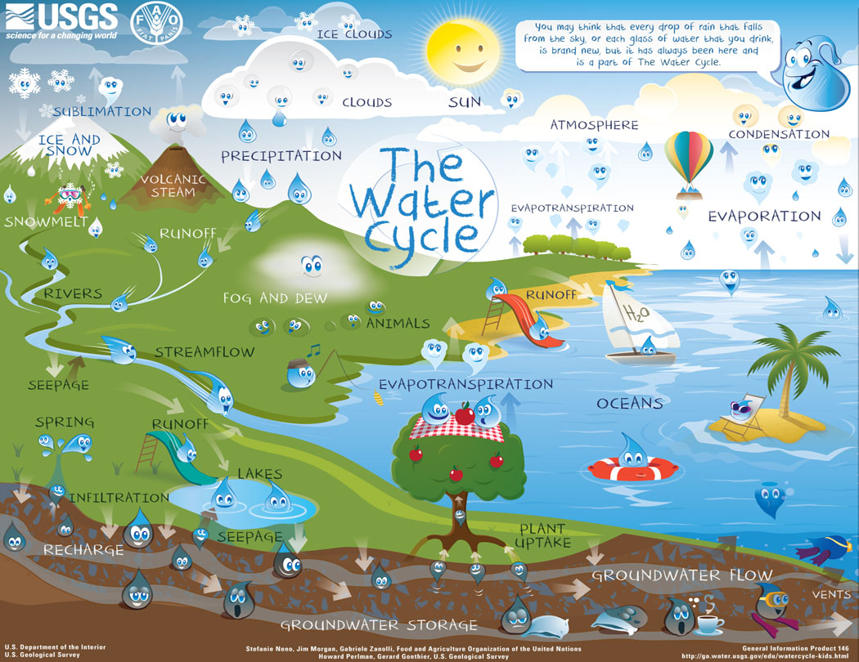
See the spring behind the slide?
The water comes from beneath the ground to the surface…that is a spring)

Slide 8
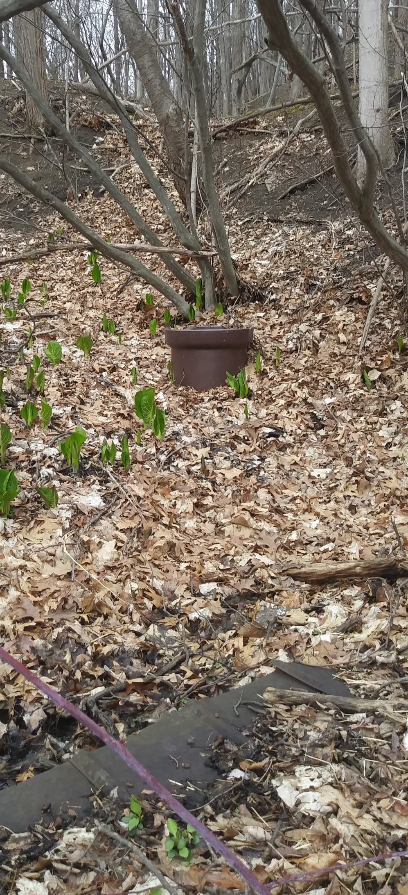
People used to get their water by putting a big pipe into the ground above a spring. A smaller pipe would bring the water from the spring to their house. This is called an artesian well.
This is a picture of an artesian well at Amberations. Notice the green shoots growing around it. Guess what they are. You’ll see a closer picture on the next page.

Slide 9
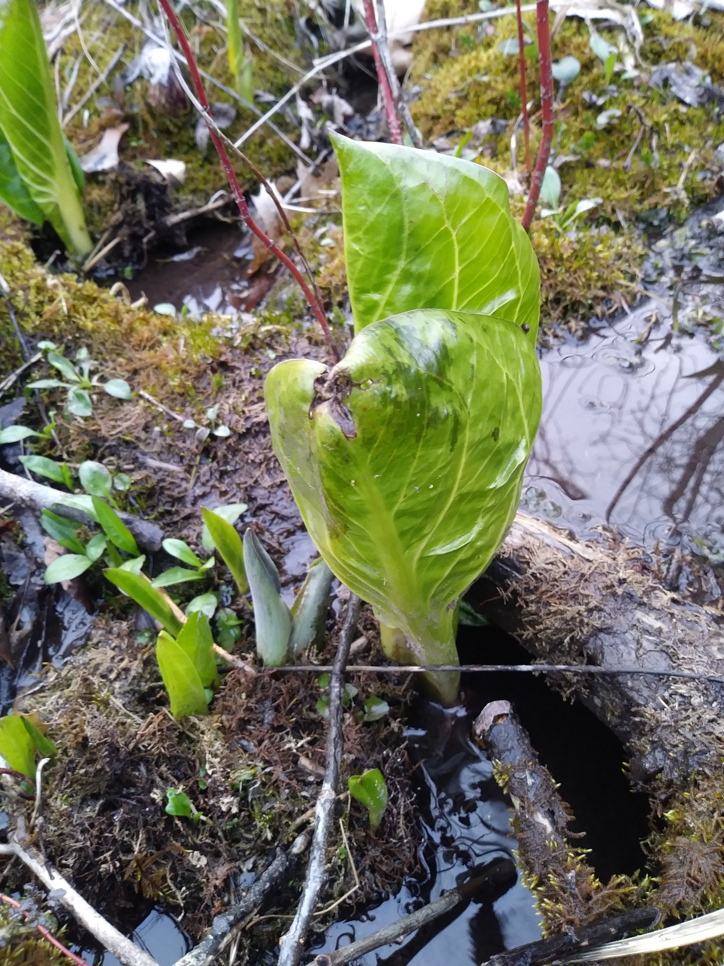
Guess what kind of plant…
Skunk Cabbage
Clover
Ginger
Corn

Slide 10
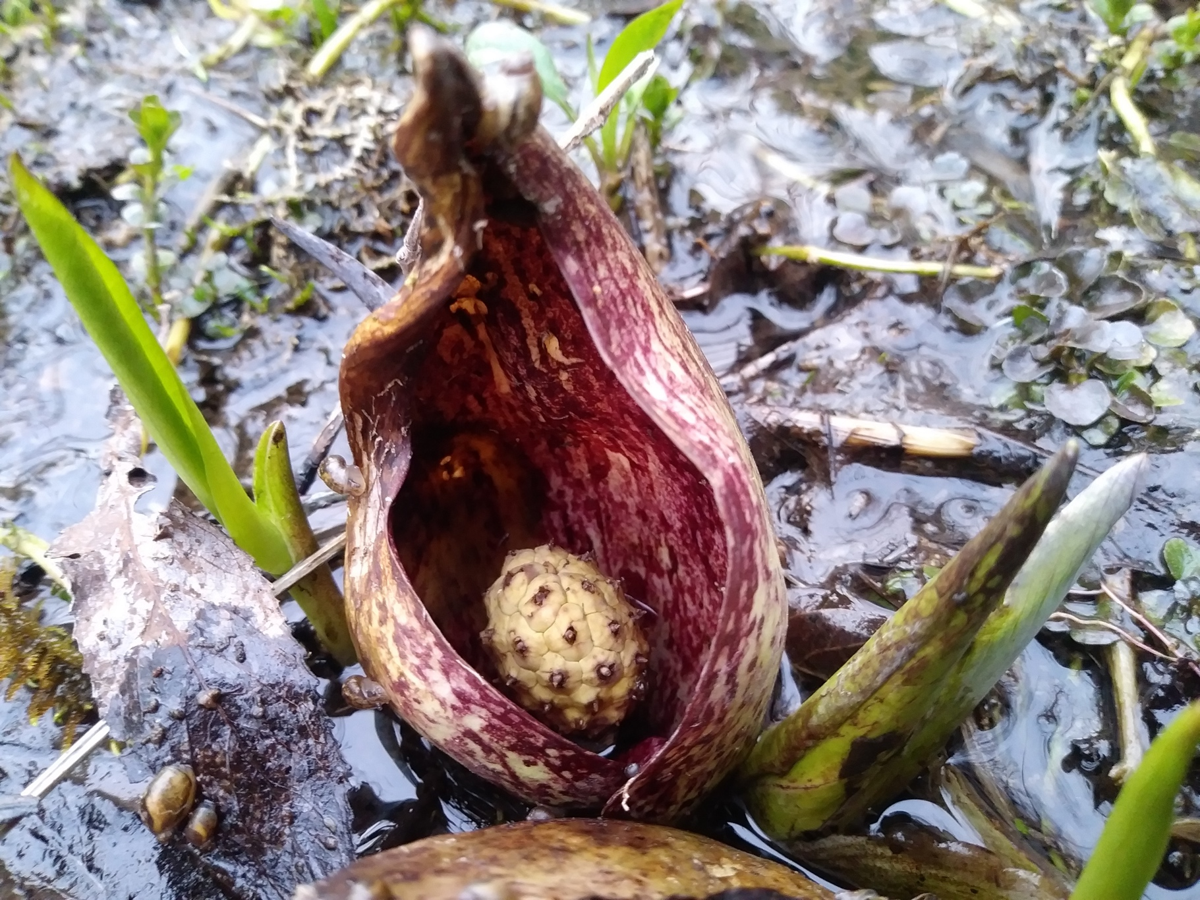
Skunk cabbage. Skunk cabbage likes to grow in wet areas. It smells a little skunky.
The little ball is the skunk cabbage flower.
→

Slide 11
Native Americans used the skunk cabbage plant for many medicinal purposes. They also used the root as an underarm deodorant.
Bears like to eat the flowers in the Spring when they wake up from hibernating
(it helps them to poop).

Slide 12
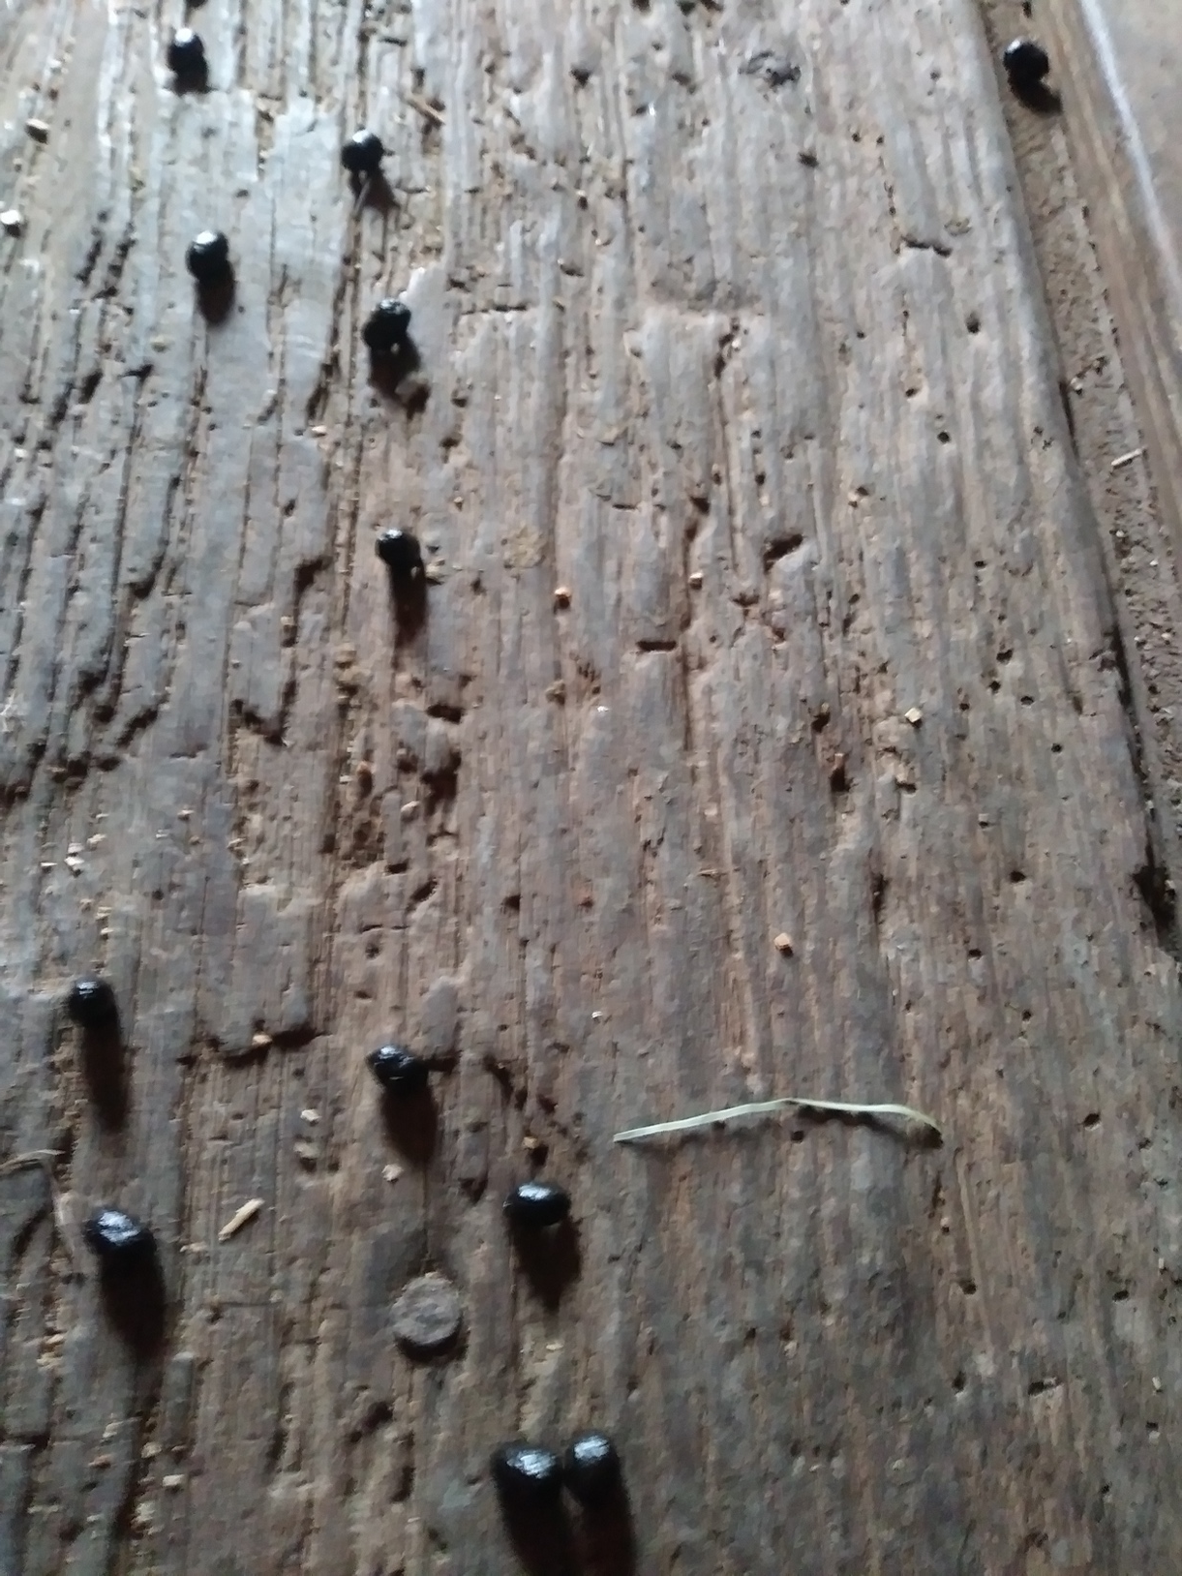
This is poop. Guess who’s.
(Hint: It is about the size of peas)
Donkey
Goat
Guinea Hen
Sparrow

Slide 13
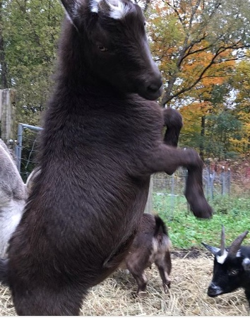
It was goat poop...
They were feeling left out

Slide 14
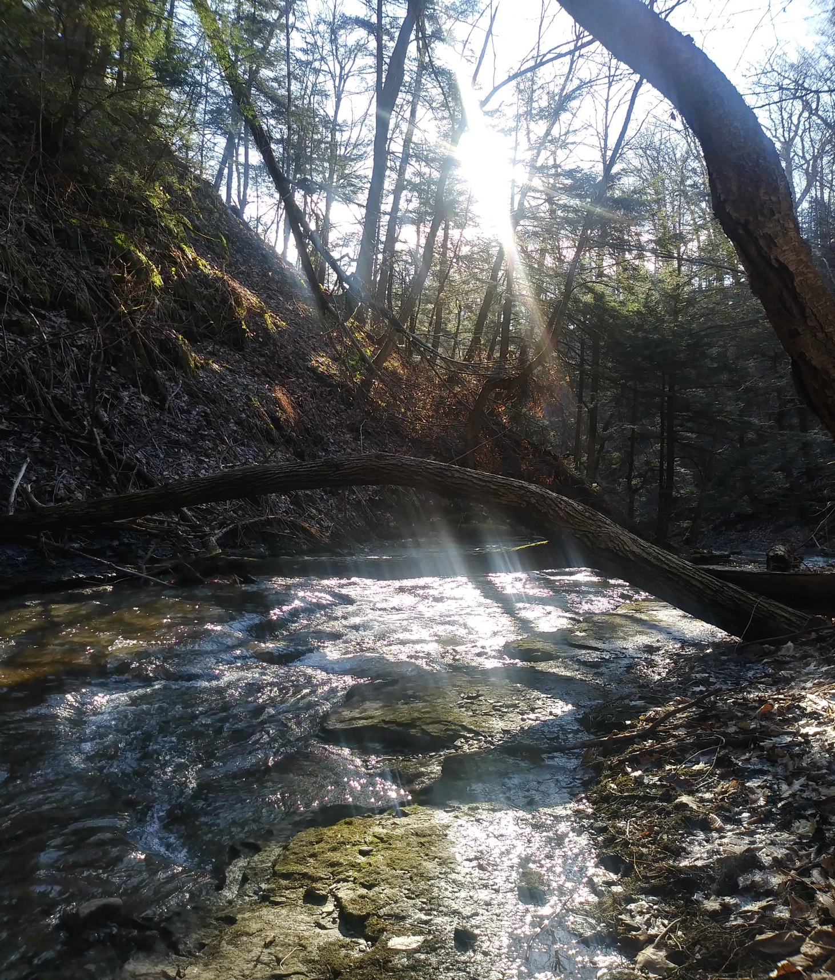
Water is one of the most important substances on the earth. All plants and animals must have water to survive. It is also one of the healthiest things you can drink.
You should always protect the earth’s water…keep it clean.

Slide 15
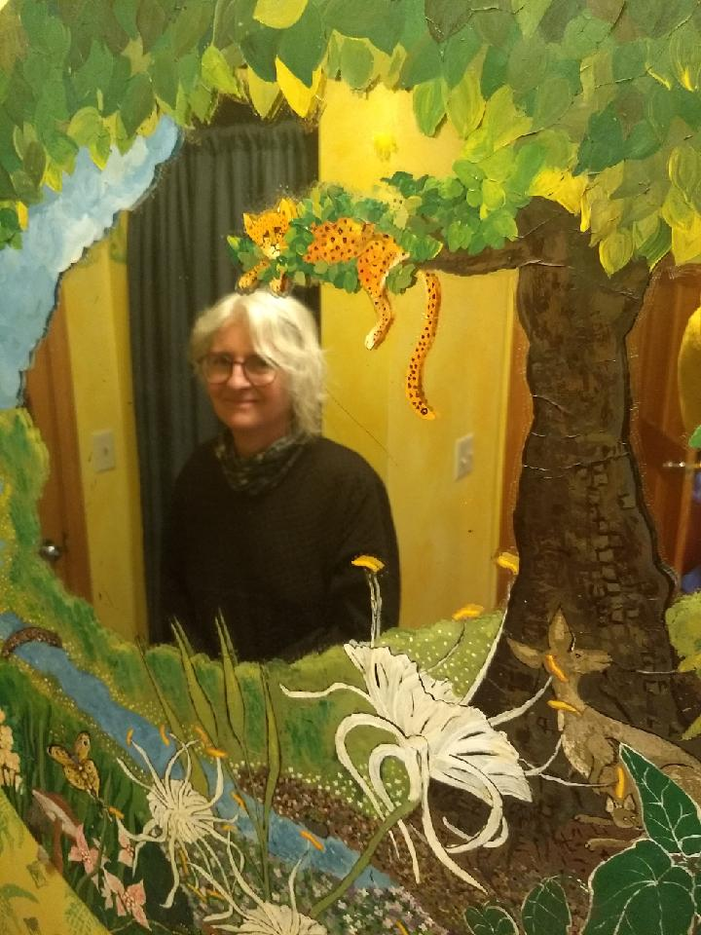
Thanks for watching!
Don’t forget to get outside for some fresh air

