Slide 1
Miss Gloria’s Science
April’s First WEEK

Slide 2
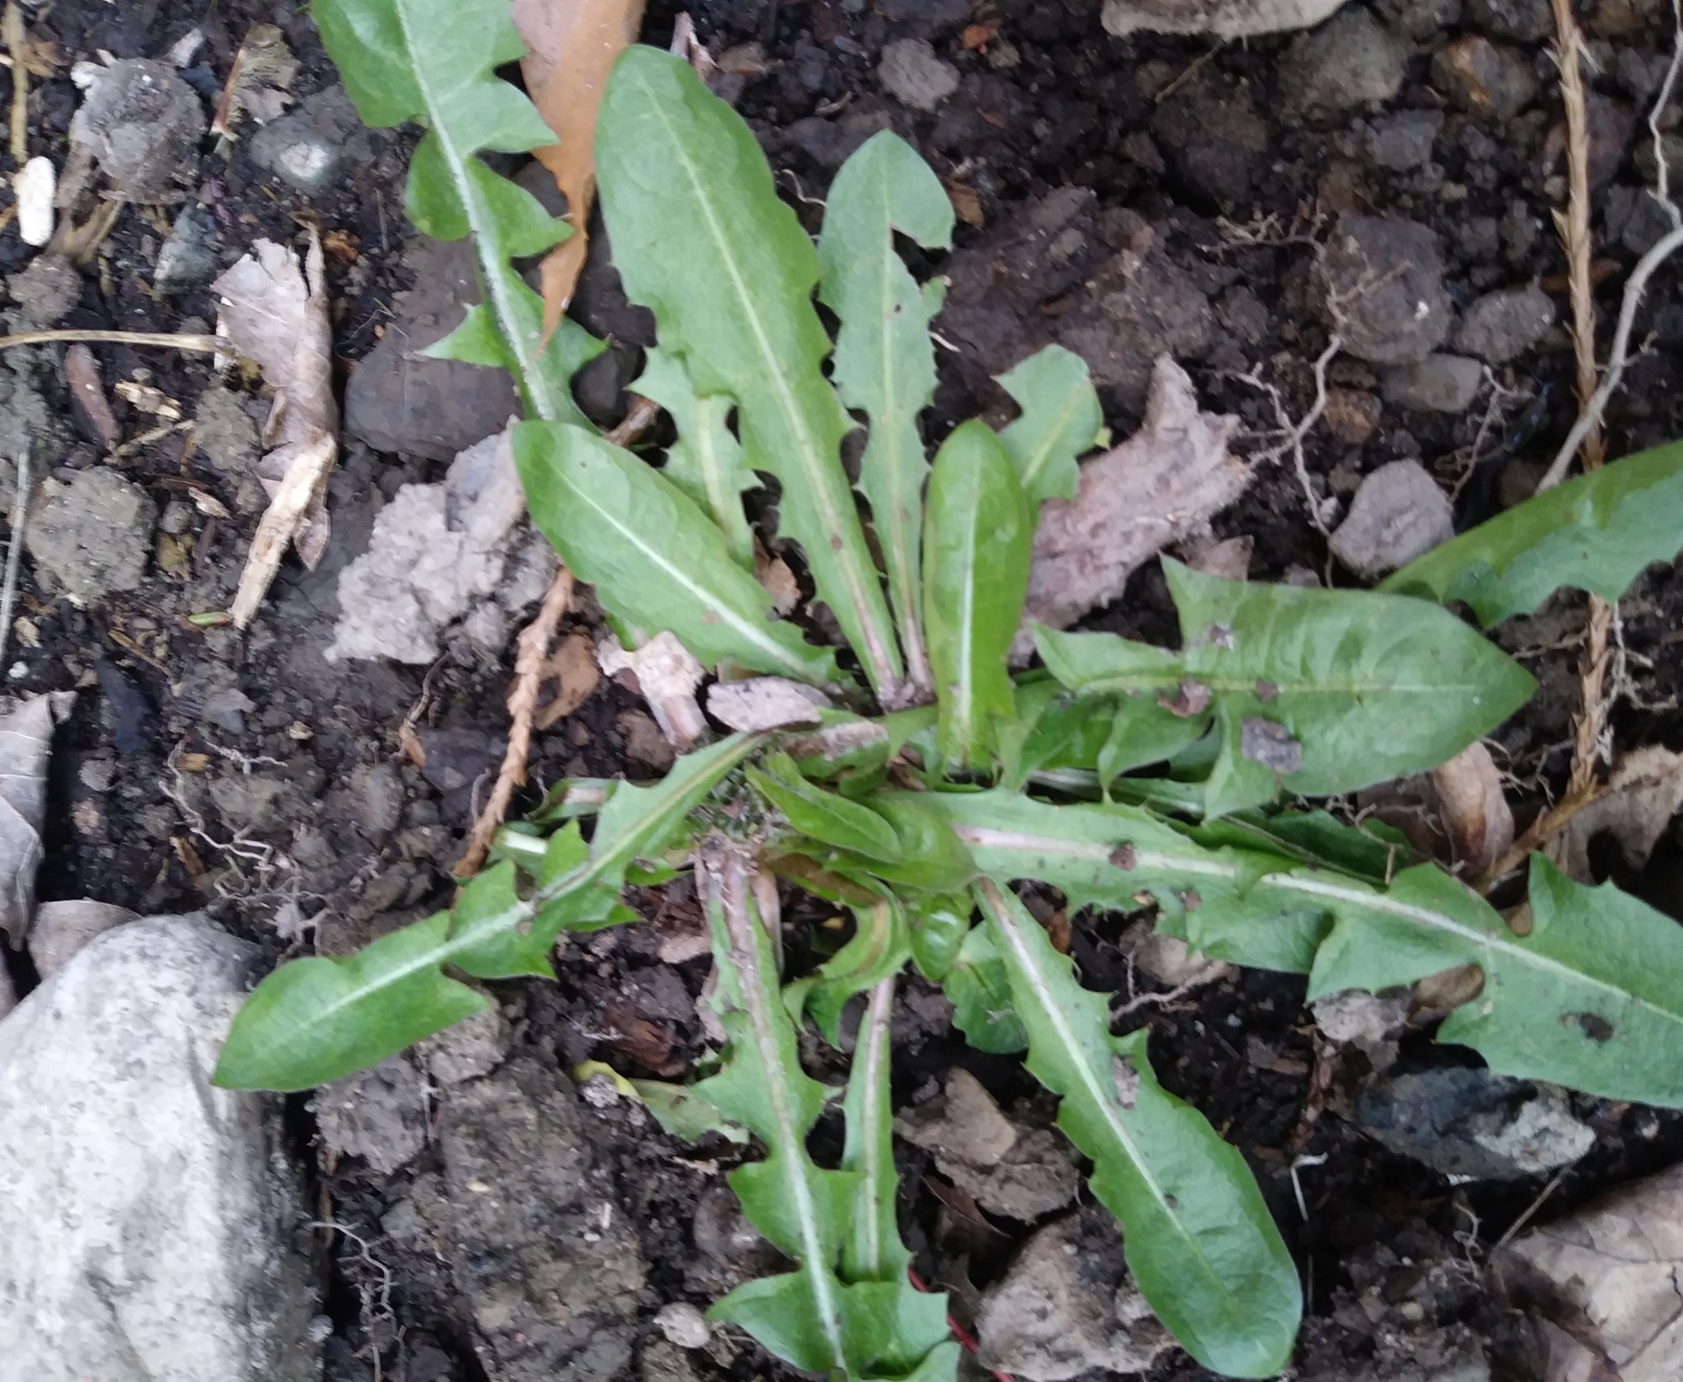
What do you think this is.
Sunflower
Daffodil
Alfalfa
Dandelion

Slide 3
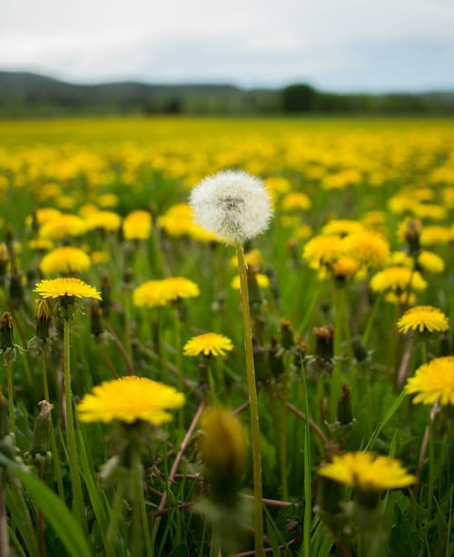
It was a dandelion. Soon it will have a yellow flower.
Do you think you can eat dandelions?

Slide 4
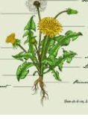
You can!
Guess which part -
Flowers
Roots
Leaves

Slide 5
This is Big Joe, he is Amberations’ donkey
All
of
them
The flowers are used to make medicines, syrup, flavored oil, vinegar and tea
The roots are roasted to make a coffee like drink
The green leaves can be eaten in salads or cooked like spinach
Joe likes carrots and hugs.

Slide 6
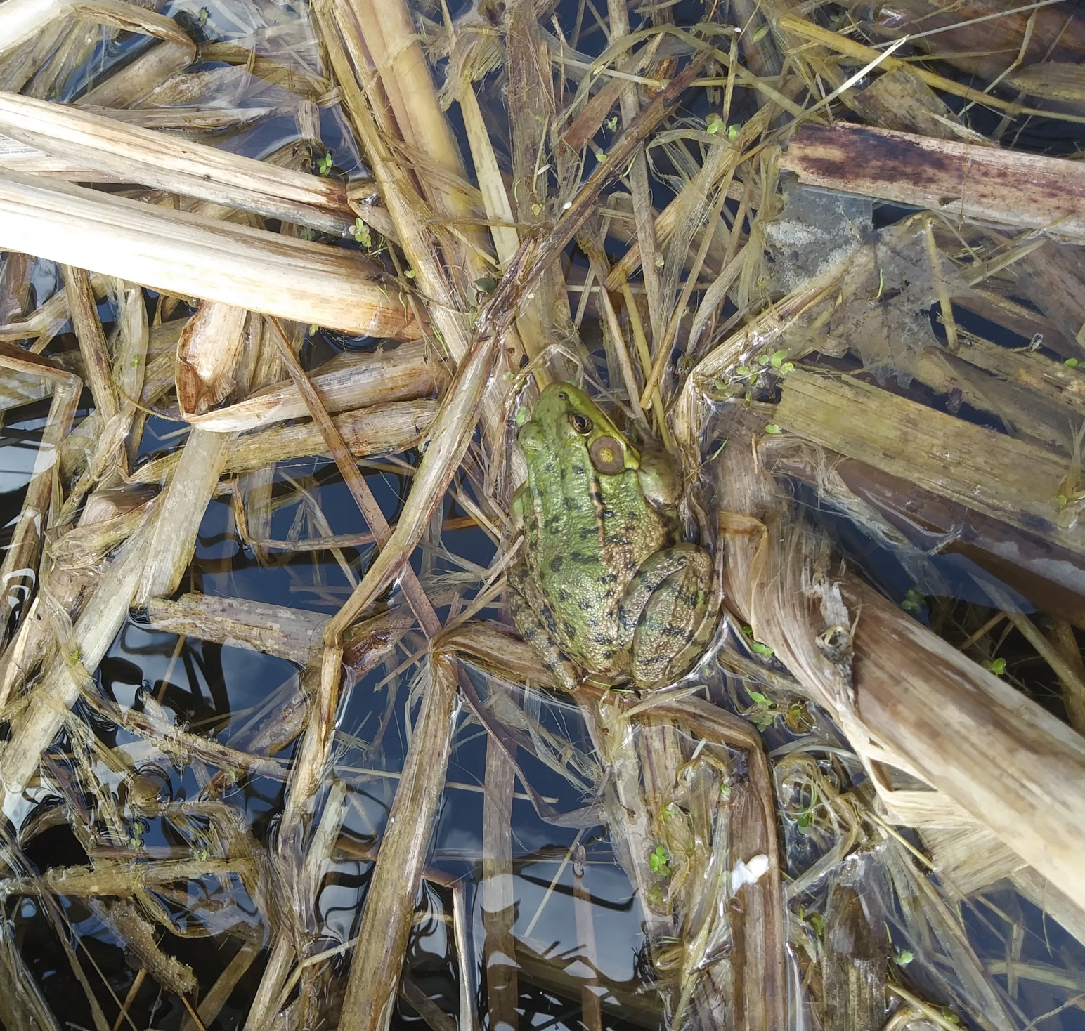
I saw this guy in our pond today. I am pretty sure you know what it is…
Salamander
Frog
Snake
Unicorn

Slide 7
Do you know where frogs spend the winter?
U
U
M
M
D
It was a frog
M
M
D
D
U
D
U
M
M
U
M
D
D
HINT
U
M
M
D
M
M

Slide 8
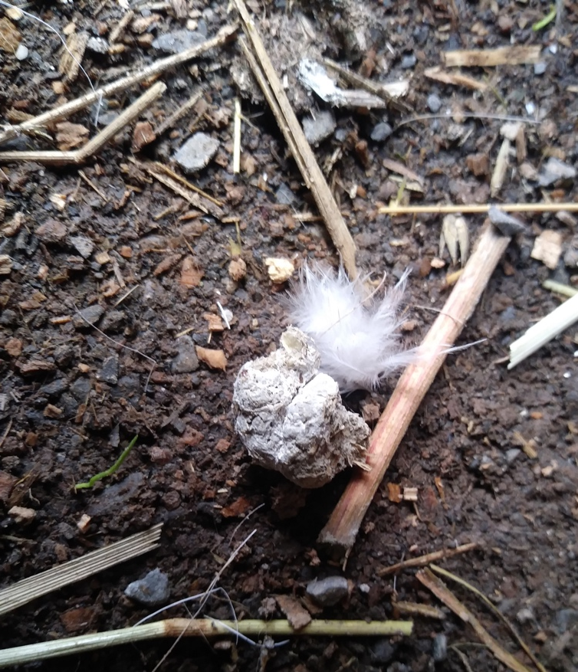
Frogs like to burrow into the MUD and hibernate in the winter.
In this picture is a little feather, some straw, dirt and poop. The poop is the size of a marble. Guess what it is from.
Now, totally unrelated…

Slide 9
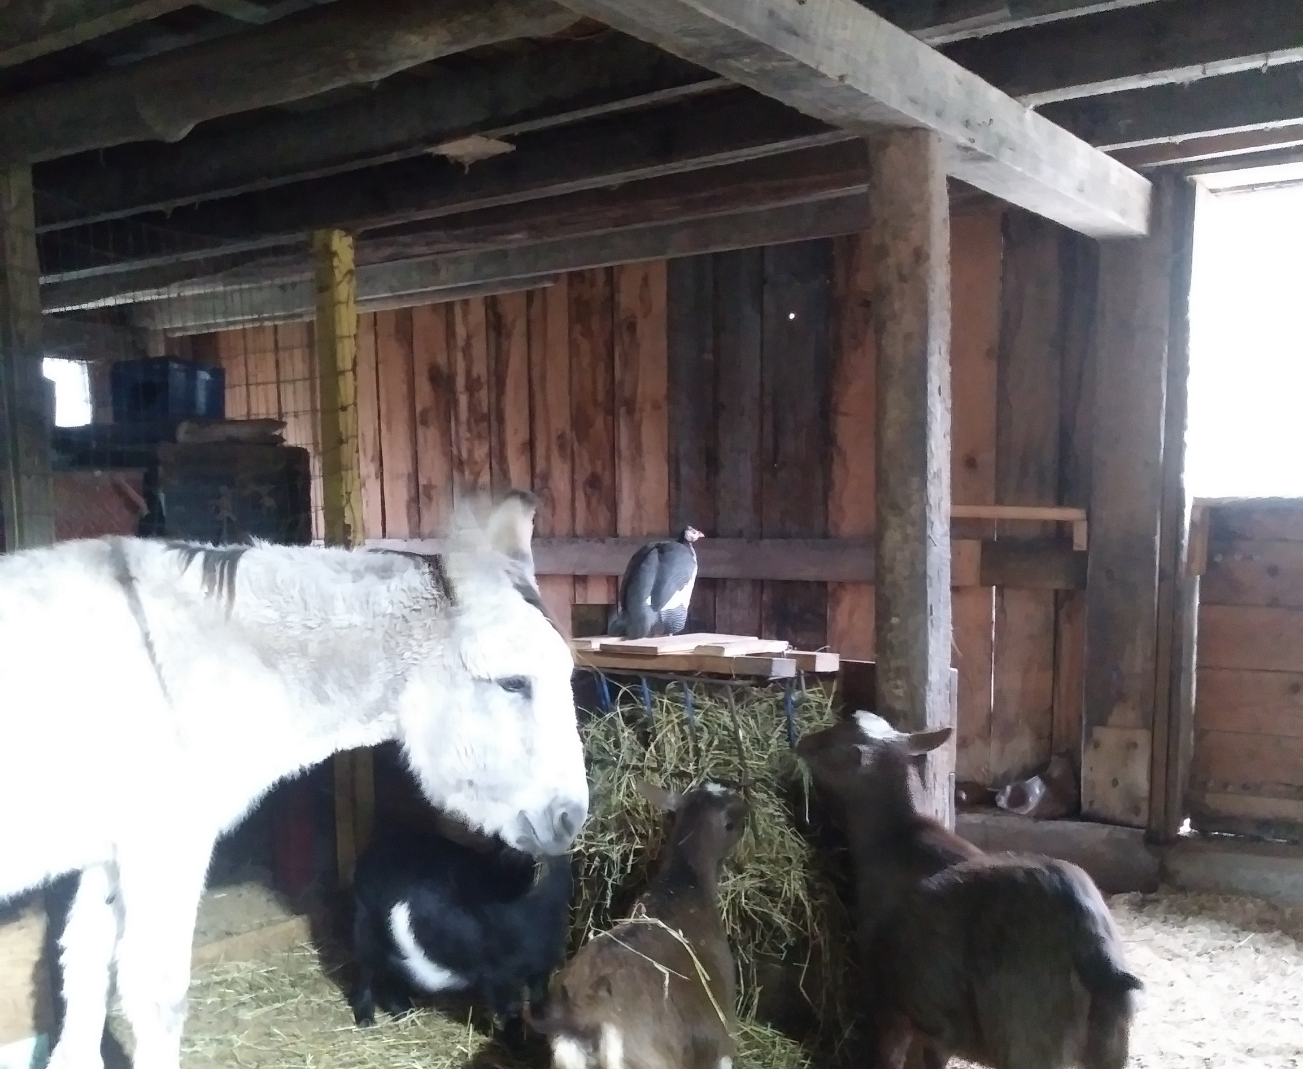
It is from one of these guys…
Goat
Donkey
Guinea Hen

Slide 10
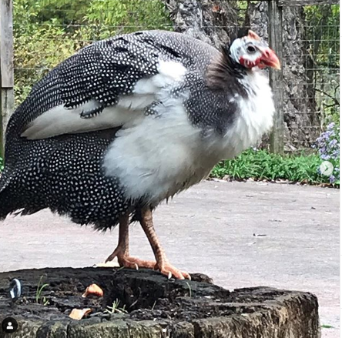
It was guinea hen poop.
Okay…a really interesting fact about bird poop. Birds only have one hole to pee and poo out of so all their waste comes out mixed together. When they lay eggs the egg comes out of that same hole but their Cloaca (the end of their digestive tract) turns inside out so the egg does not get yucky.
This was Survivor – Amberations guinea hen

Slide 11
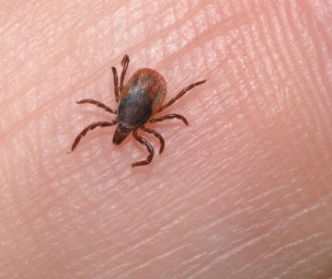
Guinea fowl are good to have around because they eat ticks
Ticks are little bugs that can make you sick
They can eat up to 4000 ticks a day
This tick is on a finger

Slide 12
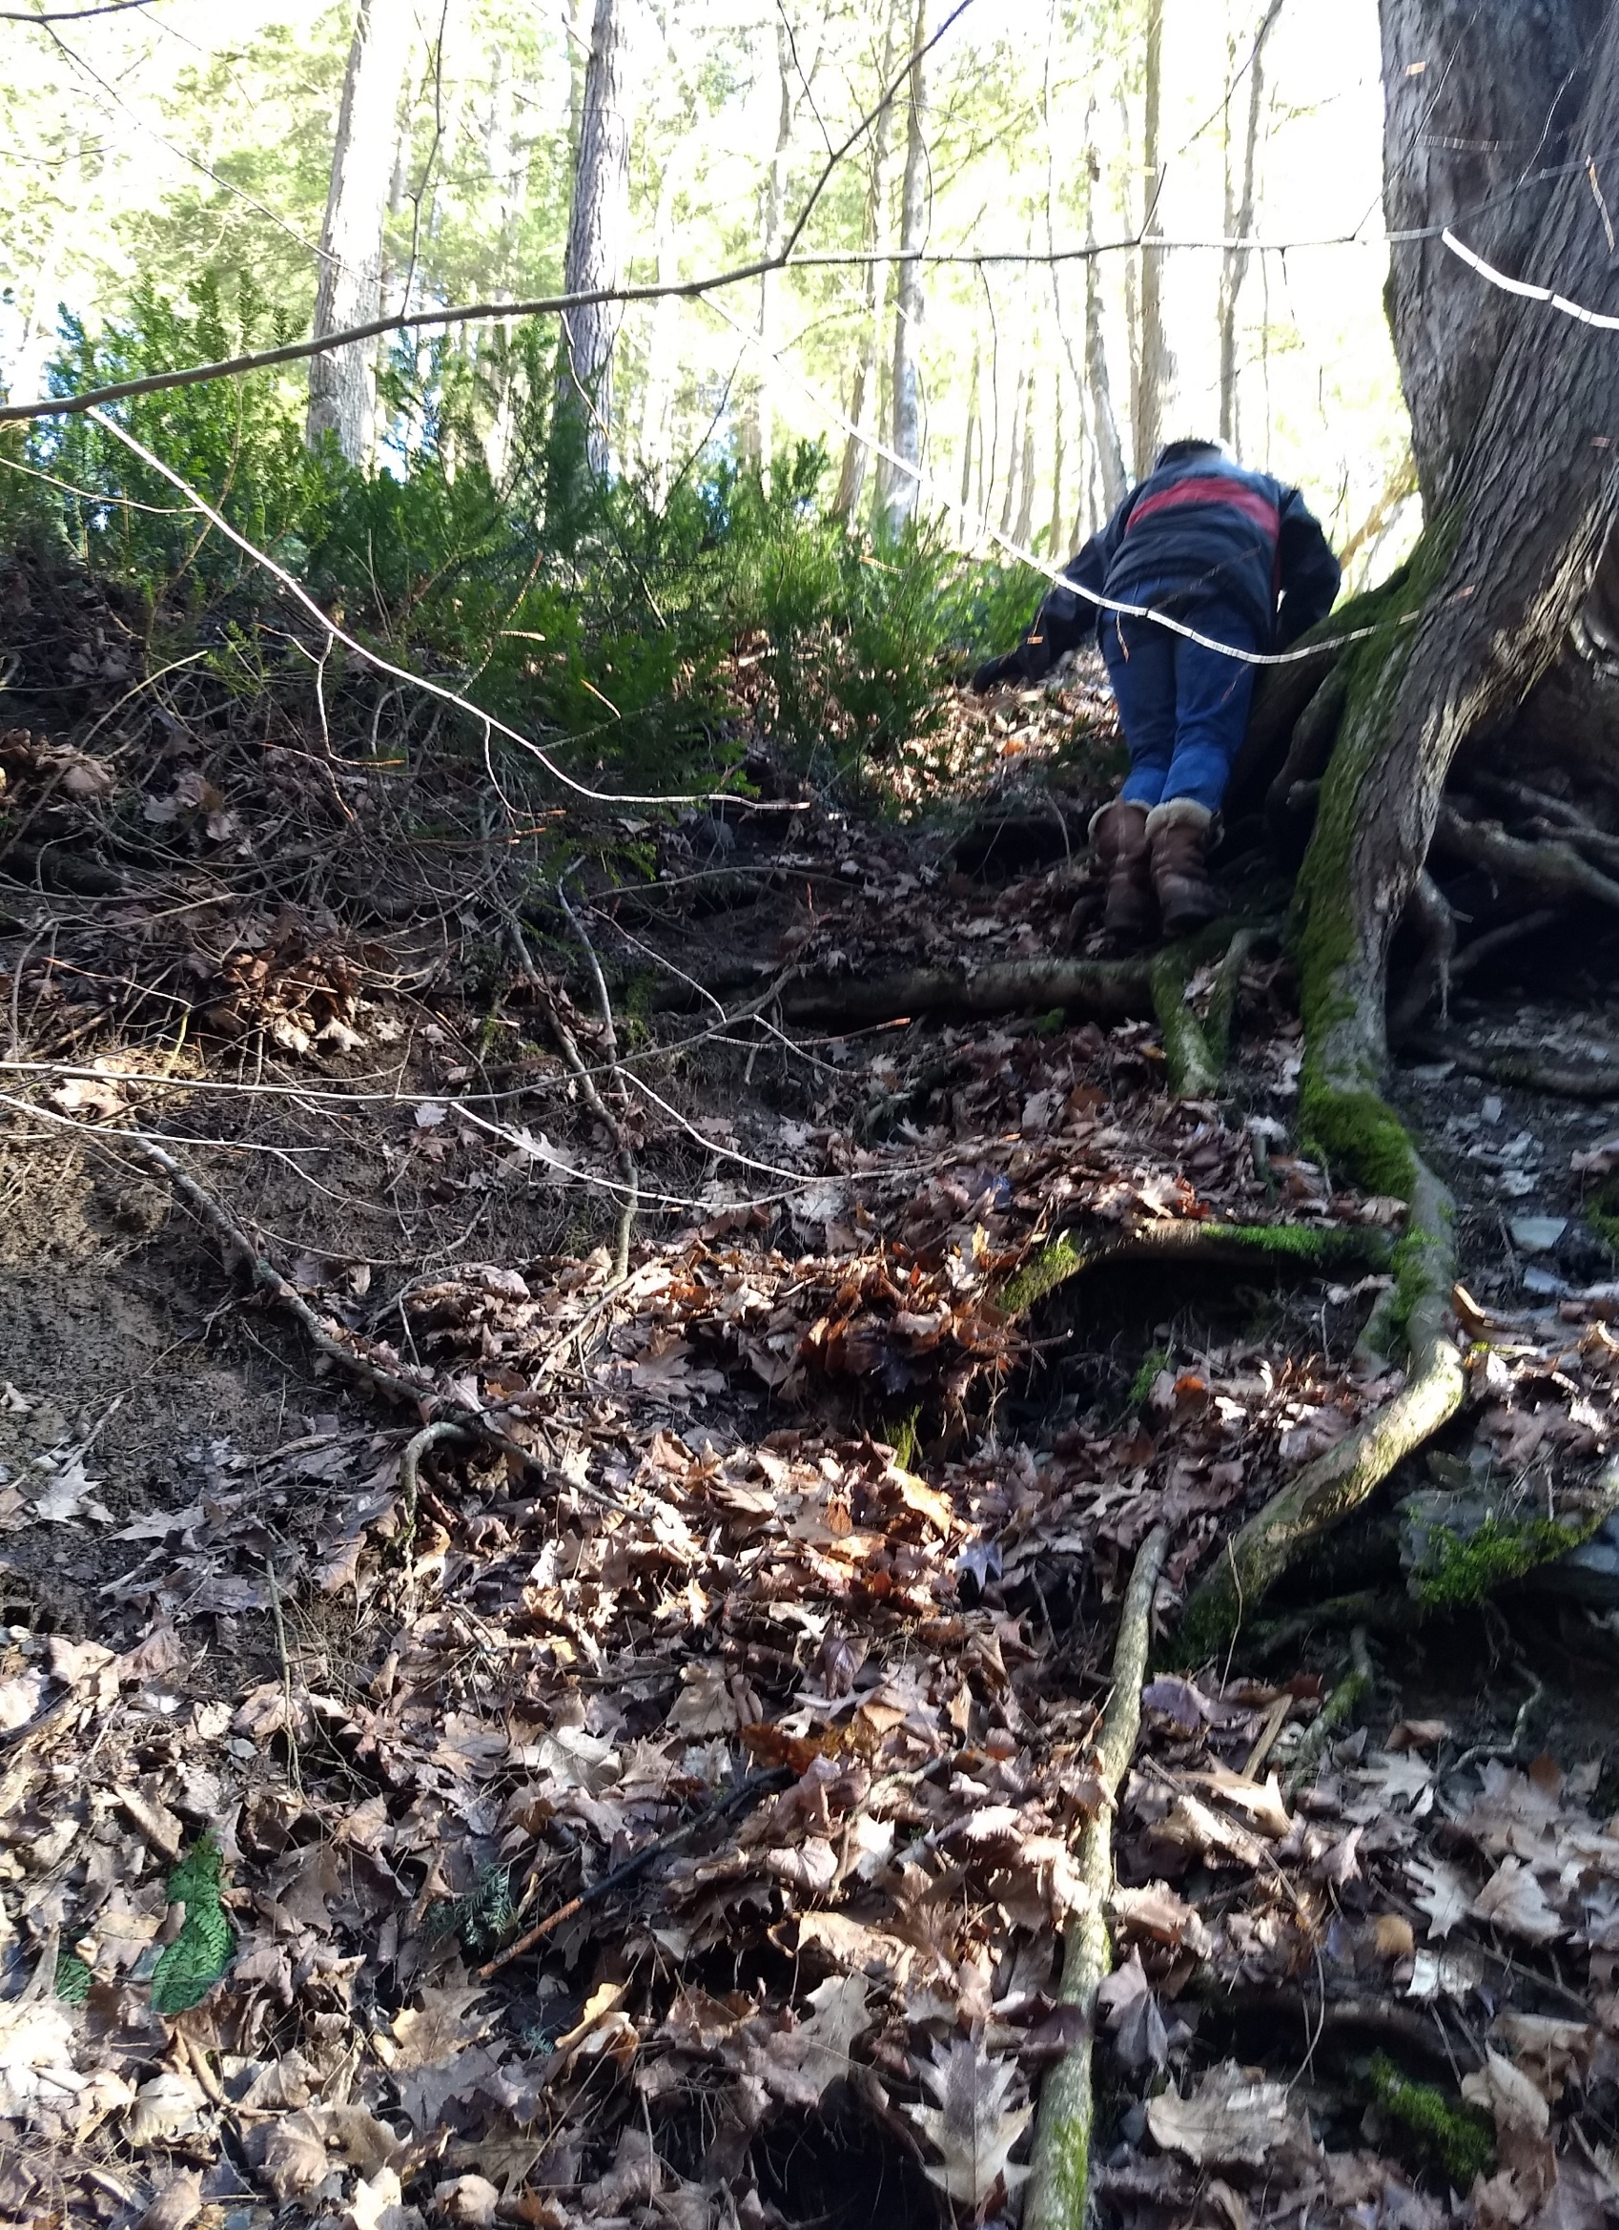
Ticks are found everywhere so it is smart to do a tick check anytime you are outdoors
Some are very small…the size of this dot
There were two ticks on her when she climbed up this hill!

Slide 13
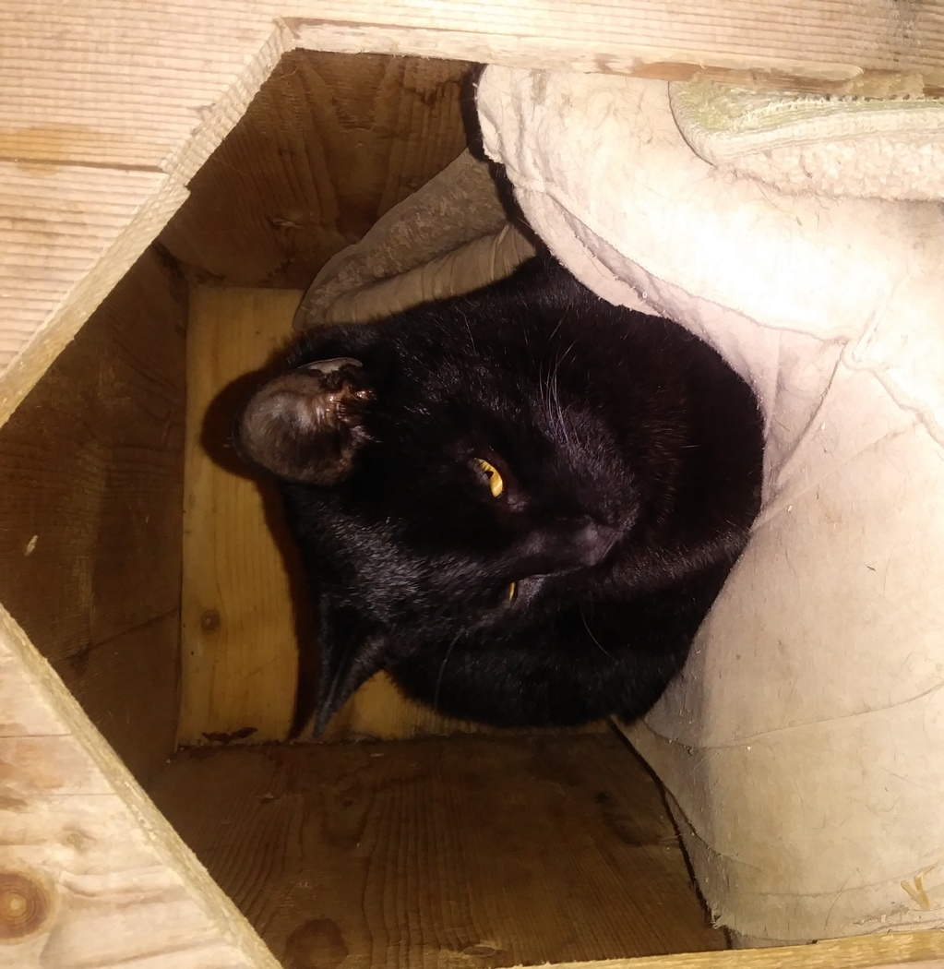
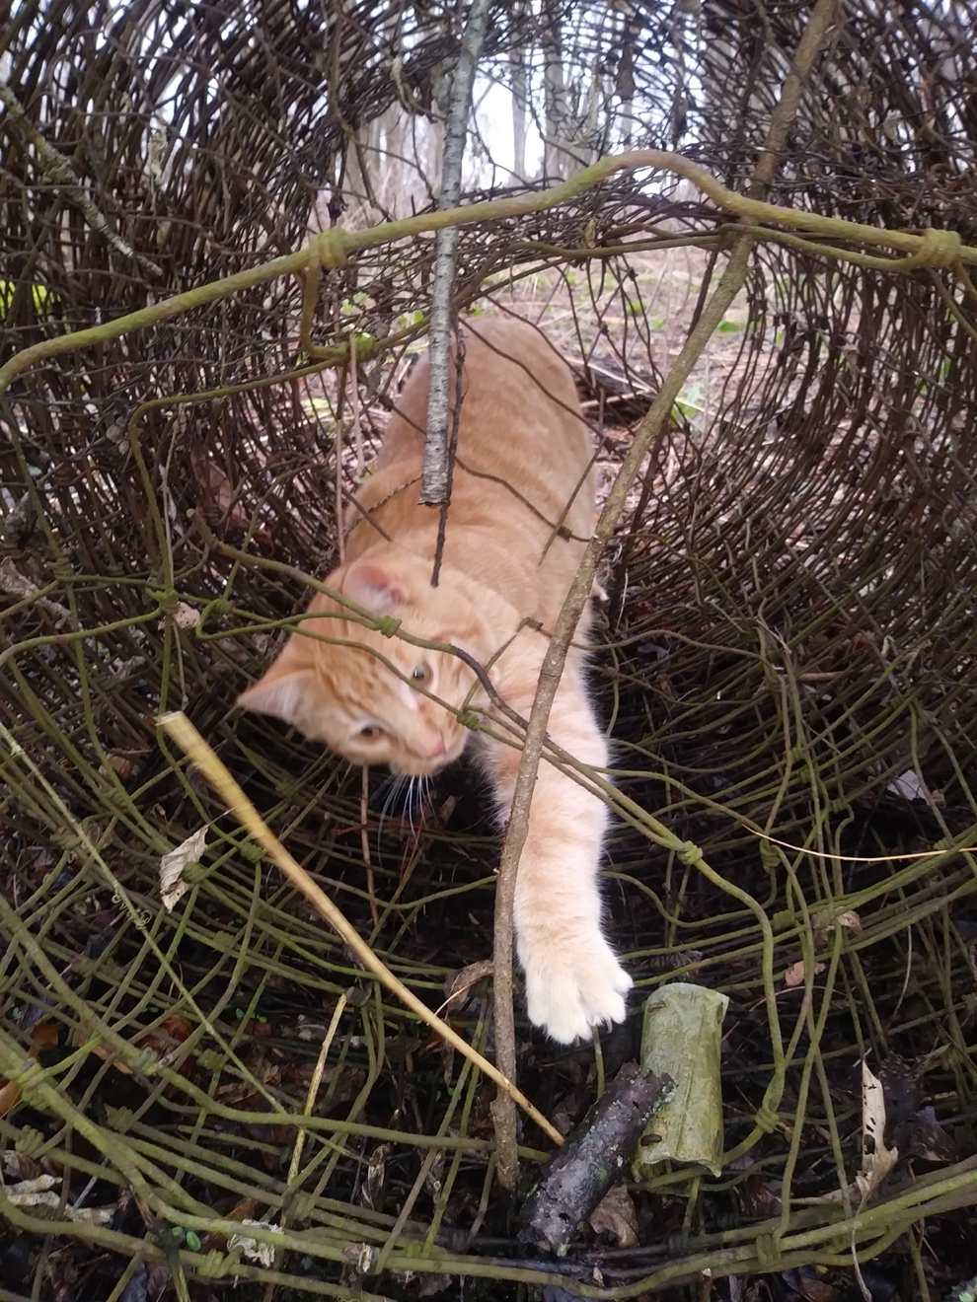
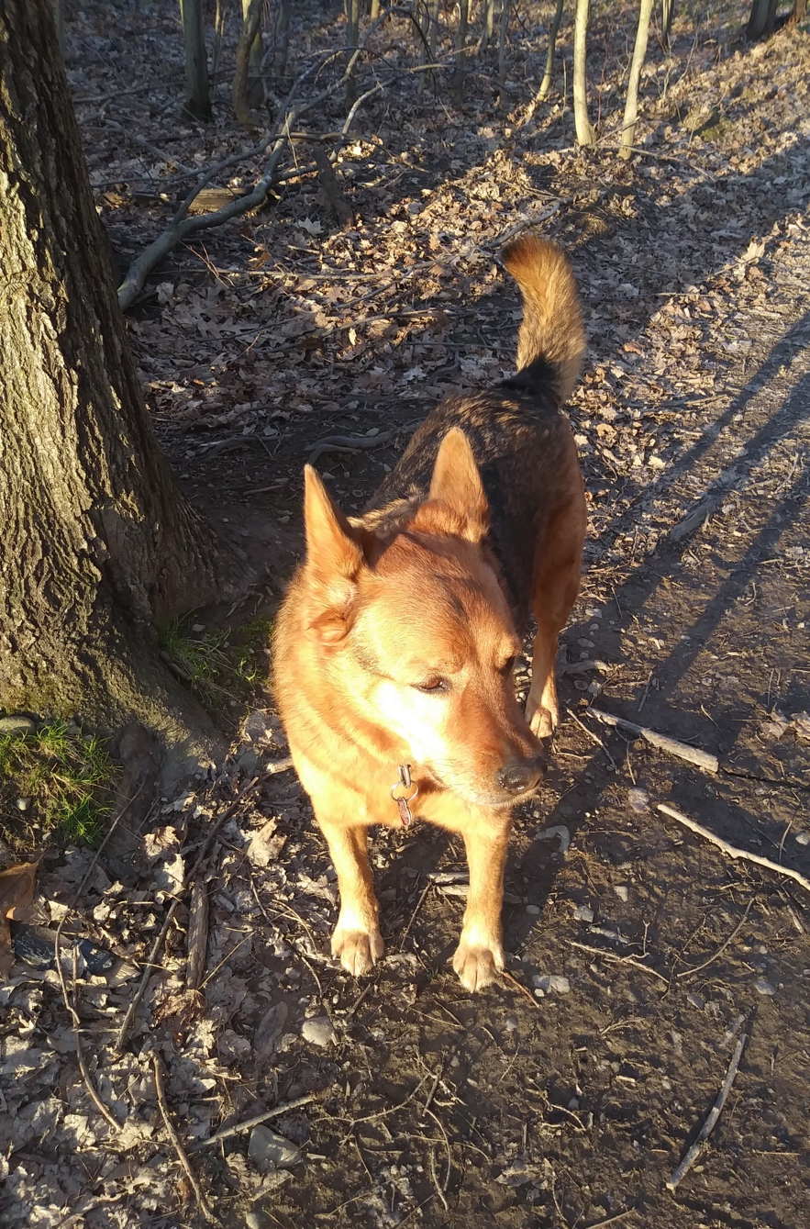
Dogs and cats get ticks too. There are special medicines or collars you can get to help keep the ticks away from your animals.
Midnight
It is a good idea if you are outside a lot to check for ticks every time you brush your teeth (hopefully that is every morning and every night).
Amber
As long as you are careful, you don’t need to worry.
Nero

Slide 14
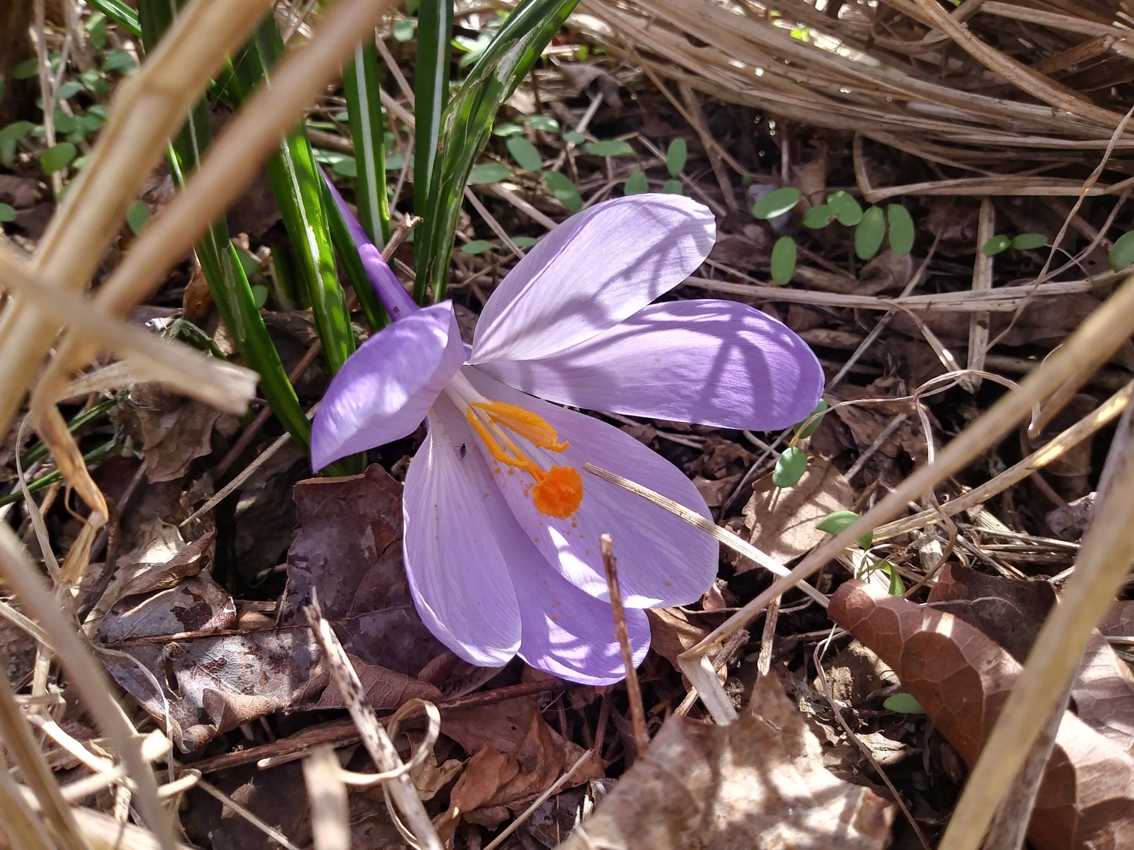
Getting outdoors is very good for you…
Guess why

Slide 15
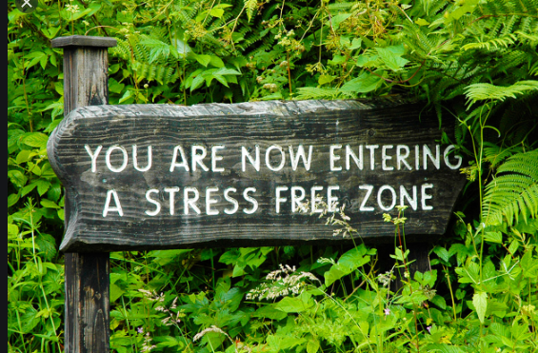
Being in nature reduces stress Being in nature improves your memory Being in nature can help you heal faster Being in nature brightens your mood

Slide 16
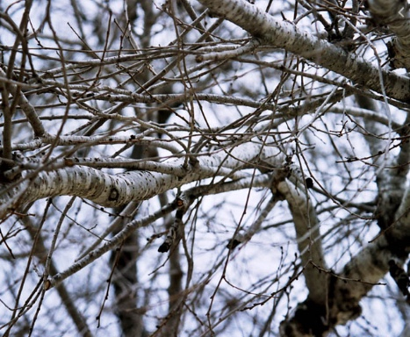
Get outside. Take a deep breath and let it out slowly. Use your senses…
What do you see?
What do you hear?
What do you smell?
What do you feel?
Lick your lips, do you taste anything?

