Slide 1
Miss Gloria’s Science
Mid-April

Slide 2
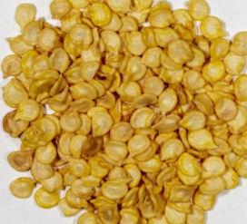
What do you think these are?
Maggots
Eggs
Seeds
Kernels

Slide 3
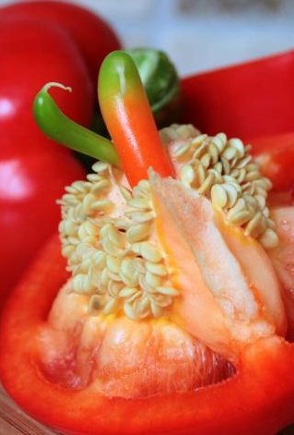
They were seeds from a bell pepper
Bell peppers are really fruits, though many people call them vegetables
They are full of vitamin C. They have more than 3 times as much vitamin C as oranges as well as a lot of other important vitamins
Bell peppers are the only pepper that does not contain capsaicin, the spicy chemical that makes the pepper in pepper shakers seem hot

Slide 4
How about this-
Fruit
Vegetable
Flower
Nut

Slide 5
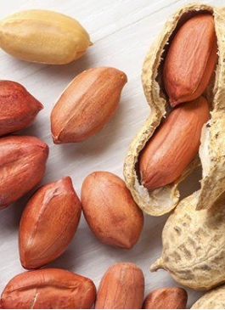
It was a peanut, but peanuts are not nuts
They are legumes, which is a kind of vegetable
The part we eat grows underground, nuts grow on trees

Slide 6
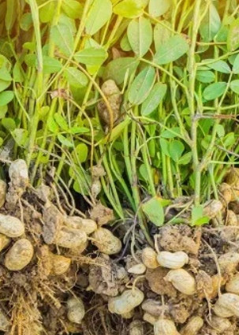
Interesting fact: There are over 500 peanuts in each jar of peanut butter.
This is what the peanut plant looks like

Slide 7
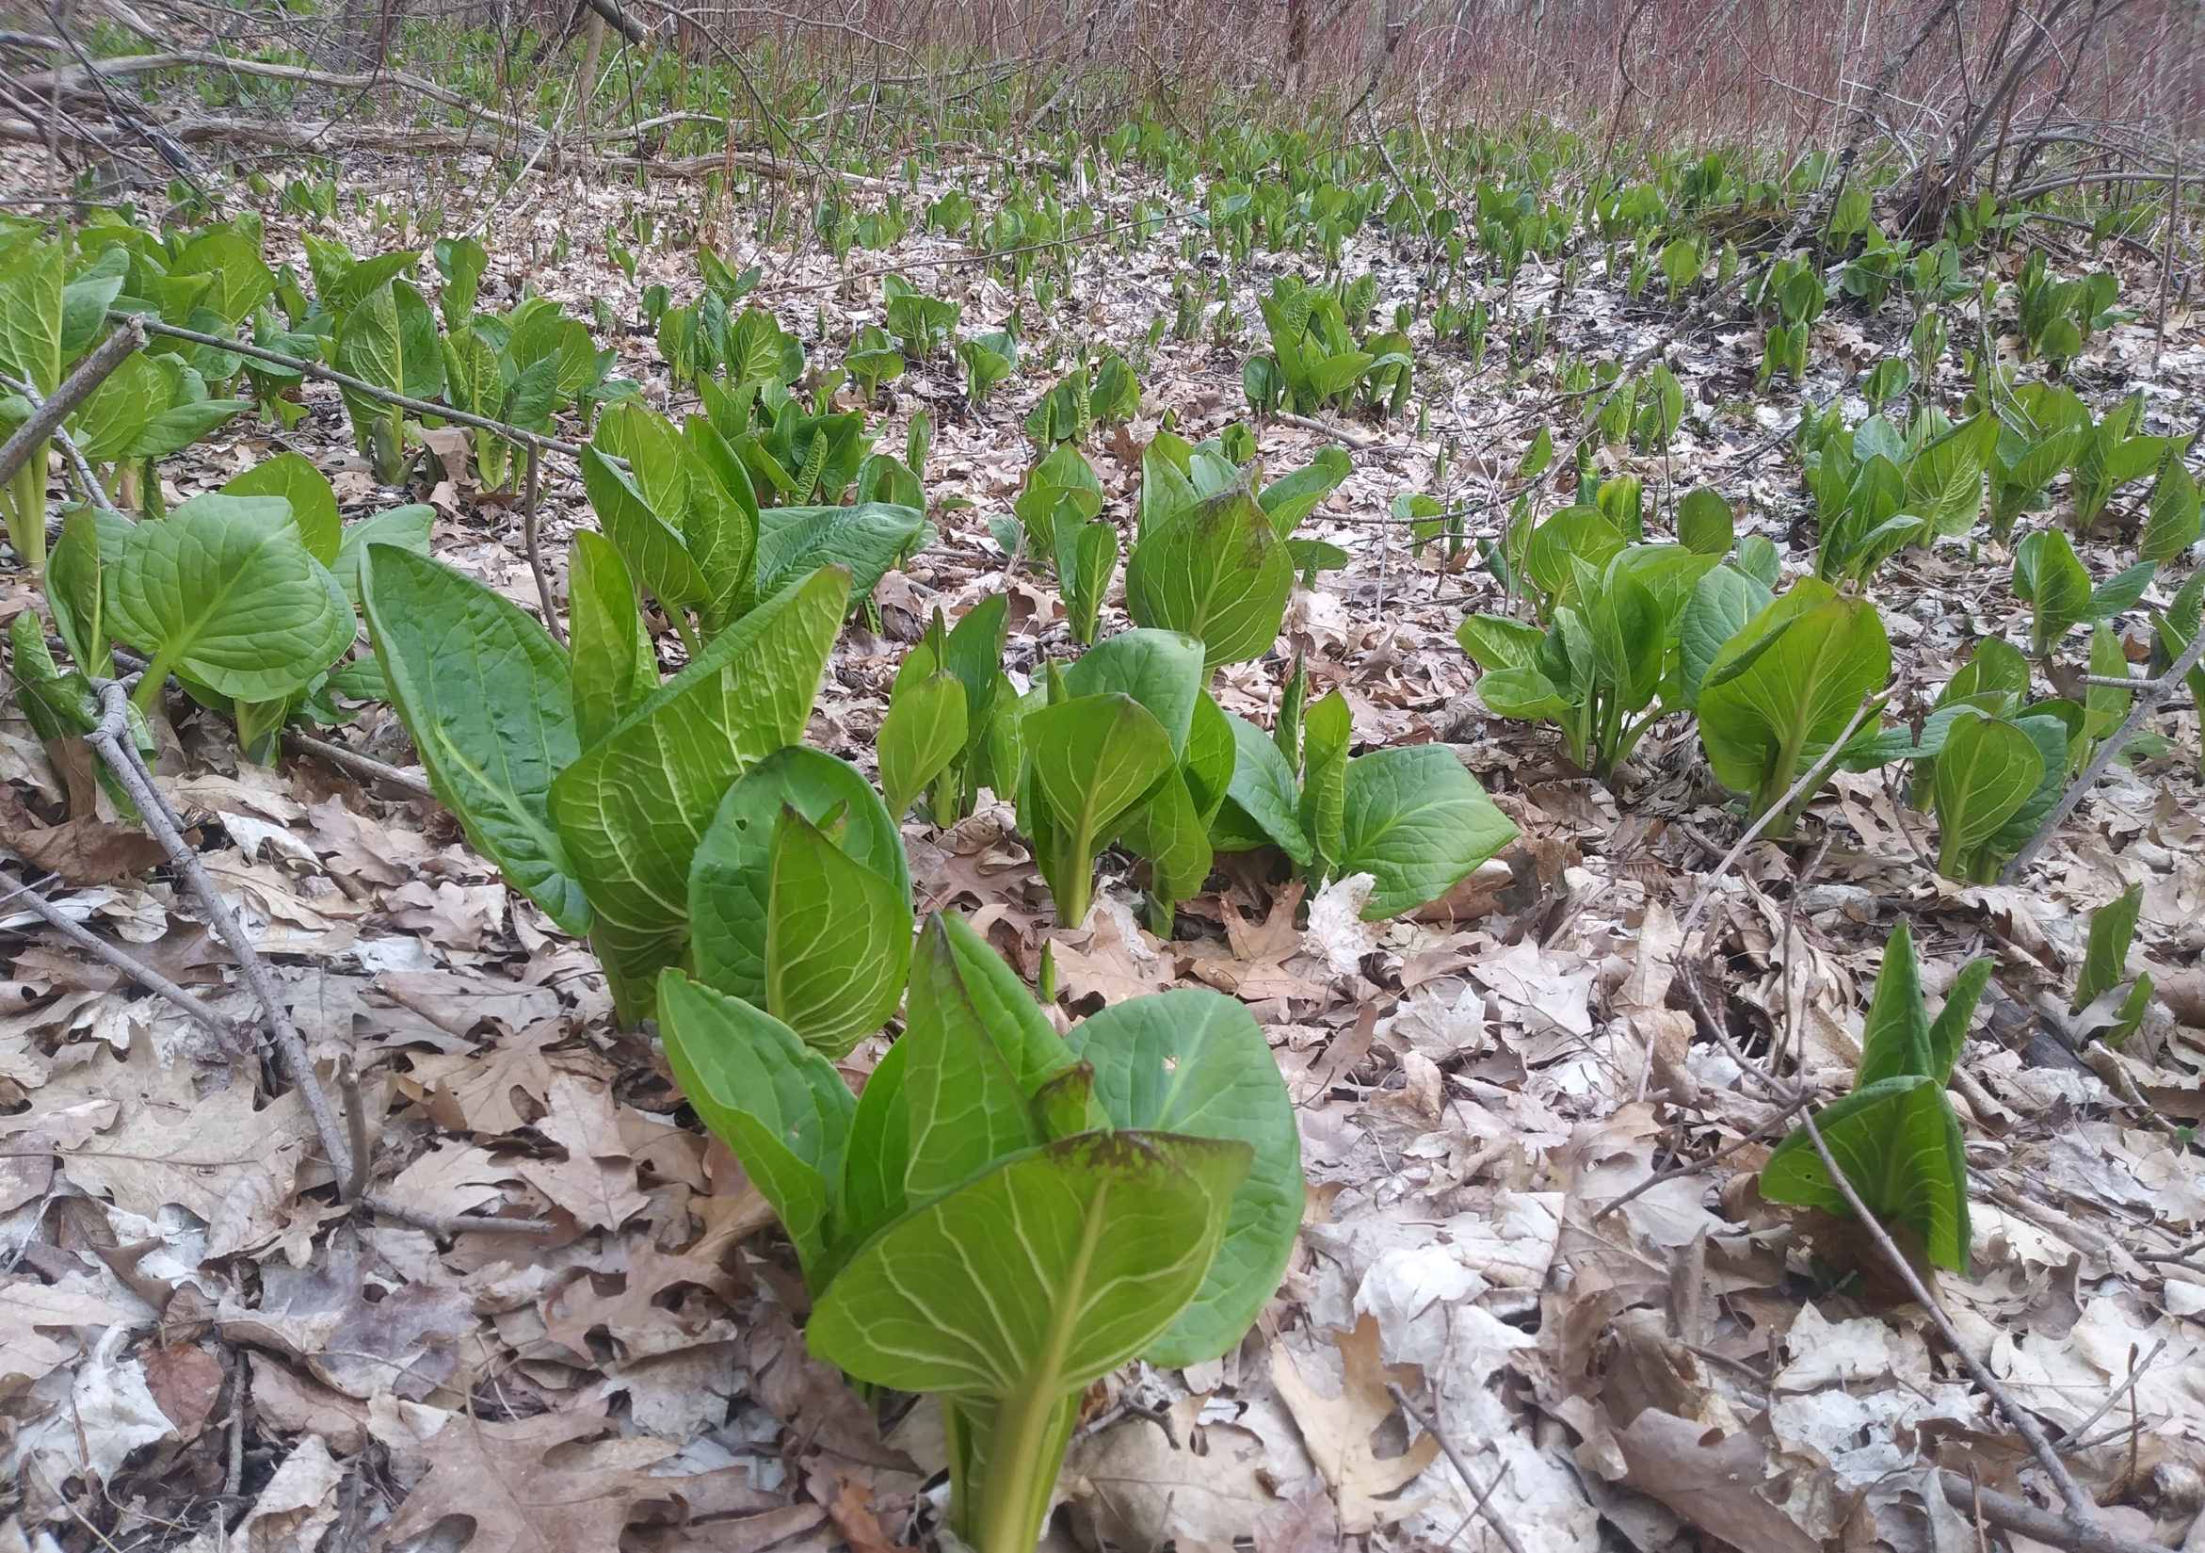
Remember the skunk cabbage plants, they have been busy growing…
One reason the Skunk Cabbage starts growing so early is because it is a Thermogenic plant
That means it actually produces heat
Thermogenic plants are rare

Slide 8
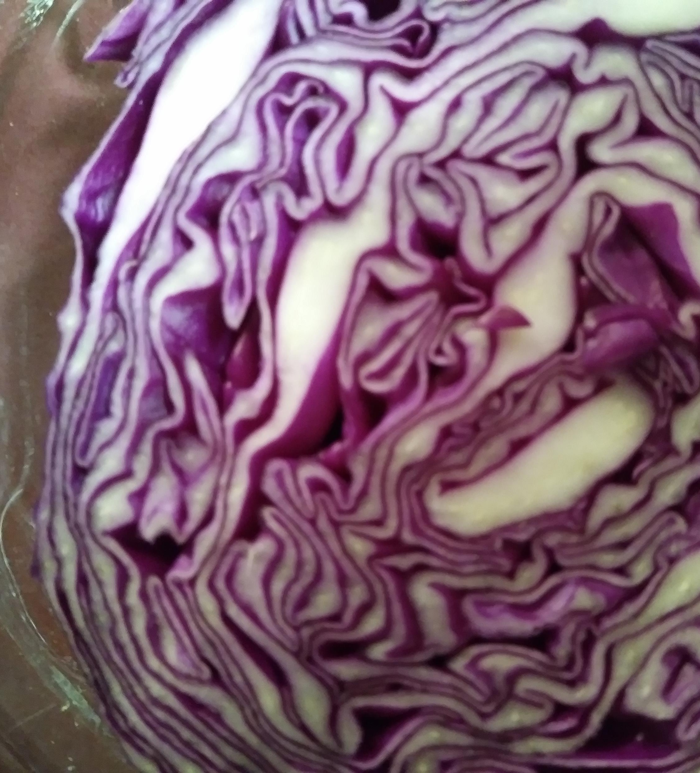
Guess what this is…
A picture of Mars
Lavender
Red Cabbage
Squirrel poop

Slide 9
Squirrel poop?
No, it was red cabbage.
IT WAS RED CABBAGE
Cabbage is super good for you and can be eaten raw or cooked
The flavonoids in cabbage help fight cancer, heart disease, asthma and stroke and helps to protect your brain
Cabbage is used to make egg rolls, cole slaw, stir fry, sauerkraut and lots of other yummy foods
Red cabbage plants grow more purple in neutral soil and redder in acidic soil
Flavonoids are what gives it the purple color
When you cook red cabbage it turns blue

Slide 10
These are three kinds of the same vegetable. Do you know what they are?
Parsnips
Carrots
Rutabagas
Potatoes

Slide 11
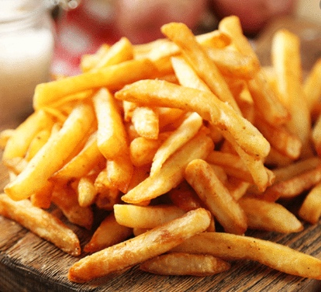
They were potatoes – red, sweet and yellow.
If you like French fries, you like potatoes

Slide 12
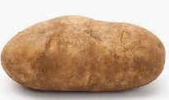
Sweet potatoes really come from a different family than regular potatoes
Sweet potatoes are from the
Morning Glory family
Regular potatoes are from the
Nightshade family
The potato is about 80% water
Both types of potatoes are rich in fiber, carbohydrates, and vitamins B6 and C.

Slide 13
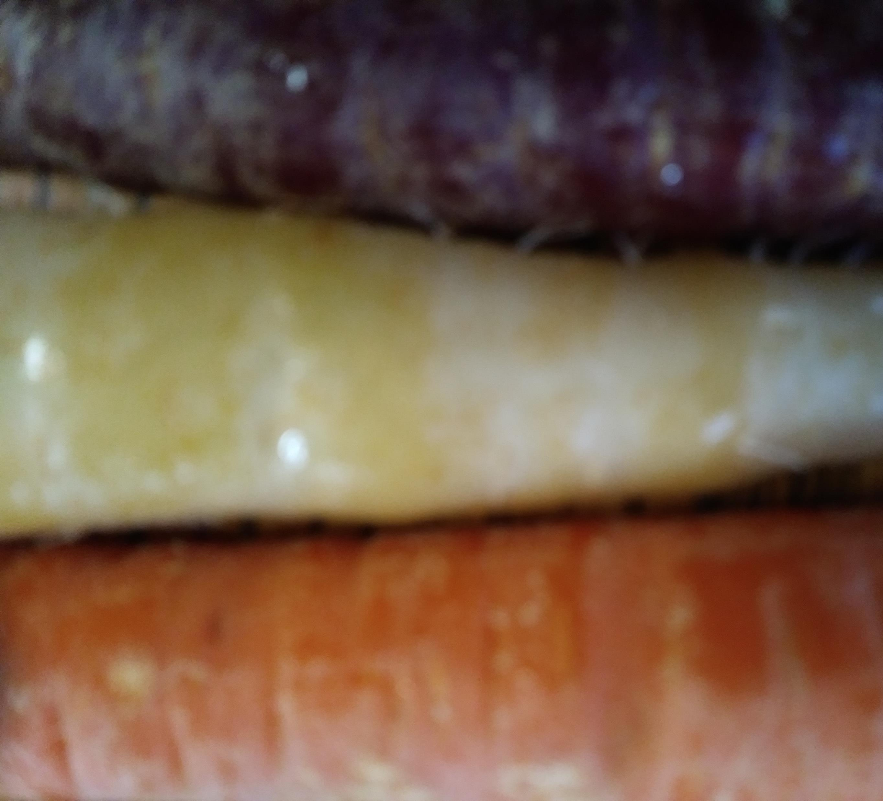
Comes in purple, black, red, white, yellow and orange
First used as medicine, not food
Can be traced back 5000 years through historical documents, no one knows where they originated
Mel Blanc, the voice of Bugs Bunny, did not like these
They are an excellent source of Vitamin A, just one of these will give you 200% of your daily requirement
FACTS FIRST THIS TIME

Slide 14
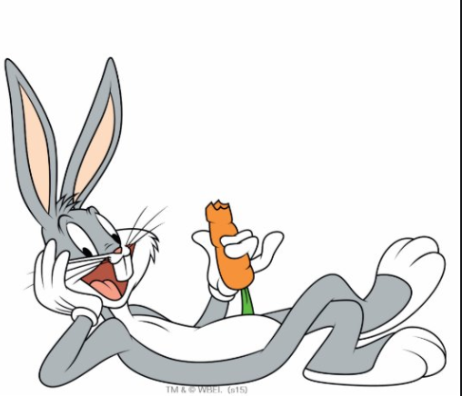
If you guessed carrot you were right.

Slide 15
I am sure you know
that eating healthy food is
Important
It doesn’t just keep you
healthy, it actually makes
you feel better
So…along with getting
outdoors, try to eat some
fruits and vegetables

