Slide 1
Miss Gloria’s Science
Last week of April

Slide 2
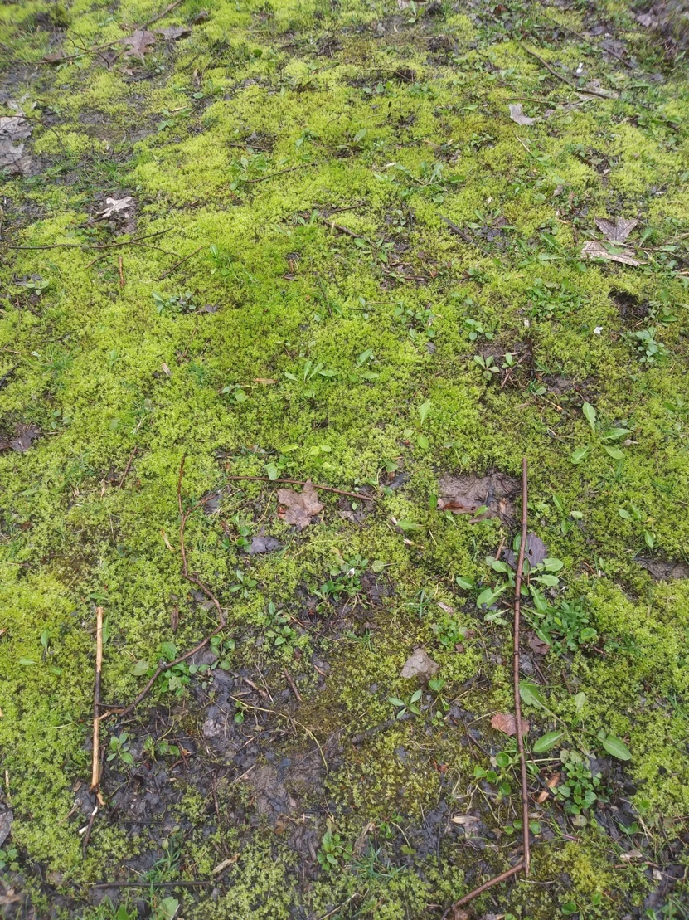
When I look at my yard I see a lot of moss
Do you know what moss is?
Fungus
Animal
Plant
Poop

Slide 3
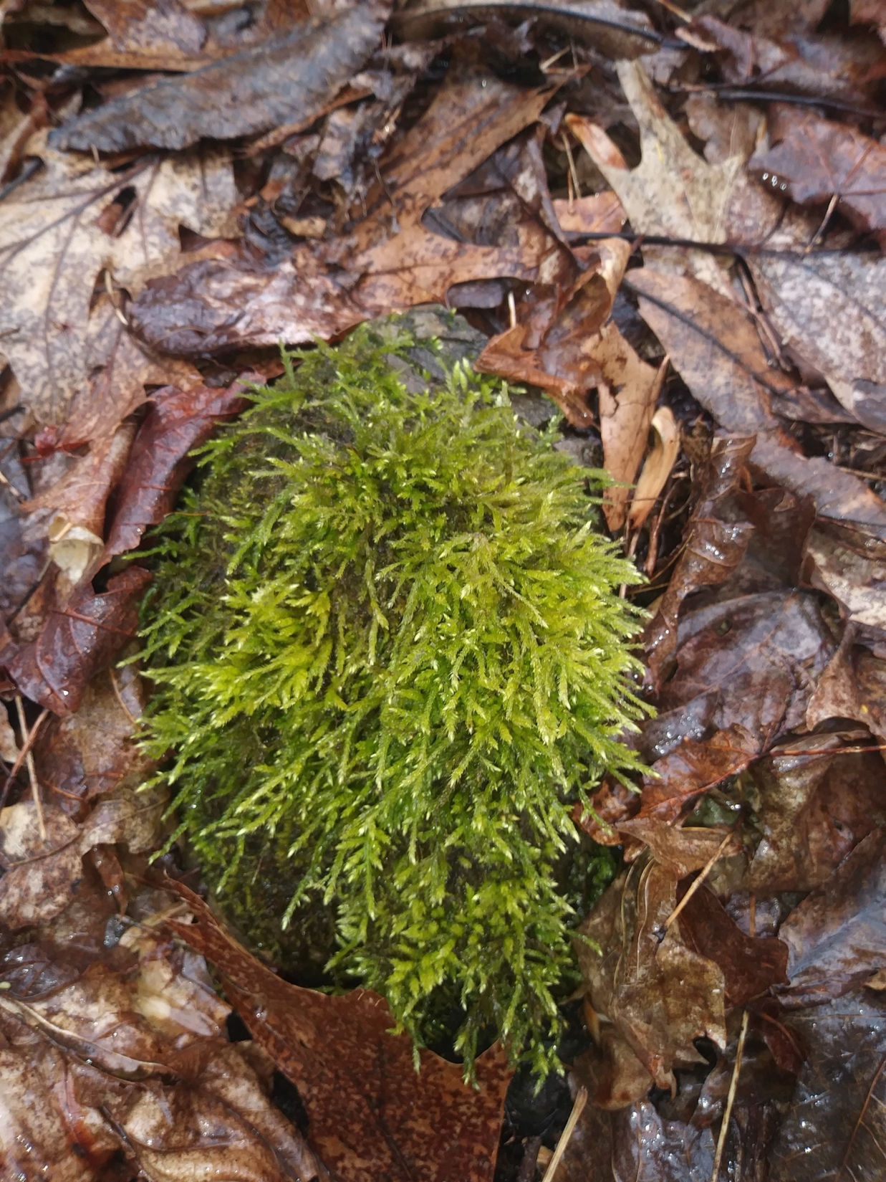
Moss was the first plant on Earth
Mosses live all over the world
Mosses don’t have roots, they are anchored by rhizoids, which look like tiny roots
Moss is a
kind of plant

Slide 4
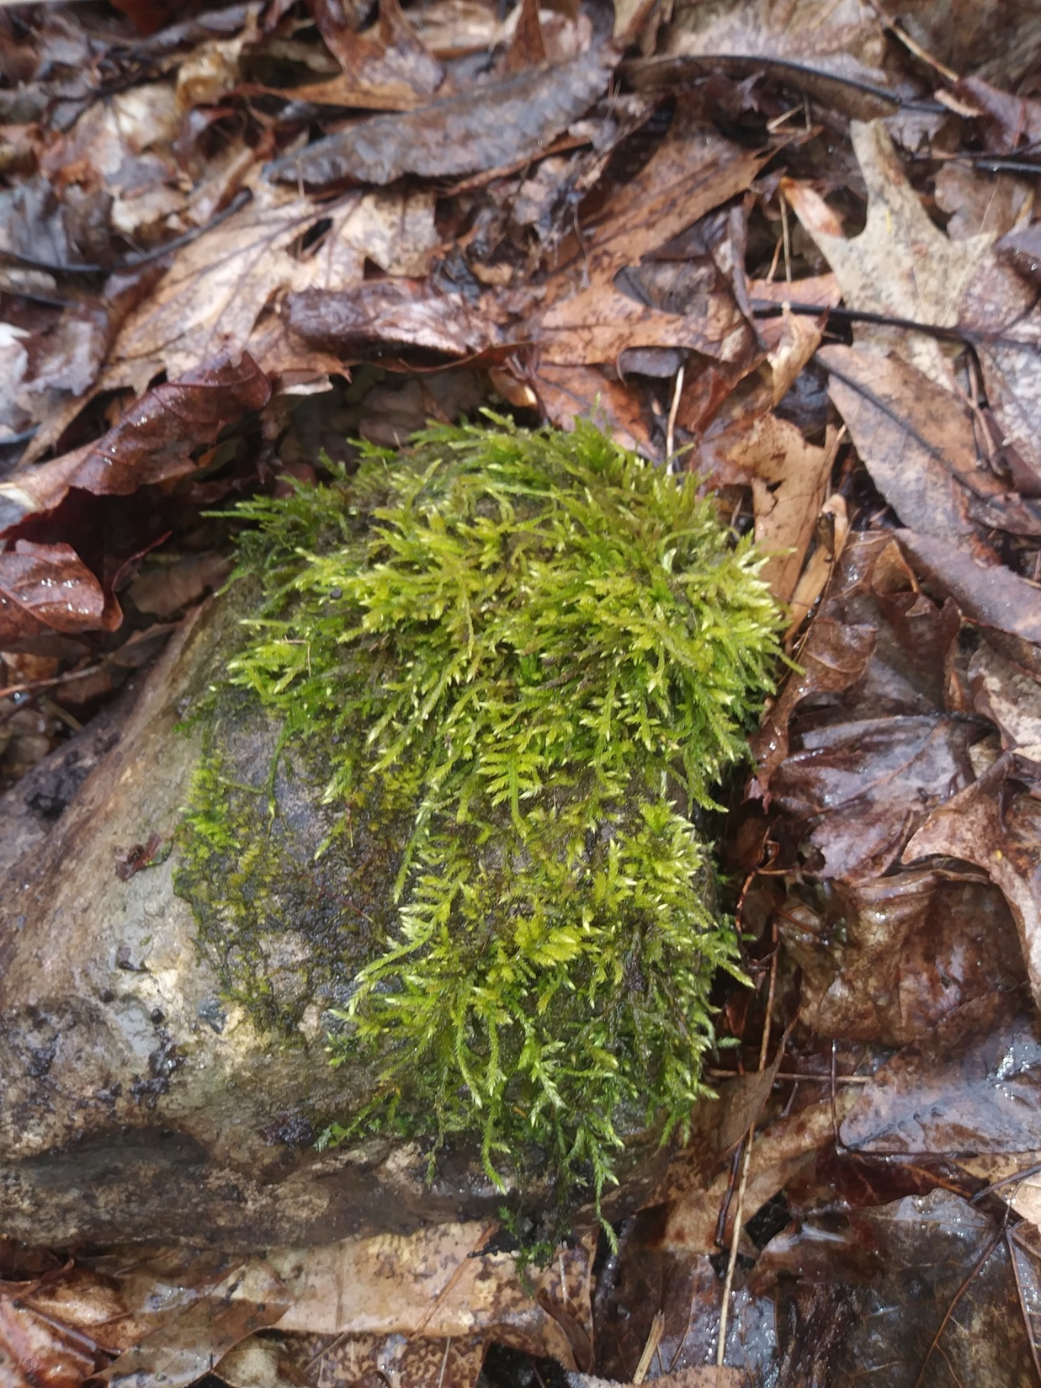
This is moss on a rock. I flipped the
rock over and guess what I found…
Worms
Bugs
Roots
Millipedes

Slide 5
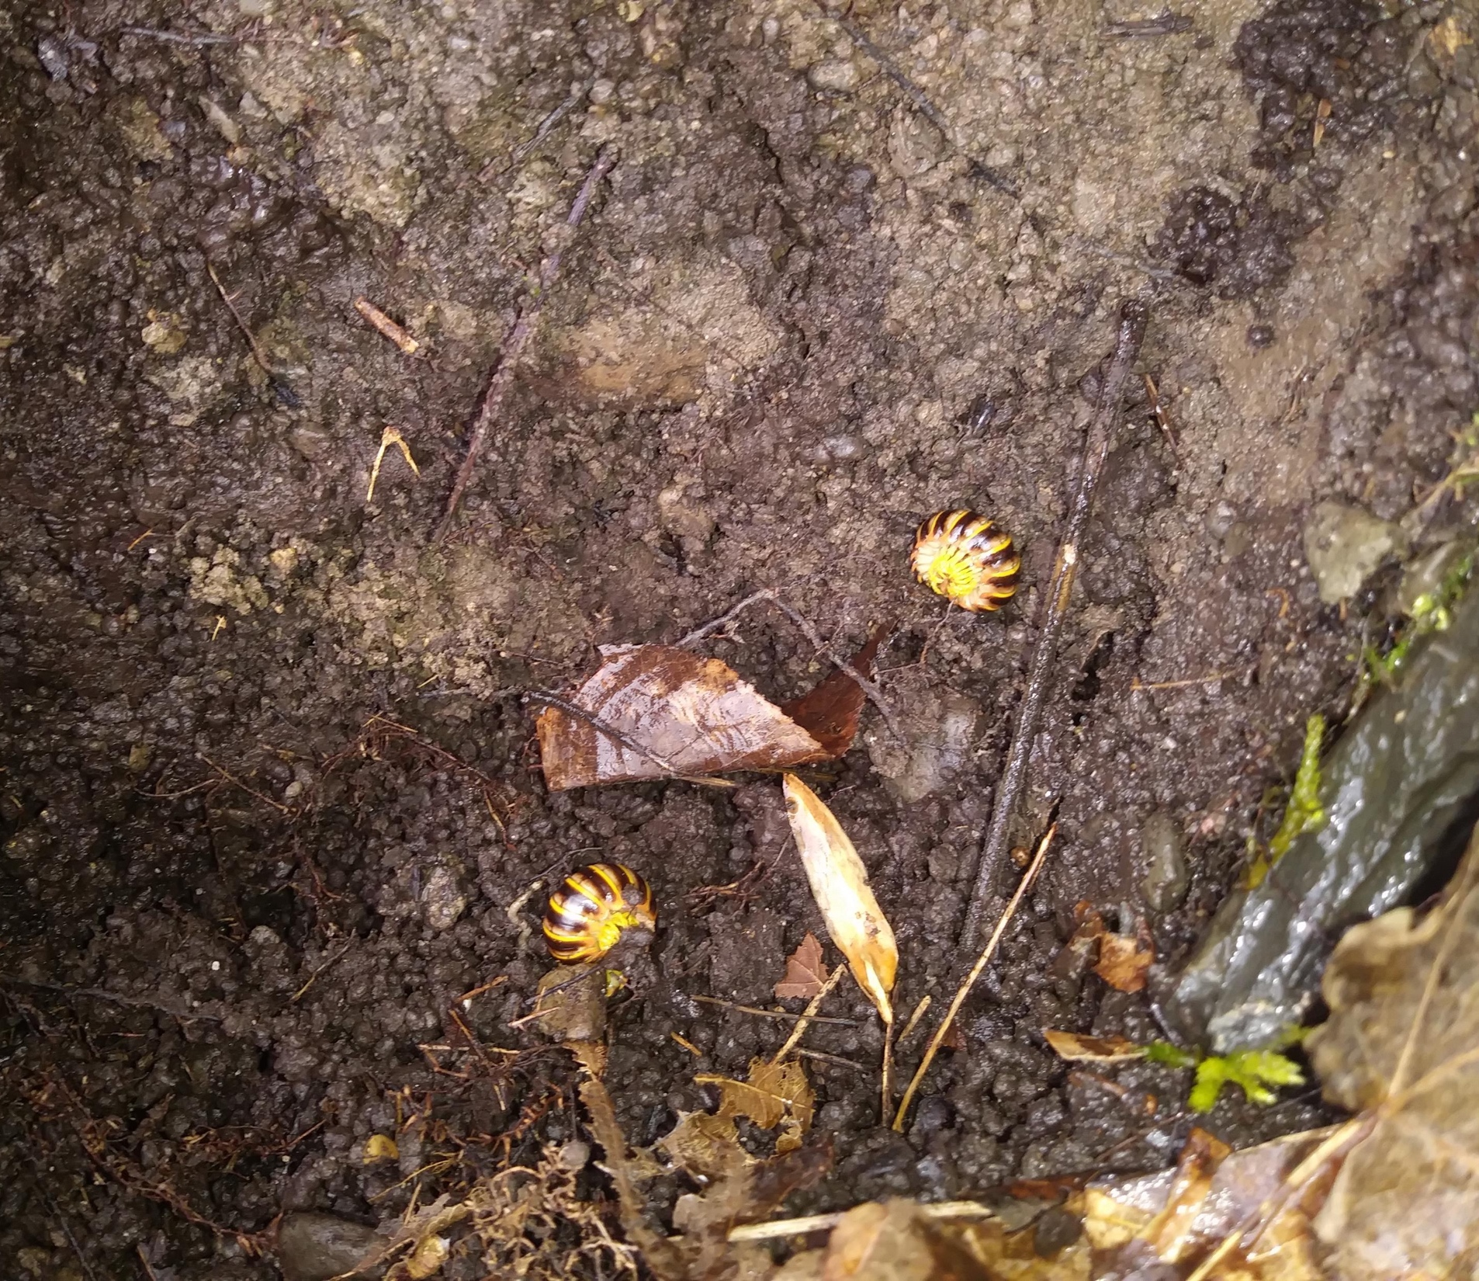
I found two pill millipedes…
There are two kinds of pill millipedes…
Northern Pill Millipedes are found in the Northern hemisphere
Giant pill millipedes are found in the southern hemisphere

Slide 6
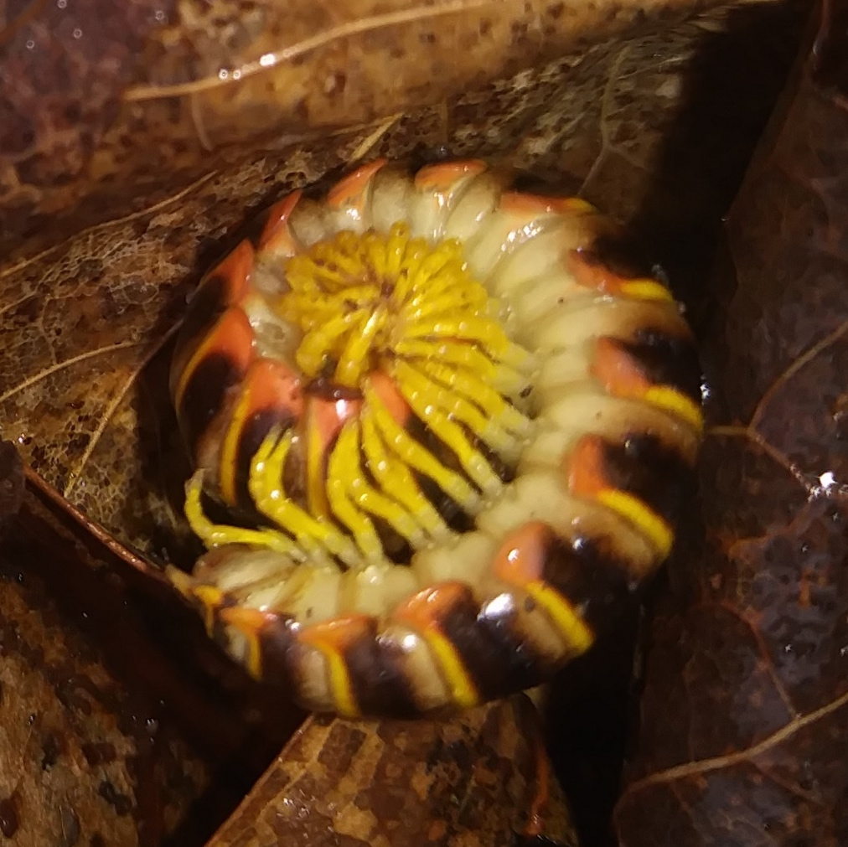
Pill millipedes roll up in a ball when threatened. They can totally hide their heads this way.
They can produce secretions which are toxic to their predators.
Predators (like birds) drop them from heights or smash them against rocks.
They can live up to 10 years.
They lay eggs along with their poop on the forest floor.
They eat vegetation.

Slide 7
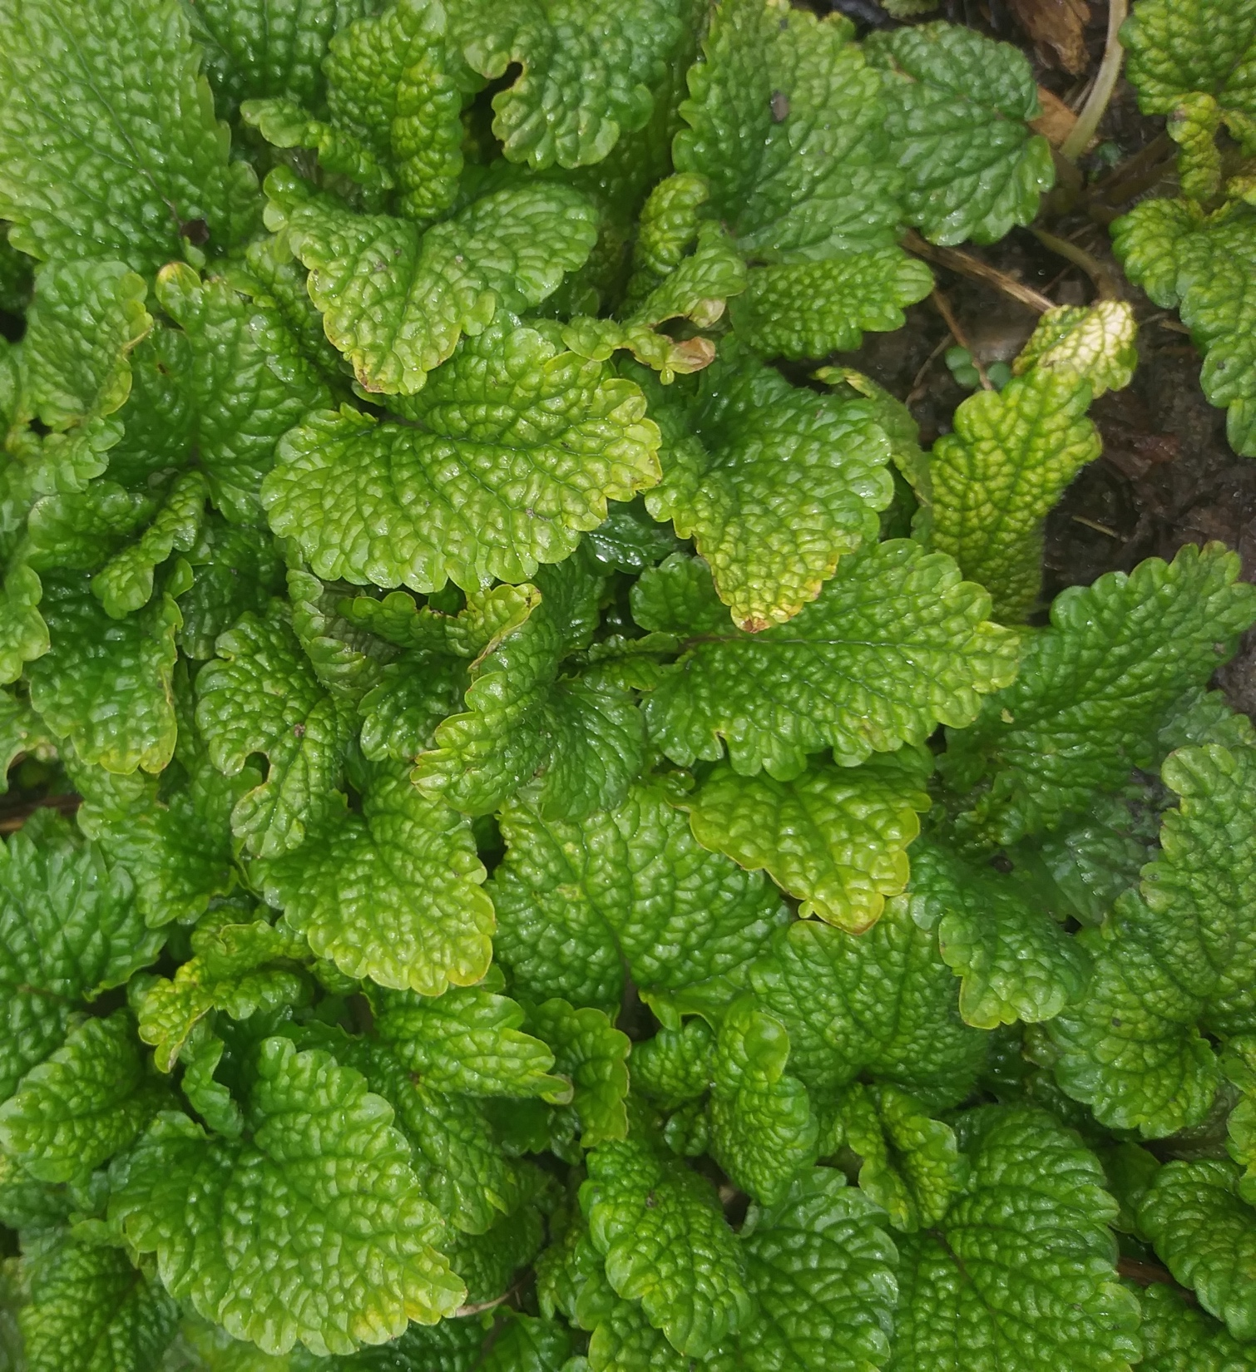
I found some of this growing too. What do you think it is?
Lemon balm
Lettuce
Alfalfa
Dandelions

Slide 8
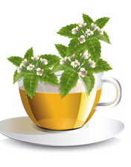
It is lemon balm. My daughter planted it two years ago and it keeps growing back
Lemon balm is a perennial herb in the mint family
It has a lemon scent
You can use it in lots of recipes and for teas, oils and sauces
It is a natural antibacterial and has many other health benefits including treatment for insomnia and anxiety and helping with diabetes, constipation, thyroid and other health problems

Slide 9
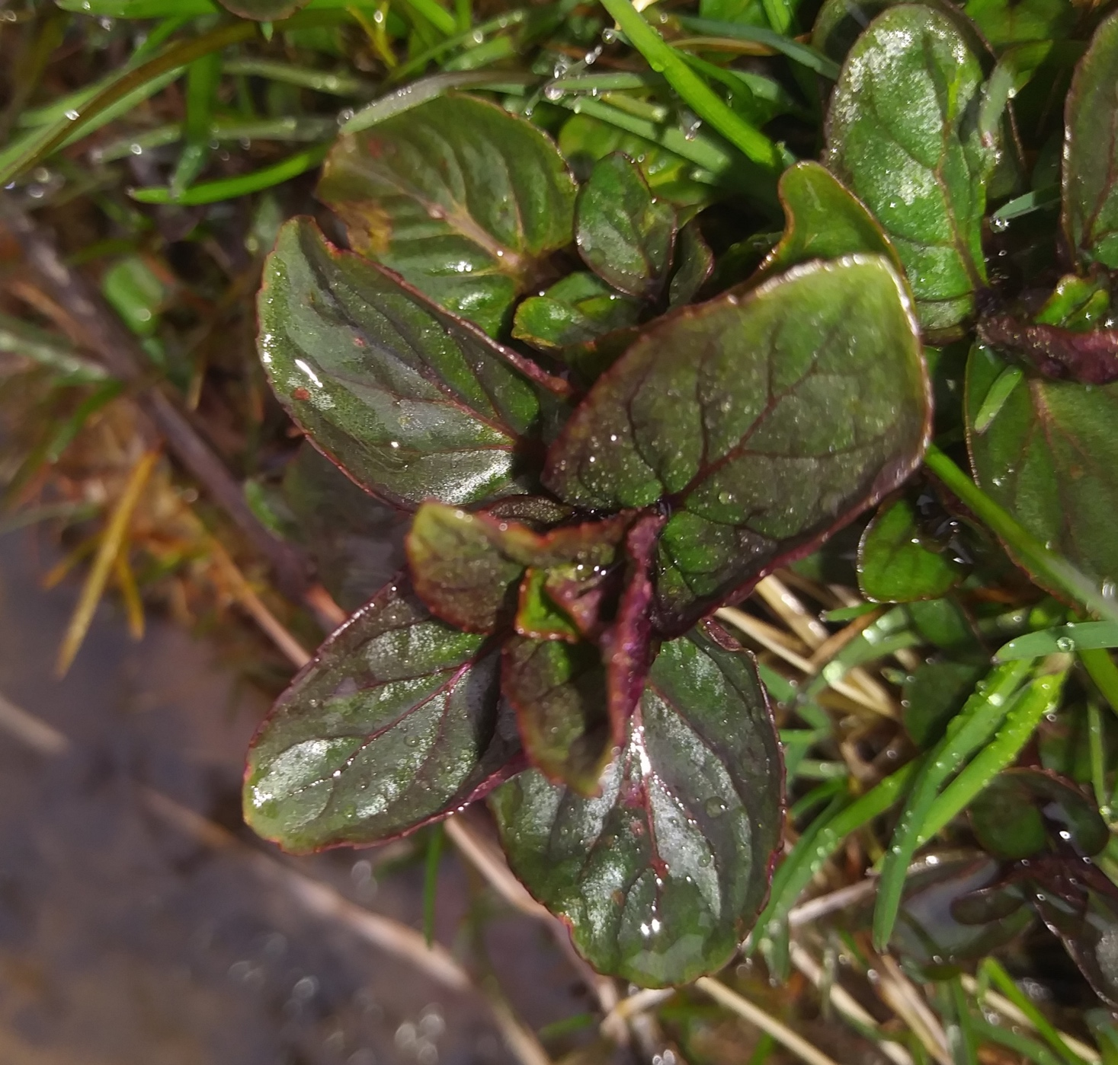
I found this plant too.
Guess what it is called…
Peppermint
Jewelweed
Catnip
Skunk Cabbage

Slide 10
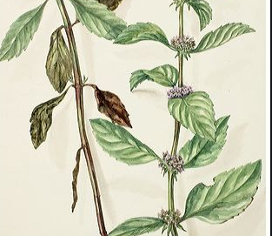
It is peppermint
The Pilgrims brought mint to the United States on the Mayflower
Mint plants are perennials, this means they grow back every year
Mint is a good source of lots of good stuff including: protein, thiamin, niacin, vitamin B6, phosphorus and zinc, dietary fiber, vitamin A, vitamin C, riboflavin, folate, calcium, iron, magnesium, potassium, copper and manganese
It is also good to relieve nausea, help with weight loss, depression and insomnia
Ancient Greeks thought mint would stop hiccups

Slide 11
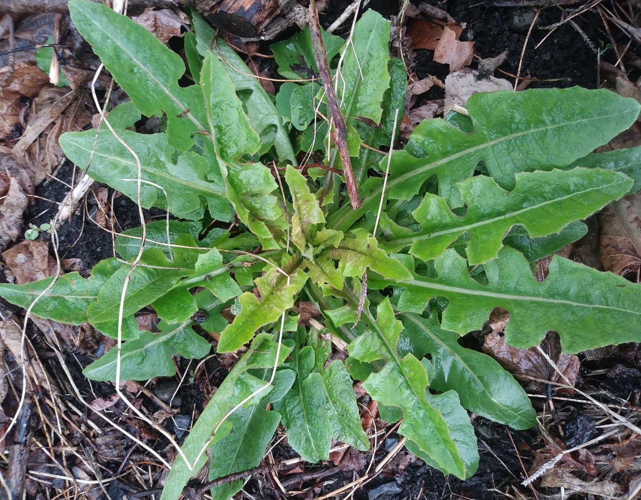
How about this? We learned about this one. You can make a coffee drink from its roots, eat the greens, make a syrup….
Skunk cabbage
Alfalfa
Sunflower
Dandelion

Slide 12
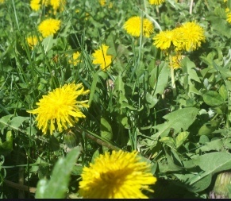
It was a dandelion. Soon you will see lots of yellow flowers from these
Remember how good they are for you. Lots of people think they are just annoying weeds…be sure to set them straight

Slide 13
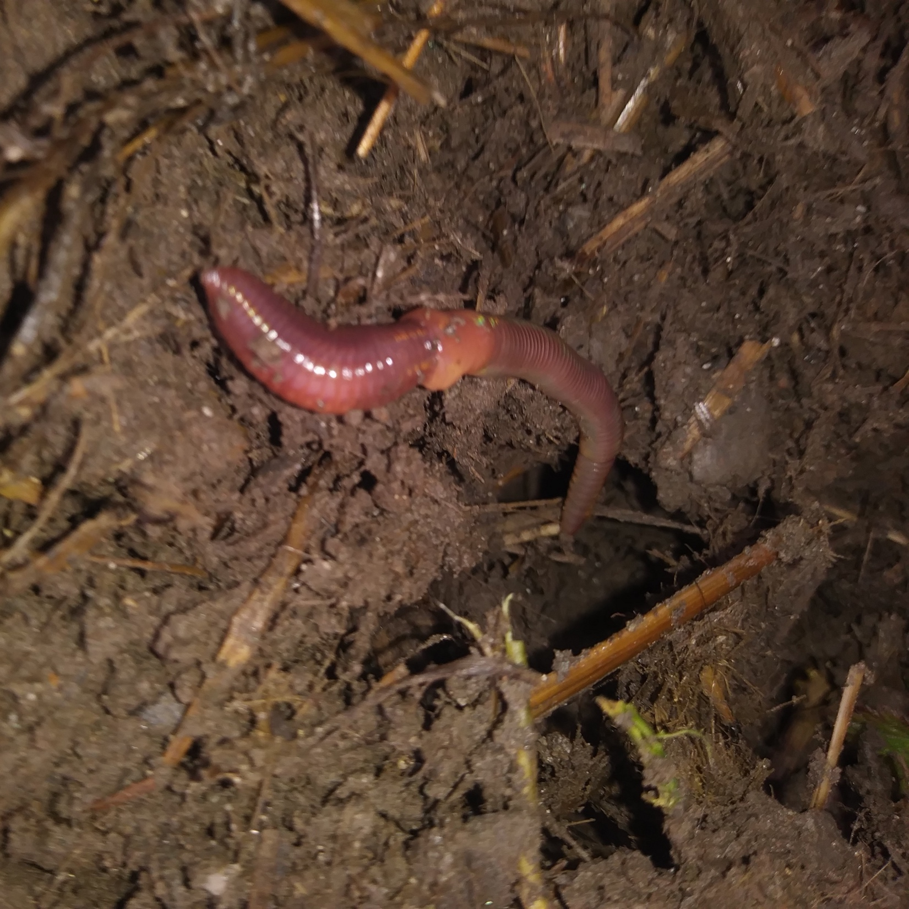
I found this guy too. You know he is an earthworm but here are some other facts you might not have known…
Each earthworm is both male and female
Earthworms breathe through their skin
Their skin exudes a lubricating fluid that helps them move through the soil
Earthworms were largely wiped out in our area by the last glacier, settlers brought more from Europe
Do you think earthworms are good for our Northern forests?

Slide 14
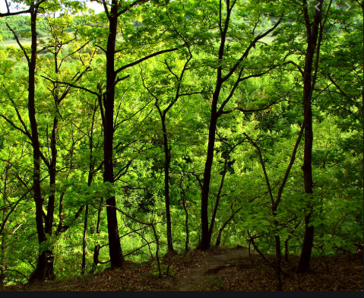
Earthworms are not good for many of our forest trees. Our forests rely on “duff”, the partially decomposed material that makes the forest floor so spongy feeling.
Earthworms speed up the decomposition process and this duff disappears. Some of our native species like oak and sugar maple are negatively
impacted and other invasive species end up replacing them.

Slide 15
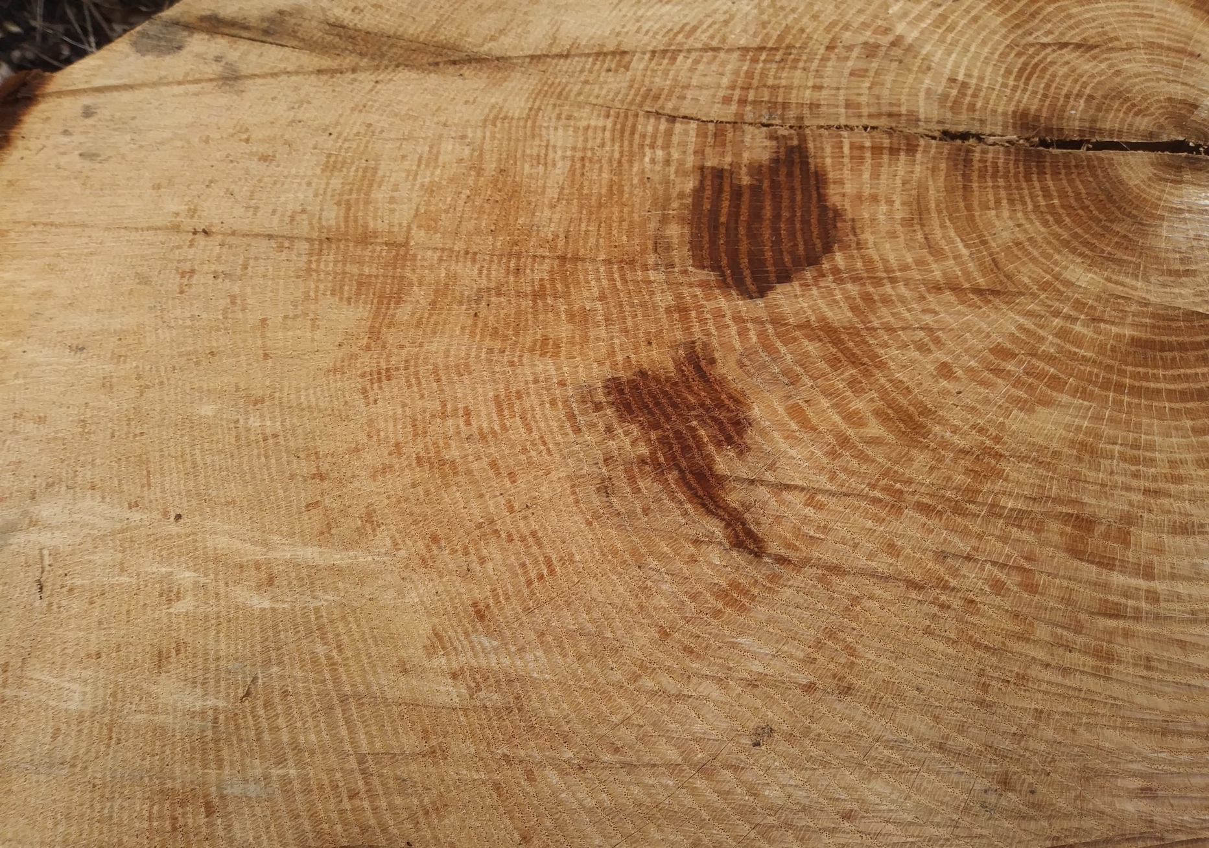
This is a picture of an oak tree that fell down in a storm. How old do you think it is?
Remember, you can tell how old a tree is by counting its rings.

Slide 16
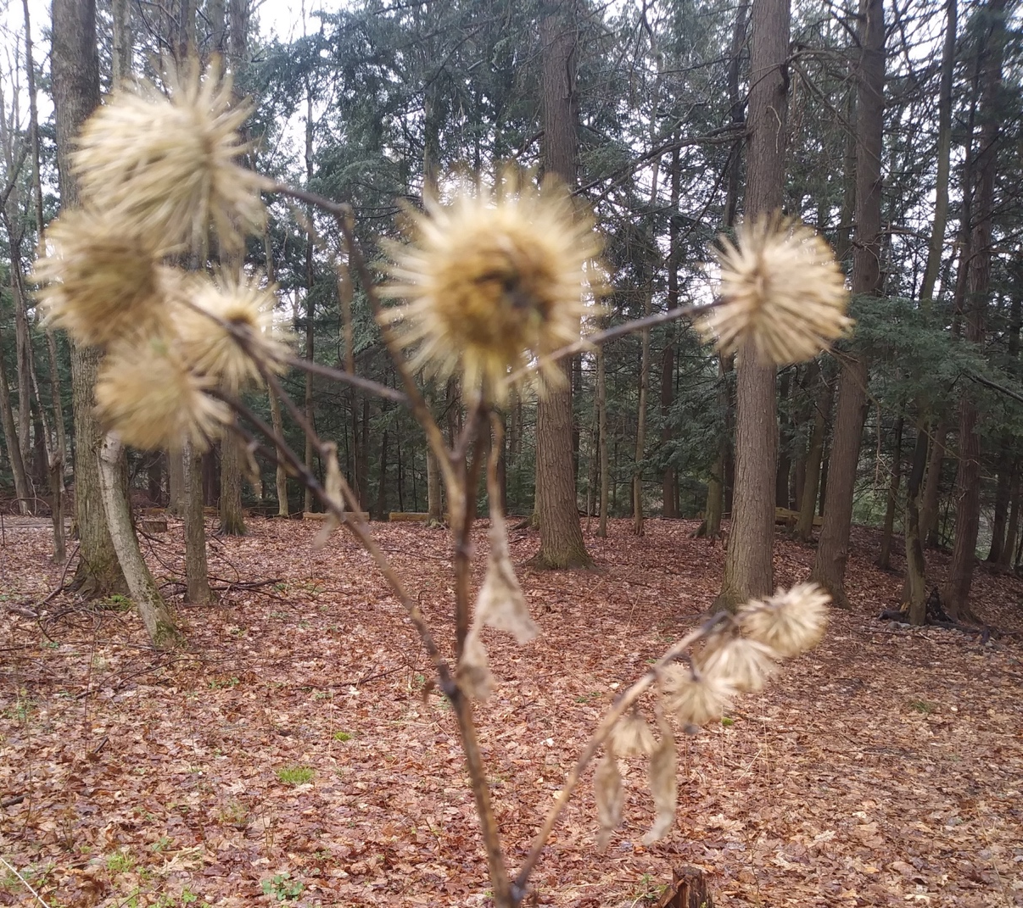
I am not sure, I couldn’t count all the rings, but I am pretty sure it was older than me.
Guess what this is…
Hint: In 1941, George de Mestral, a Swiss engineer, on a hiking trip through the woods found burrs clinging to his pants and also to his dog's fur. On closer inspection, he found that the burr's hooks would cling to anything loop-shaped. This accidental discovery led him to invention of hook and loop fasteners we now know as Velcro.

Slide 17
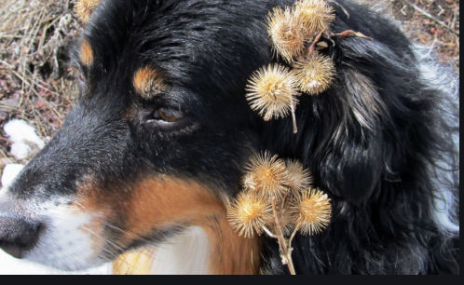
It was burdock!
Burdock is no fun when it
gets tangled in your hair but…
Like so many other plants we have learned about it has many health benefits.
Almost all parts of the plant can be eaten, but its carrot shaped white root is the most popular.
Burdock root contains lots of antioxidants and has been proven to remove toxins from the blood.

Slide 18
What did we not see pictures of this week?
A dinosaur
Poop
Skunk cabbage
All of the above
Nero
Answer: D. All of the above

