Slide 1
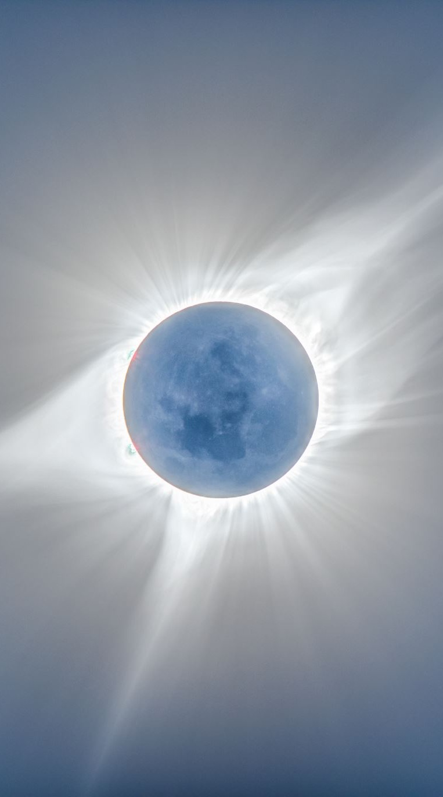
Miss Gloria’s Science
Late-May 2020

Slide 2
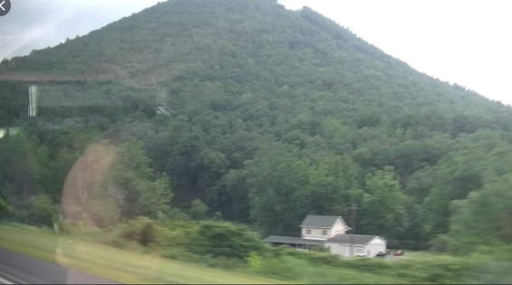
Do you know what state is between New York and Maryland?
A. California
B. Maine
C. Pennsylvania
D. New Hampshire
I went through this state when I drove to Maryland…

Slide 3
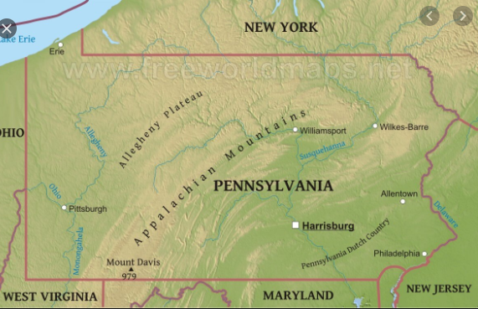
PENNSYLVANIA
The mountains I saw were part of the Appalachian mountain chain
These mountains are the oldest mountains in North America.
They formed about
480 MILLION years ago.
That is a long time!

Slide 4
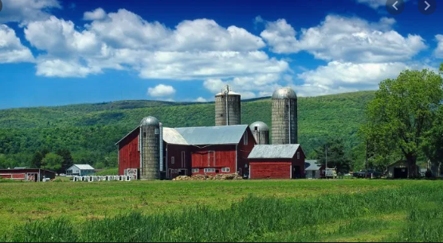
I saw a lot of farms too
One farm had a sign for something I had never heard of on a farm
Guess what it was
Bigfoot
Ginseng
Cashews
Lavender

Slide 5
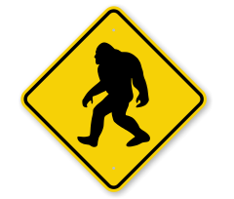
The sign said the farm was one of a cluster
of farms where Bigfoot has been sighted.
Bigfoot, also known as Sasquatch, are said
to be big, hairy ape-like creatures that live
in the wilderness.
Most people don’t believe Bigfoot exists but
many people do.
If Bigfoot do exist they are apparently not
harmful and very probably scared of humans.
Pennsylvania has had the third most reported
Bigfoot sightings in the United States, behind
Washington and California.
BIGFOOT
Do you believe
in Bigfoot?

Slide 6
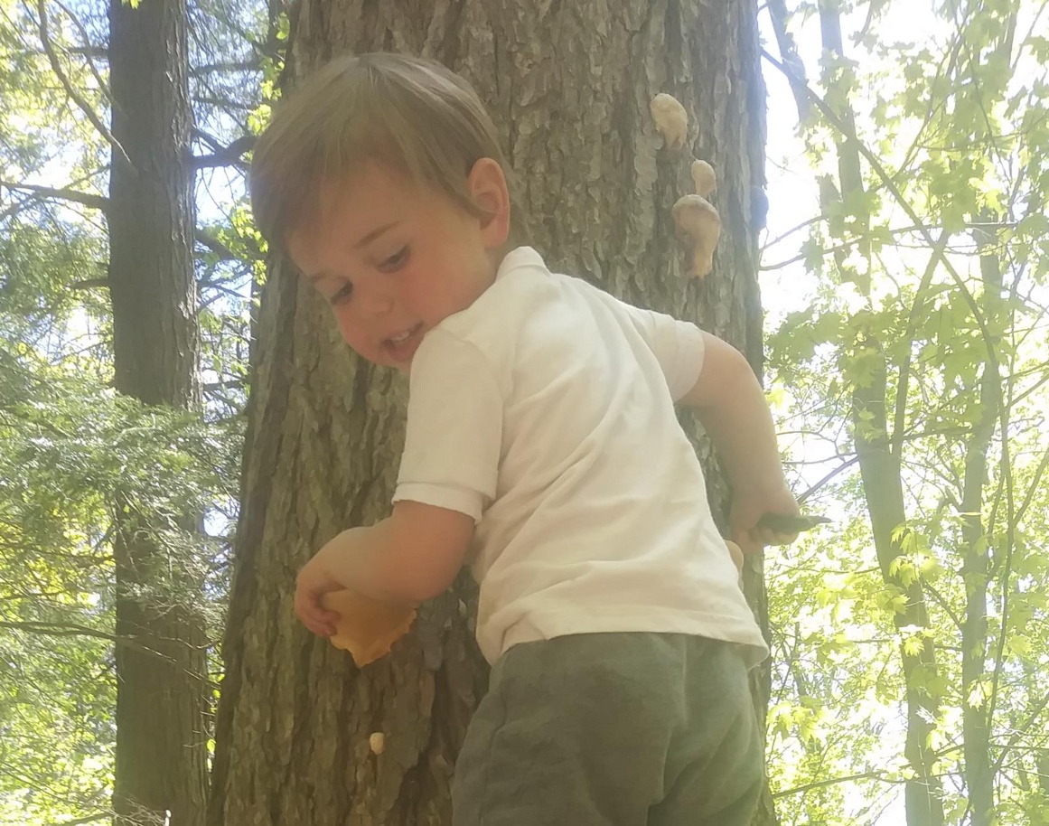
Guess what he
is standing on…
Rocks
Fungi
Tree stump
Bone spurs
Remember Moses?

Slide 7
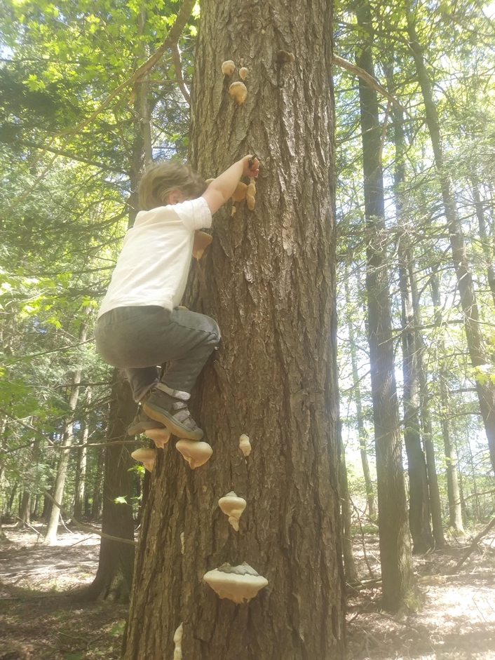
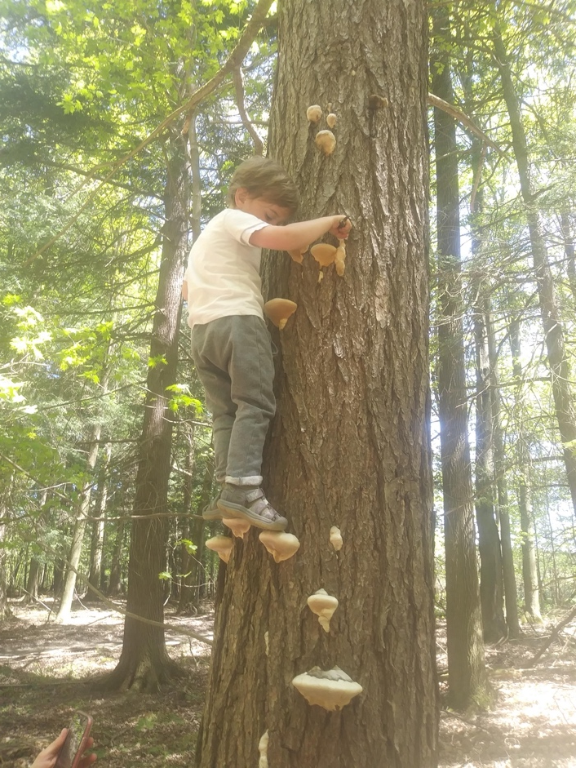
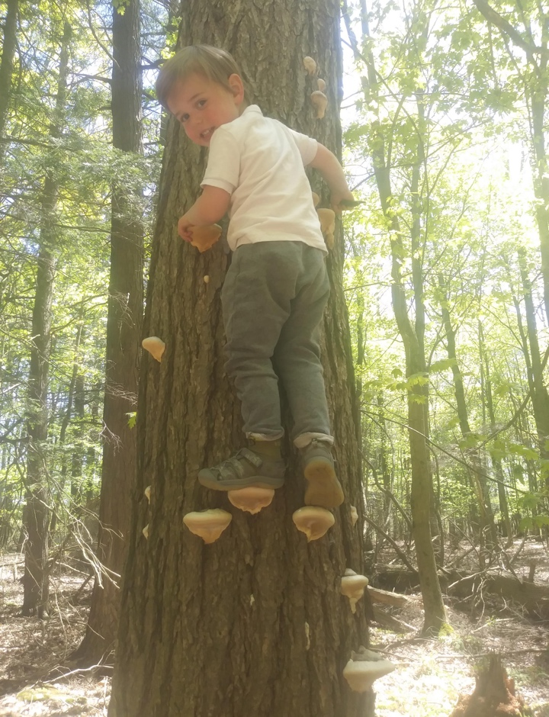
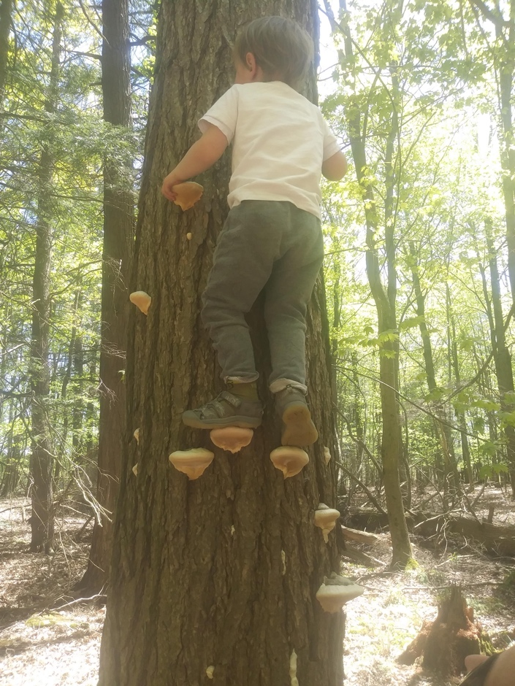
Moses is standing on fungi
Polypore is the name often used for a group of fungi that includes many of the hard or leathery fungi, which often lack a stipe (stem), and grow straight out of wood.

Slide 8
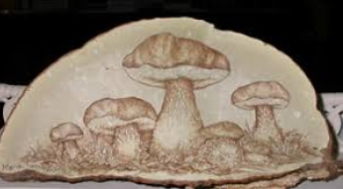
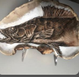
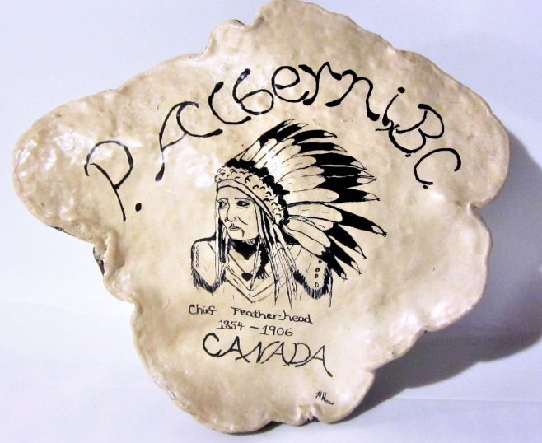
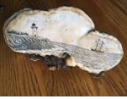
While most fungi are not
harmful, some are deadly.
Never eat any!
You can, however, use fungi for art.
One kind of fungi is called Artist’s Conk because artists like to use it for their artwork.
Any sharp-pointed object
can be used to carve in them.
THEY CAN STAIN THOUGH, SO
BE CAREFUL!

Slide 9
These are Buttercups
What do you think?
Poisonous
Or
Edible
?

Slide 10
There are nearly 2000 different species of buttercup
Buttercups have a layer of reflective cells, which makes them shiny
Buttercups are ‘heliotropic’ which means they follow the sun
All parts
of the buttercup
plant are
poisonous
to both
people and
animals

Slide 11
Do you see ANYTHING in this pond scum?

Slide 12
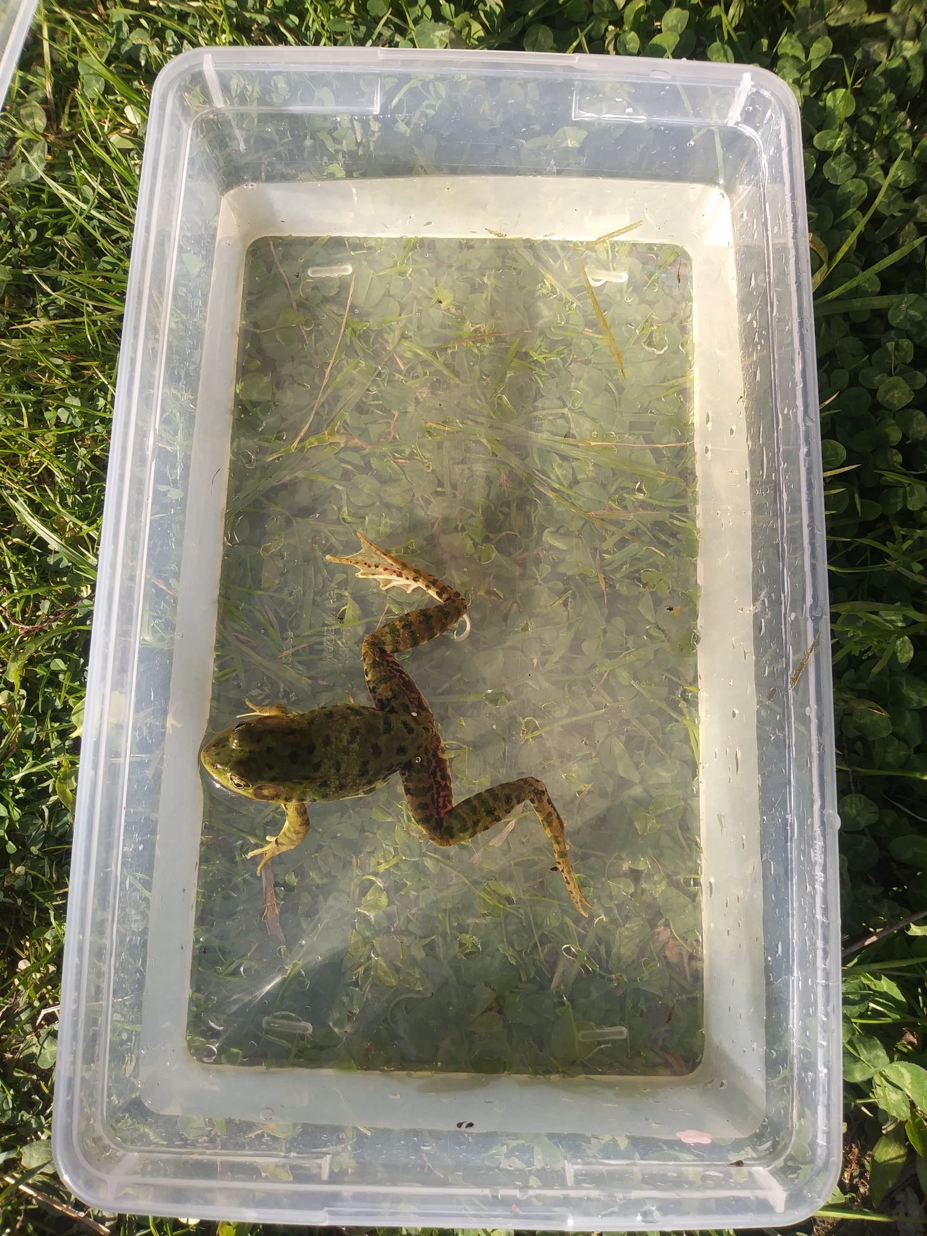
THIS FROG WAS PEEKING OUT OF THE MUCK
The frogs outside are very loud right now. Frogs only croak when they are mating. The male frogs croak to attract females and to warn other males to stay away.
Some female frogs make sounds but it is
mostly the males we hear. When the females make noise it is a much softer noise than the male croaking sound.

Slide 13
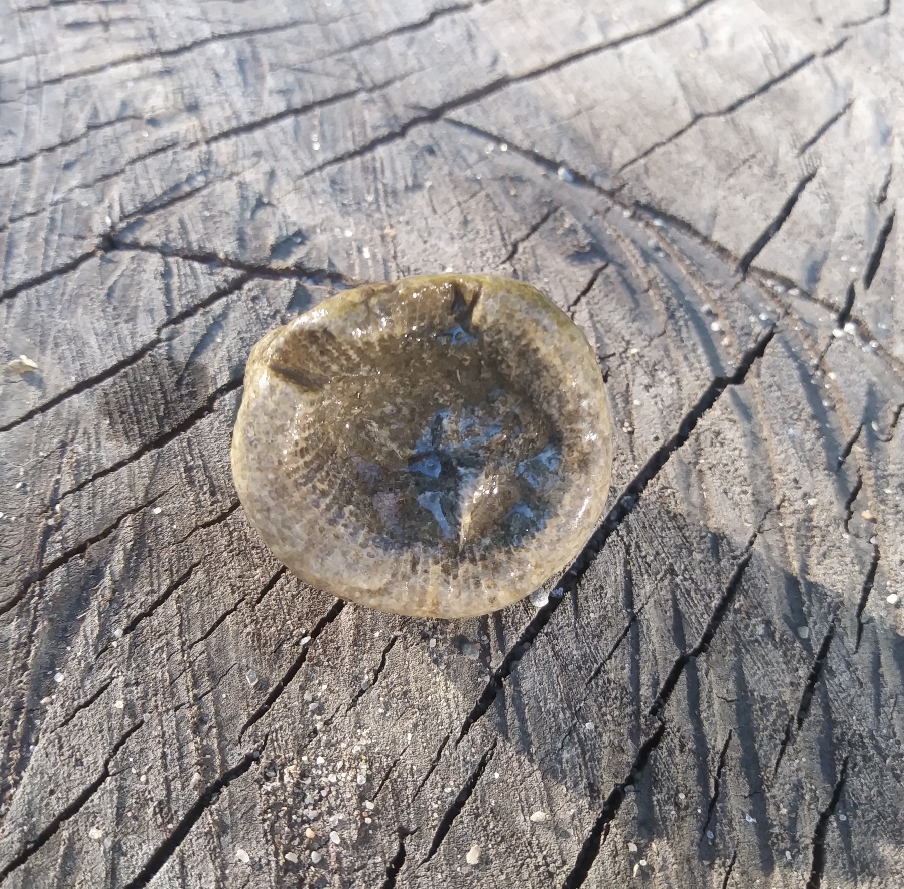
I found this in our stream. What do you think it is?
Fossil
Coral
Skeleton

Slide 14
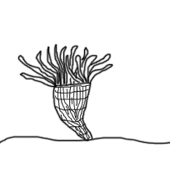
It was all of those things…
it was a Horn coral fossil
Horn Corals are from the extinct order of corals called Rugosa. They grew in long cone shapes like a bull’s horn. The fossil is the skeleton of the coral animal. They built these cone shaped structures from calcium carbonate that came from the ocean water. The animal lived at the top of the cone. As the animal got bigger it added more material to the cone. Each layer was a little bigger than the previous one.
Horn coral fossils are over 200 million years old.
Horn Coral

Slide 15
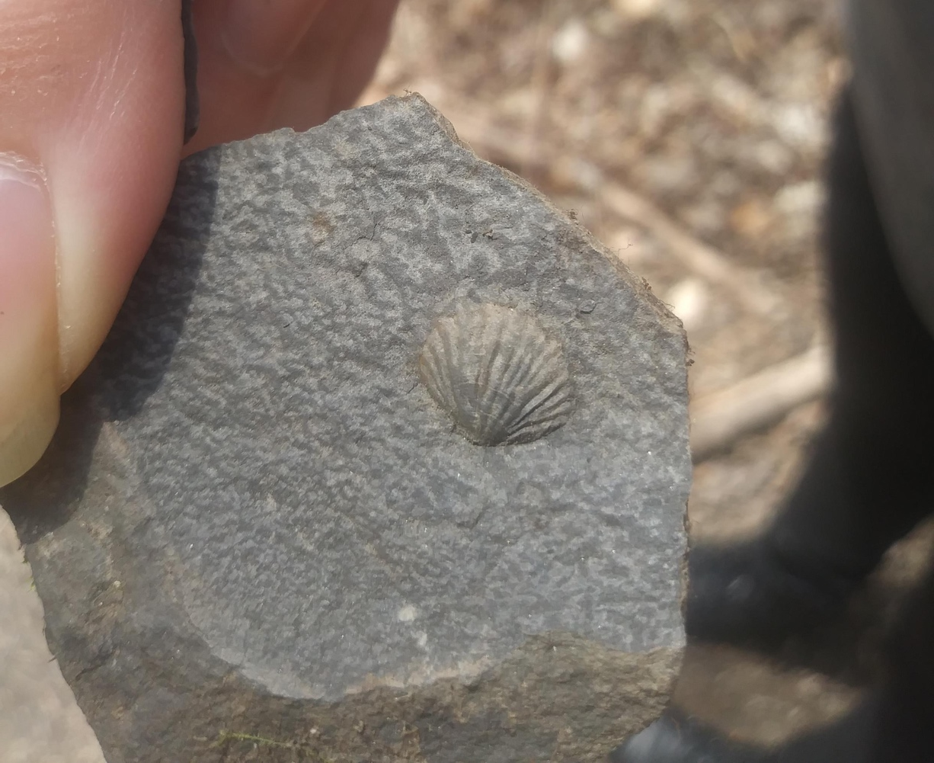
What kind of fossil do you think this is?
Brachiopod
Trilobite
Cephalopod
Coral
We found this fossil in the stream too

Slide 16
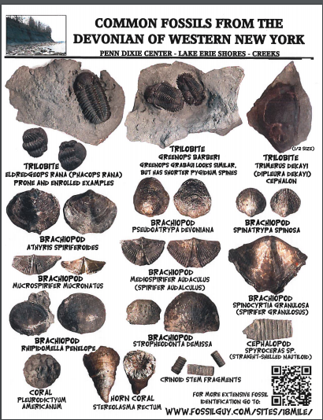
Based on this chart I found
I would say it must be a
Brachiopod
Brachiopods are bottom dwelling, ocean, bivalves (having two shells).
They are considered living fossils, with 3 orders present in today's oceans.
They are rare today but during the Paleozoic Era they dominated the sea floors. Though they appear to be similar to clams or oysters they are not related,

Slide 17
It has been hot these past few days but it will rain soon and the weather will get cooler.
The air temperature decreases when it rains because rain falls from a cooler layer of air above, and as it falls into the warmer air near the ground it exchanges heat via conduction and convection.
Hang in there

Slide 18
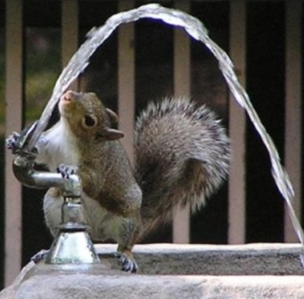
Stay cool and drink plenty
of water
(not sugary drinks!)

Slide 19
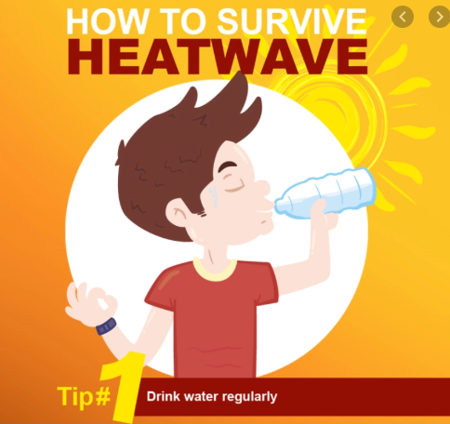
What did the pig say on the hot
summer day?
What happens when you throw a green rock into the Red Sea?
What did the ocean say to the
sailboat?
What holds the sun up in the sky?
Why don’t oysters share their pearls?
What does the sun drink out of?
^ I’m bacon ^ It gets wet ^ Nothing it just waved ^ Sunbeams ^ Because they’re shellfish ^ Sunglasses ^

