Slide 1
Miss Gloria’s Science
June – first week

Slide 2
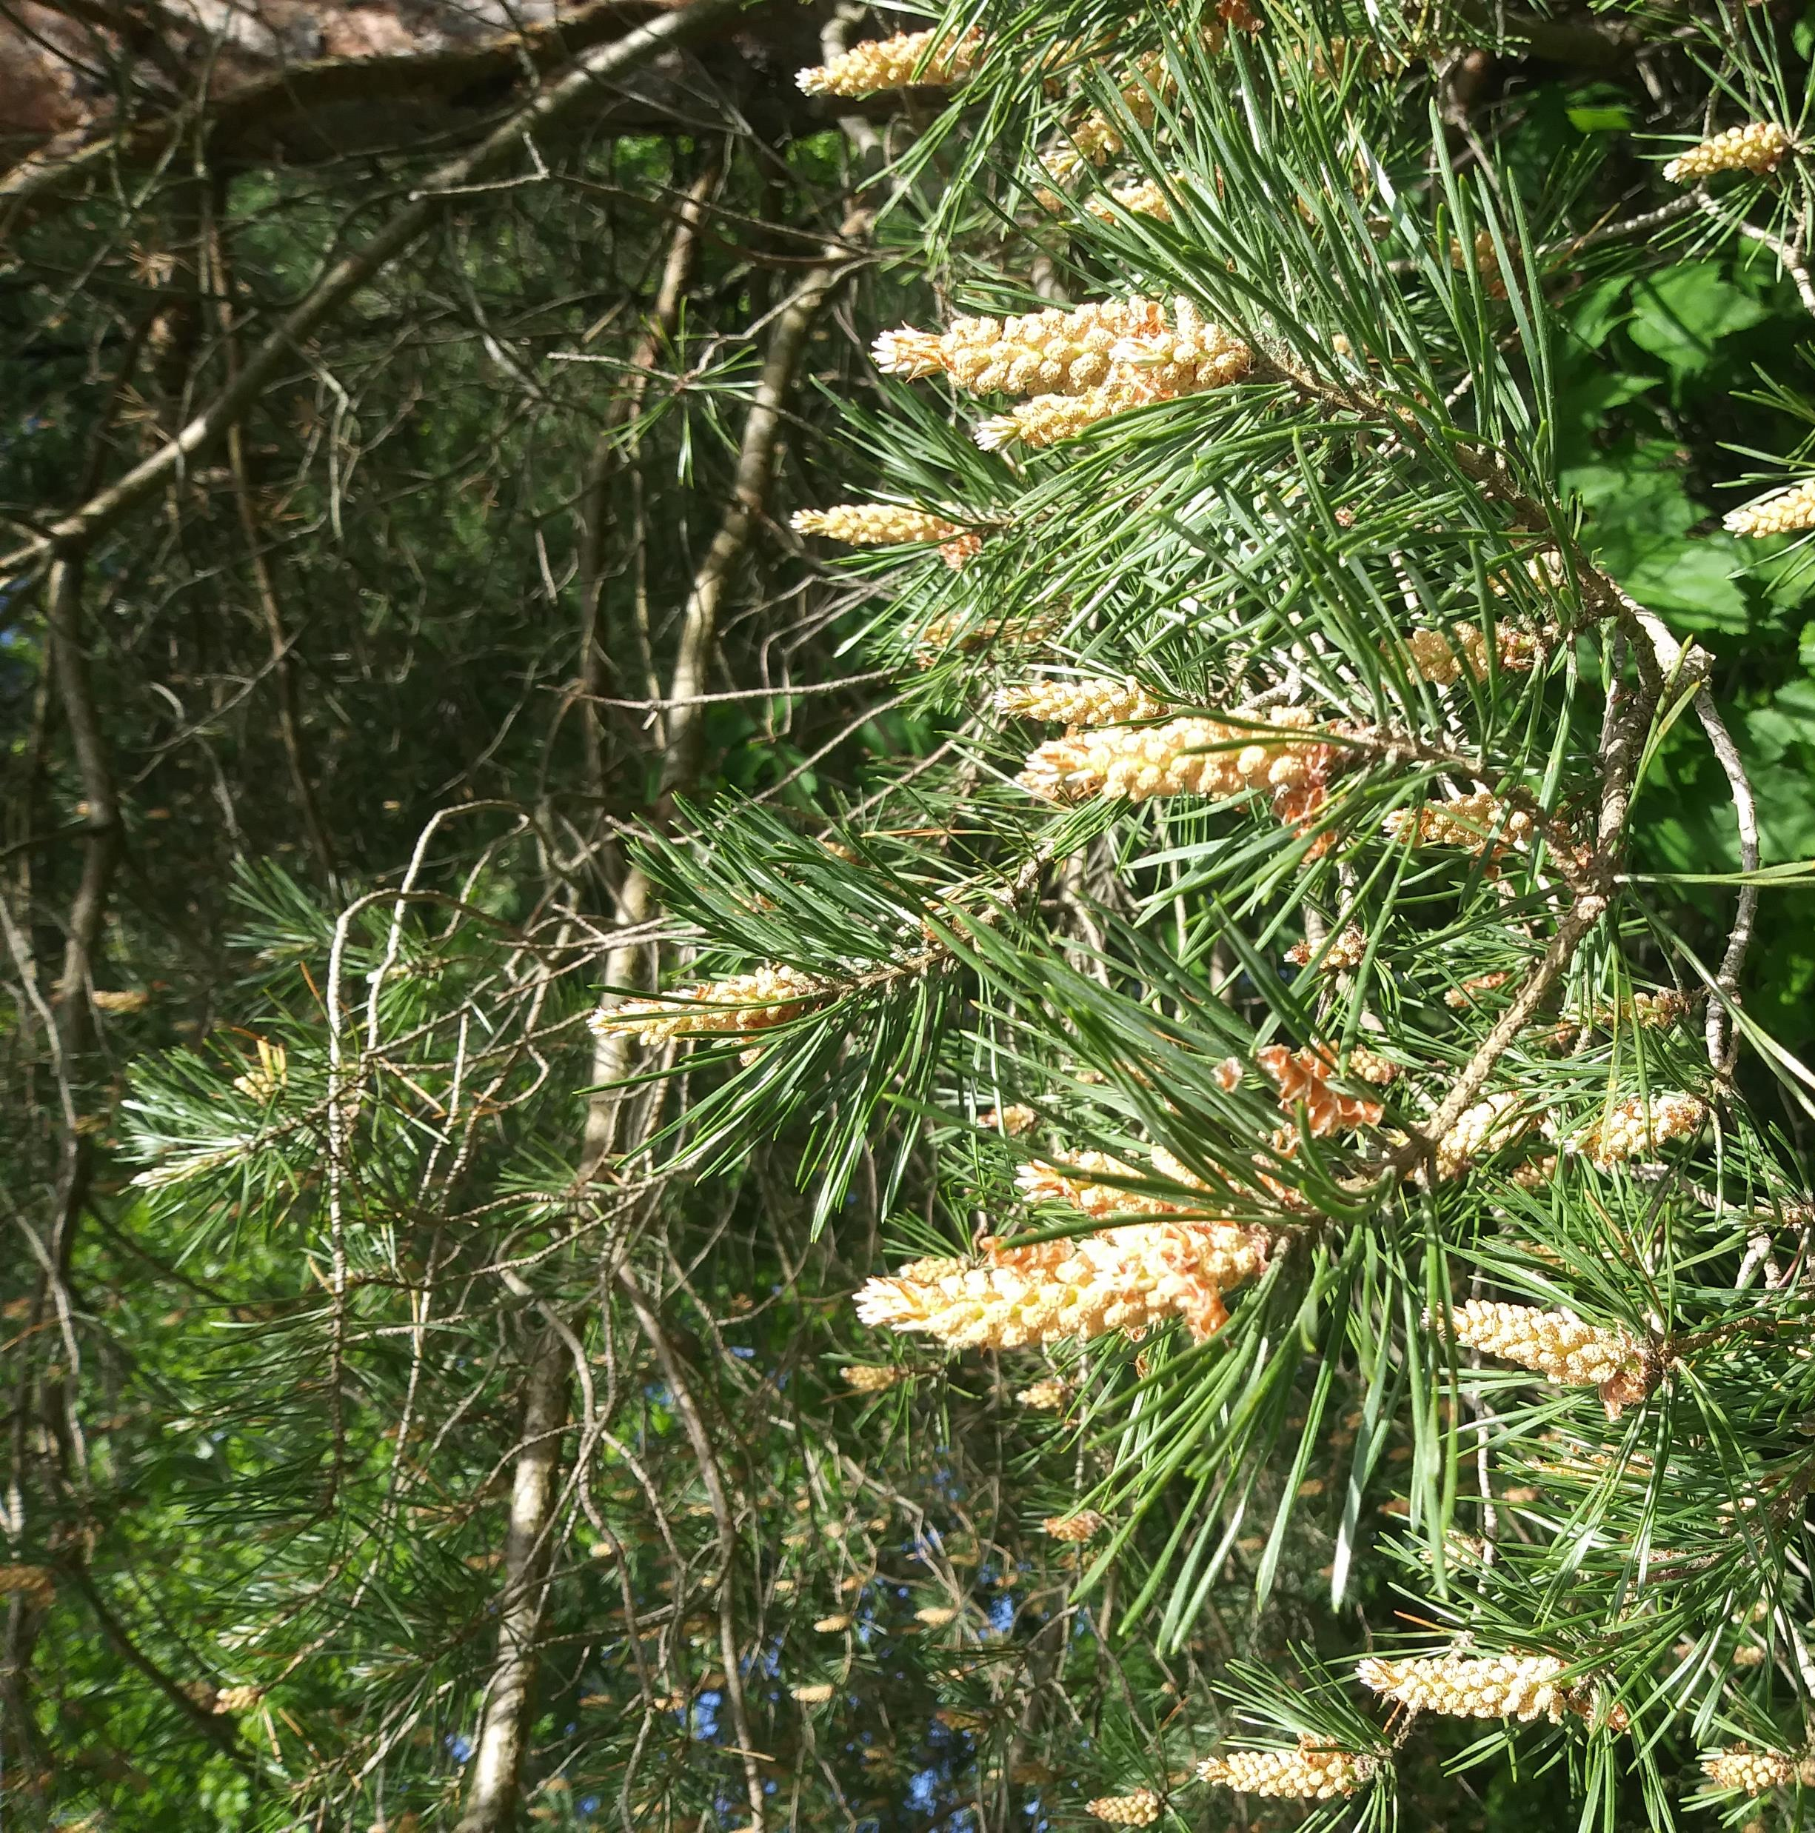
What do you think all the little shoots are on this pine tree?

Slide 3
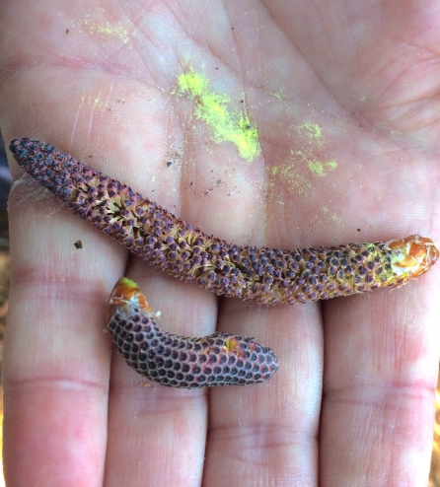
The little shoots are…
Caterpillars
Male pine cones
Flowers
Cocoons

Slide 4
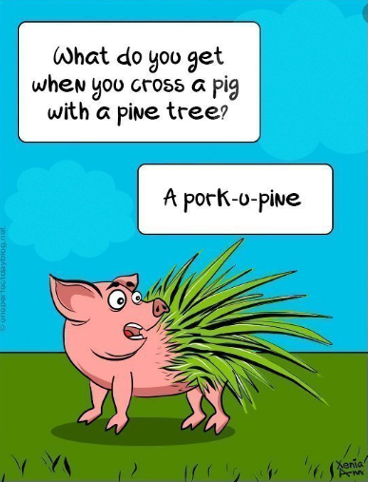
I saw a lot of farms too
One farm had a sign for something I had never heard of on a farm
Guess what it was
They were male pine cones.
Pine trees don’t have flowers.
The larger cones we are familiar
with are the female pine cones.
The smaller shoots are the male
pine cones. The pollen drifts from
the male cone to fertilize the
female cone.

Slide 5
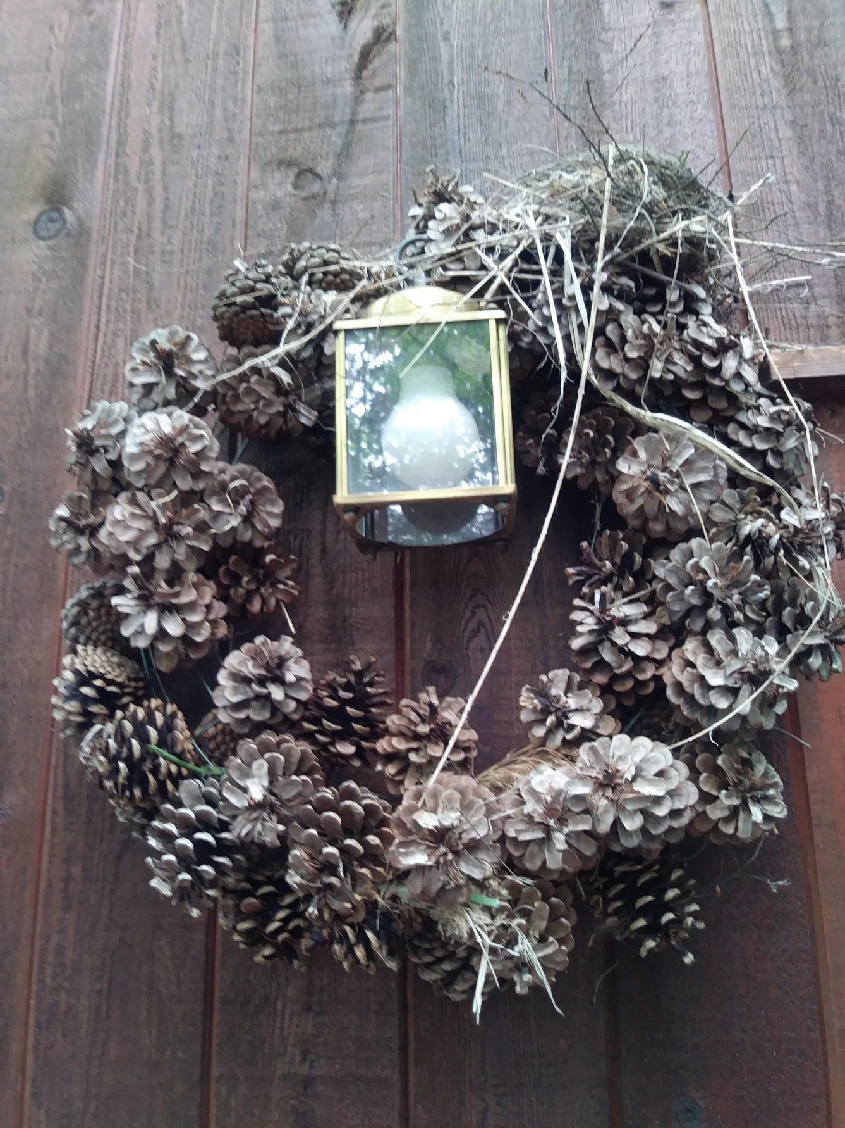
This is a pine cone wreath on the wall of Miss Gloria’s deck.
Do you know who is
living above the light?
Squirrel
Luna moth
Robin
Bat

Slide 6
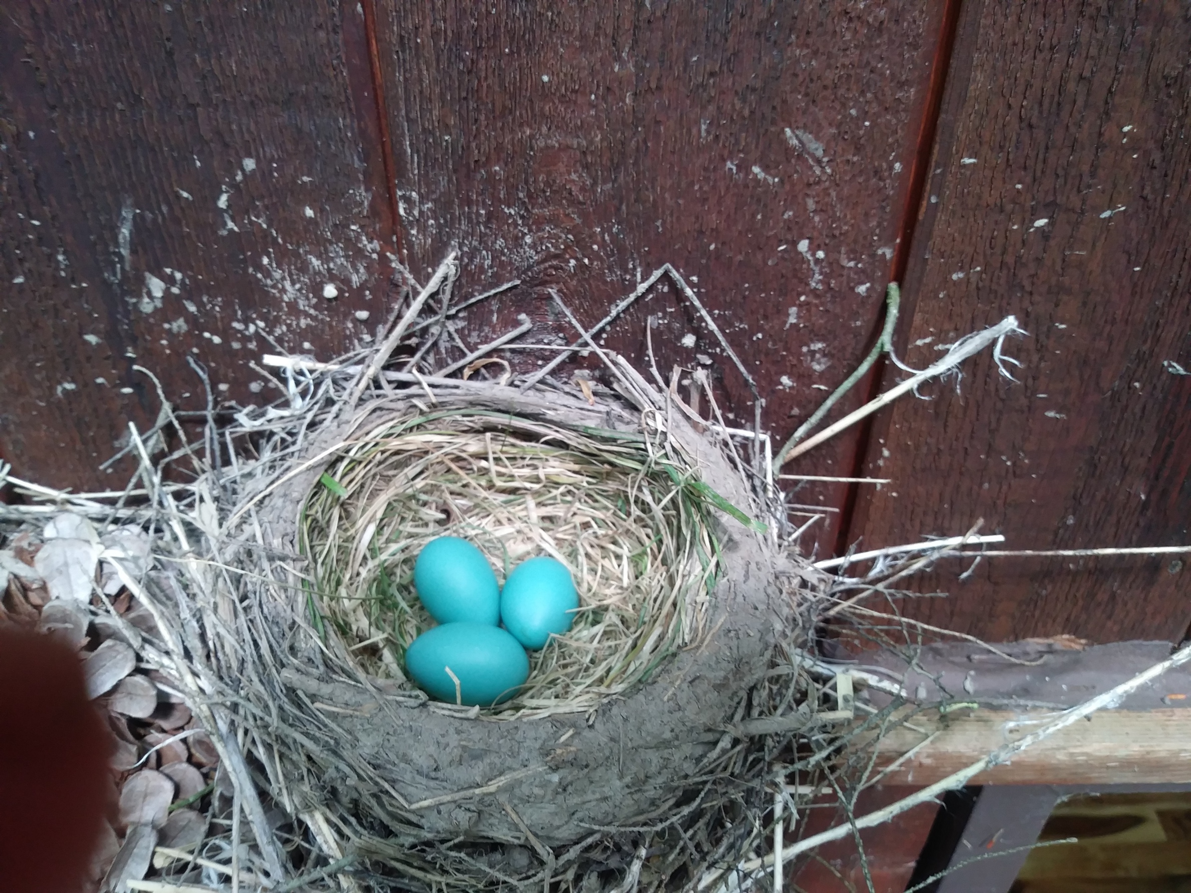
It is a robin. She has been sitting on these eggs. Every time I go near her nest she flies away.

Slide 7
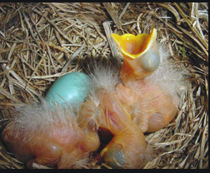
The female robin builds the nest for her clutch of eggs.
A clutch consists of 3 to 5 eggs.
The eggs hatch after about 14 days.
The young leave the nest about 2 weeks after that.
This is what the baby robins will look like when they hatch

Slide 8
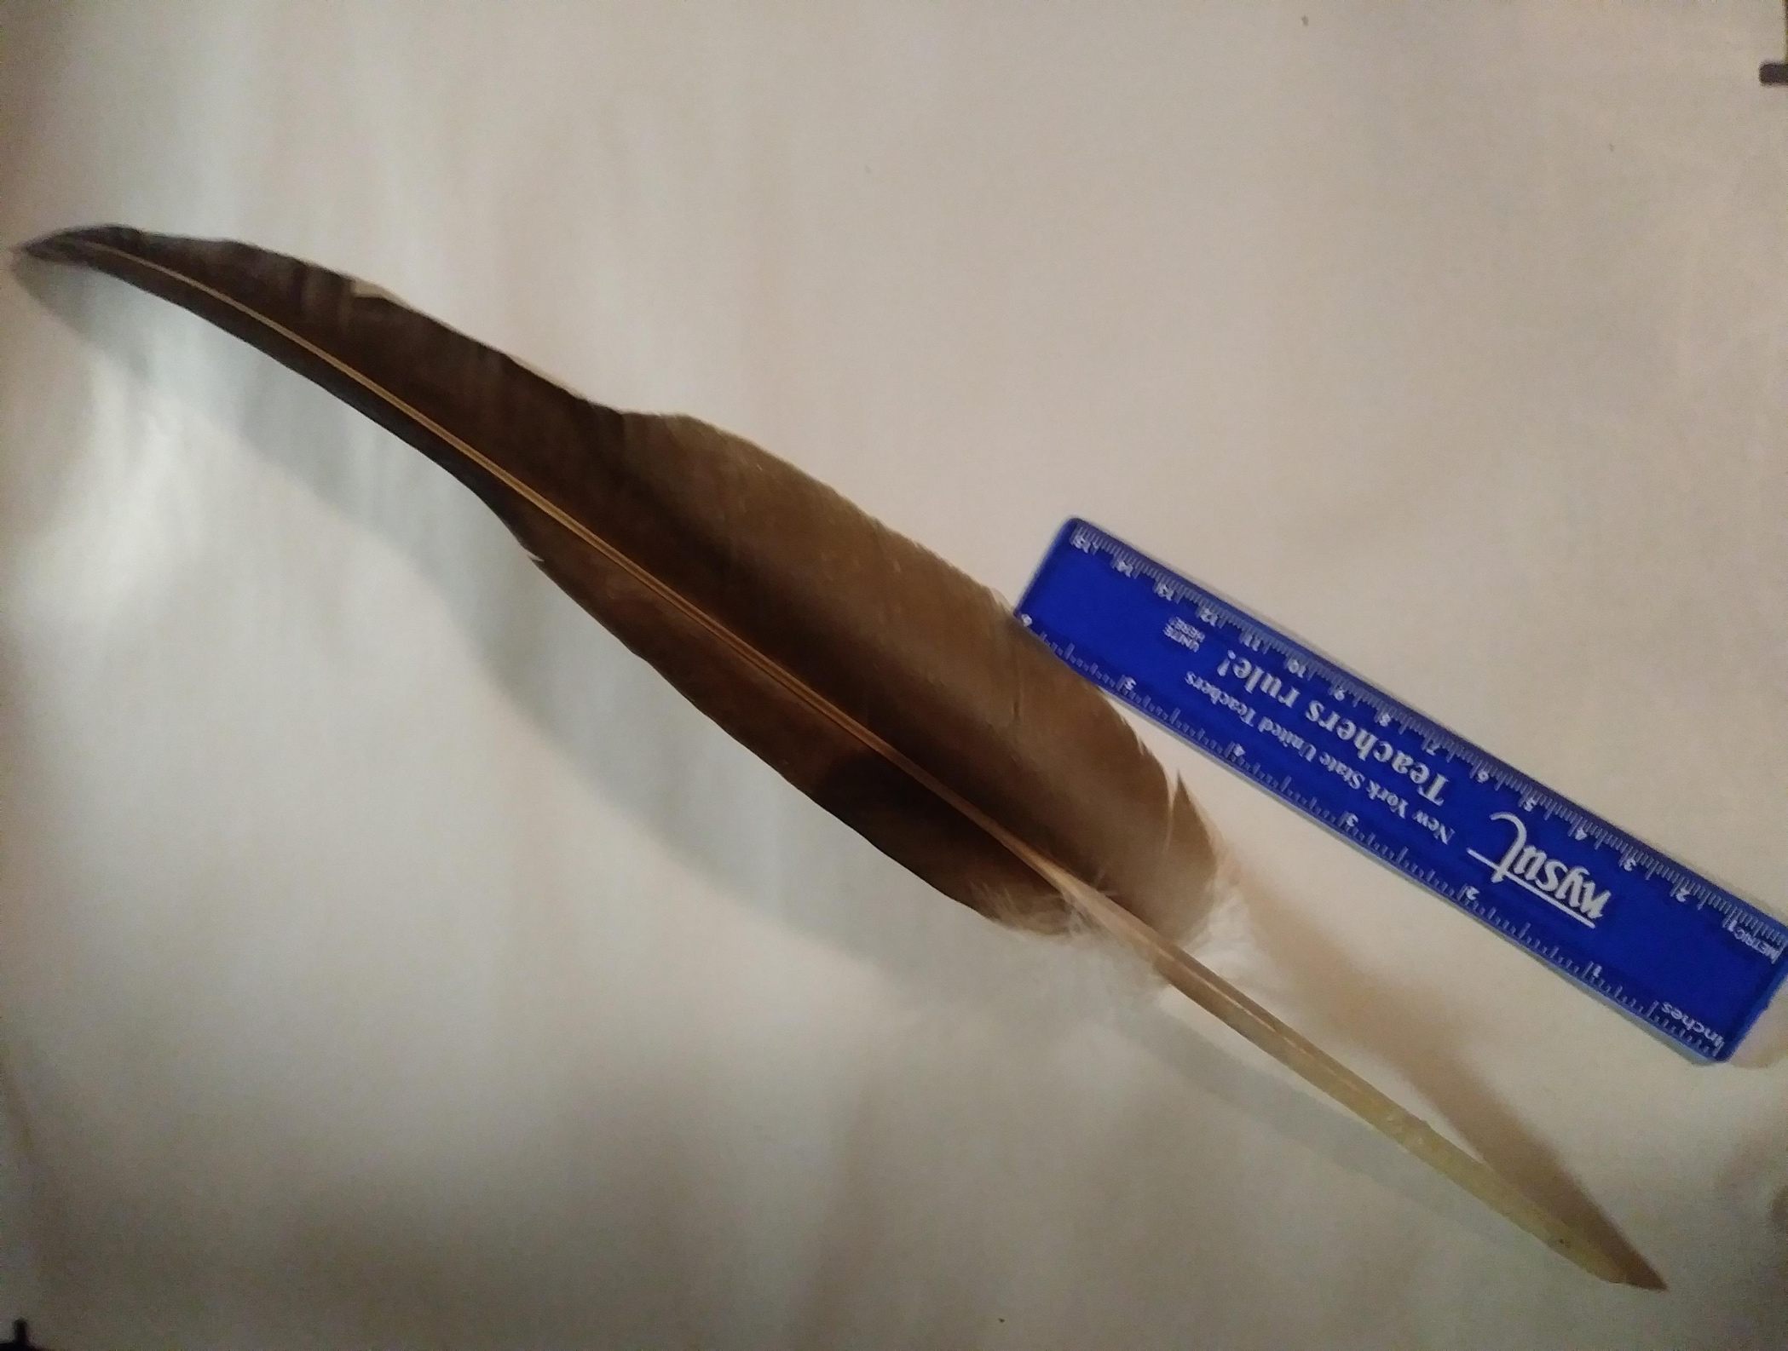
I found this feather in my driveway. The ruler is 6 inches long, the feather is 18 inches long. What do you think the
feather came from?
Robin
Turkey vulture
Bat
Raven

Slide 9
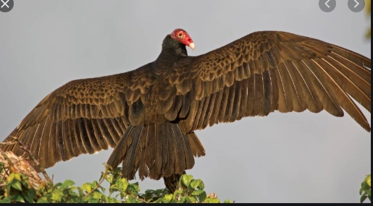
It came from a Turkey Vulture
These guys are cool so we are going to learn a lot about them

Slide 10
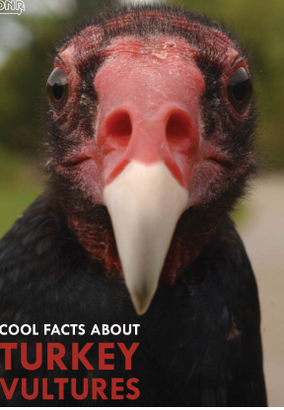
Groups of vultures are called a “wake.”
Individual vultures usually sleep on the same branch in the same tree every night.
Turkey vultures have no vocal organ and are only able to
grunt or make low hissing noises.
Their sense of smell is amazing. They can smell dead animals
from more than a mile away.
They like fresh meat and will not eat extremely rotted
carcasses.
When frightened by intruders, turkey vultures may pretend to
be dead. If on their nest, the vultures will hiss, regurgitate and
spit and can hit their target up to six feet away. The smell of
their vomit is really bad so this works to scare away intruders.
The strong acid in their stomach kills bacteria and viruses, so vultures play an important role in the ecosystem by disposing of carcasses that would otherwise be a breeding ground for disease.

Slide 11
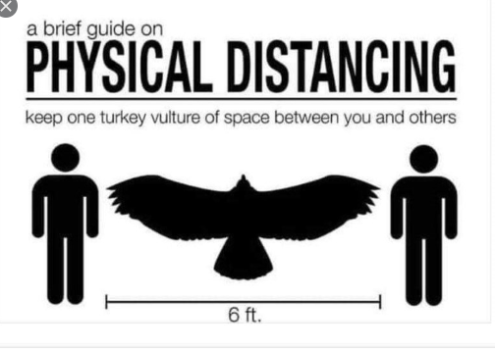
Despite the fact that they dig around in bloody carcasses for meals and urinate onto their legs to keep cool, turkey vultures are very clean birds and will spend two to three hours a day preening. They also bathe in water when possible.
Turkey vultures are curious about people and objects and are gentle and very intelligent. They play follow the leader and tag with each other.
It is illegal to possess or kill turkey vultures in the United States and violation of the law is punishable by a fine of up to $15,000 and imprisonment of up to six months

Slide 12
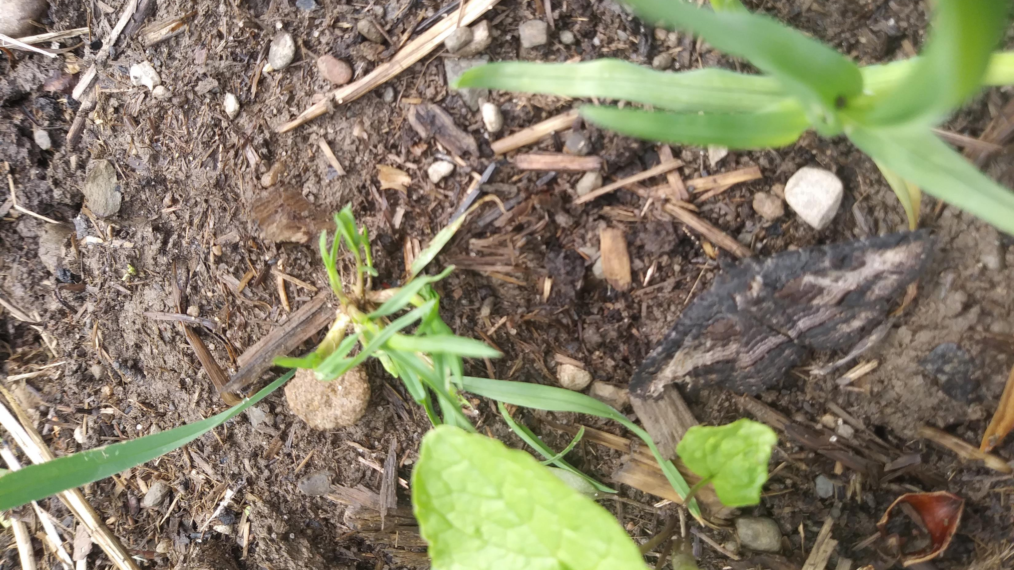
Remember our camouflaged moth lesson and hunt we had in the classroom? Look what I found.

Slide 13
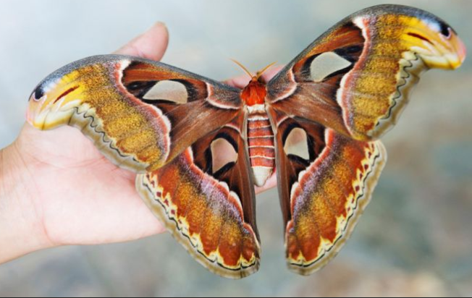
(It is really the Atlas moth from Asia with a wing span of 10 to 12 inches)
Atlas Moth

Slide 14
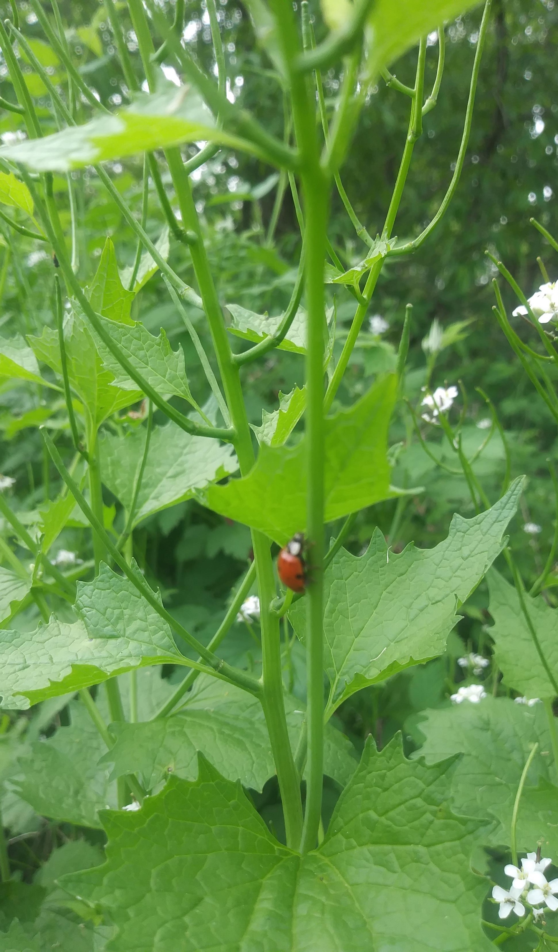
What is that
on the Garlic Mustard plant?
Lady bug
Lady beetle
Lady bird

Slide 15
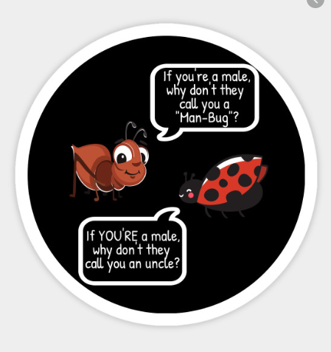
The little red bug is actually
Known by all those names,
technically it is a beetle though.

Slide 16
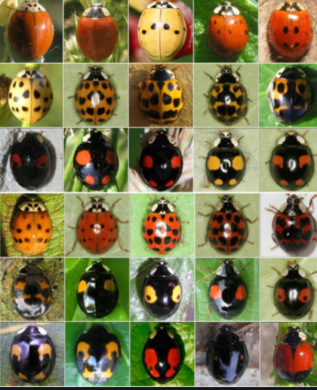
There are about 5000 different species of ladybugs
Ladybugs live about one year
They eat as many as 5000 insects in their lifetime
Ladybugs produce toxins so they don’t get eaten by predators

Slide 17
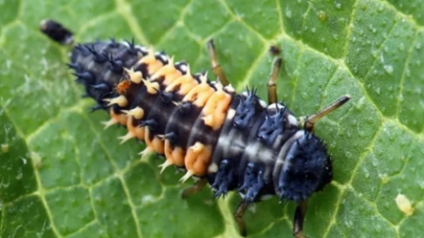
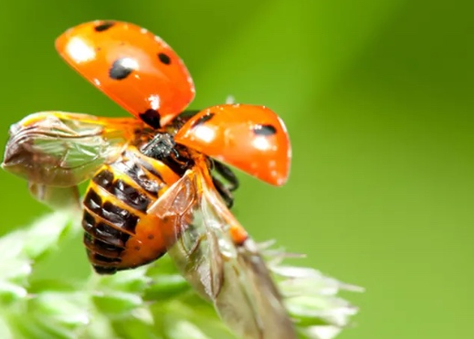
Ladybugs have aerodynamic wings folded under their outer shell that they use for flying
This is what the larvae that hatches from a ladybug egg looks like before it breaks down its body parts and grows new ones.

Slide 18
