Slide 1
Miss Gloria’s Science
Join her for a nature walk

Slide 2
Take a walk with Miss Gloria and see how many questions you can answer.
Have fun with this!
The answers are at the end but I bet you will know almost all of them.

Slide 3
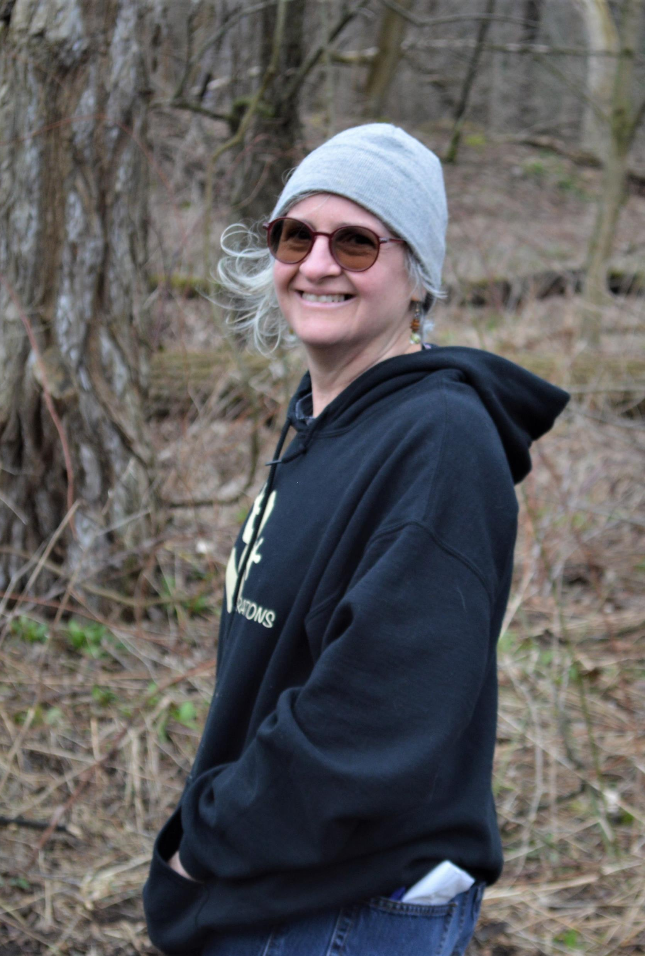
Guess who this is…
An alien
Spongebob
Miss Gloria
Michael Jackson

Slide 4
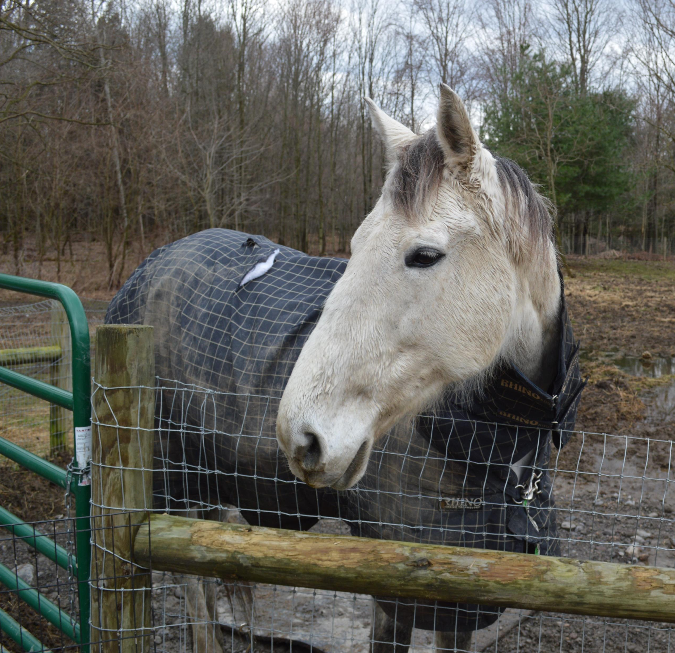
This is “Q”. He is a …
Horse
Bear
Donkey
Alligator

Slide 5
These are Tiger Lily shoots. They will flower in the …
Winter
Fall
Spring

Slide 6
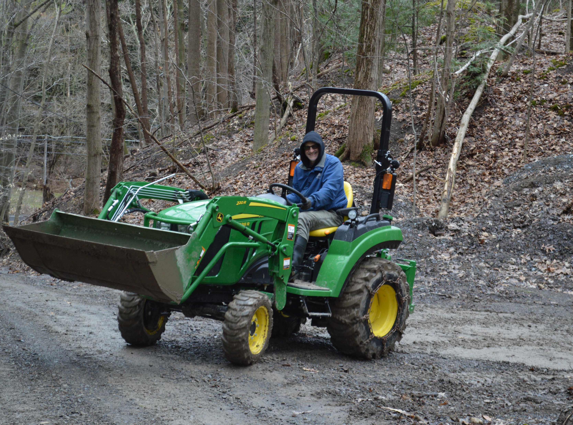
This is Miss Gloria’s husband John. He is on a …
Golf cart
Bus
Tractor
Motorcycle

Slide 7
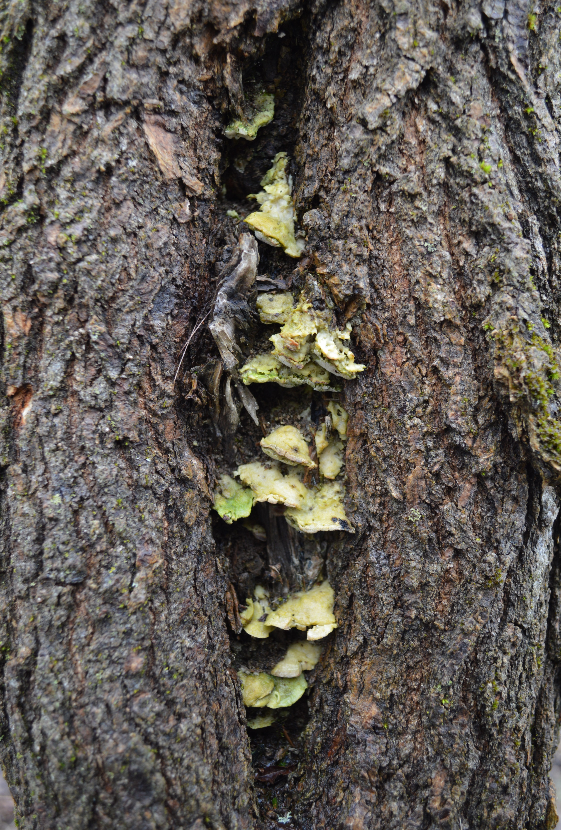
There is something growing in this tree. It is a …
Leaf
Fruit
Vegetable
Fungus

Slide 8
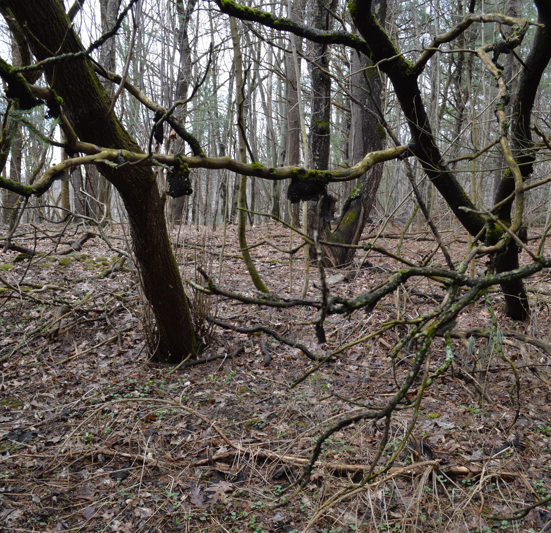
Moses says dinosaurs live here. Do you believe him?
Yes
No

Slide 9
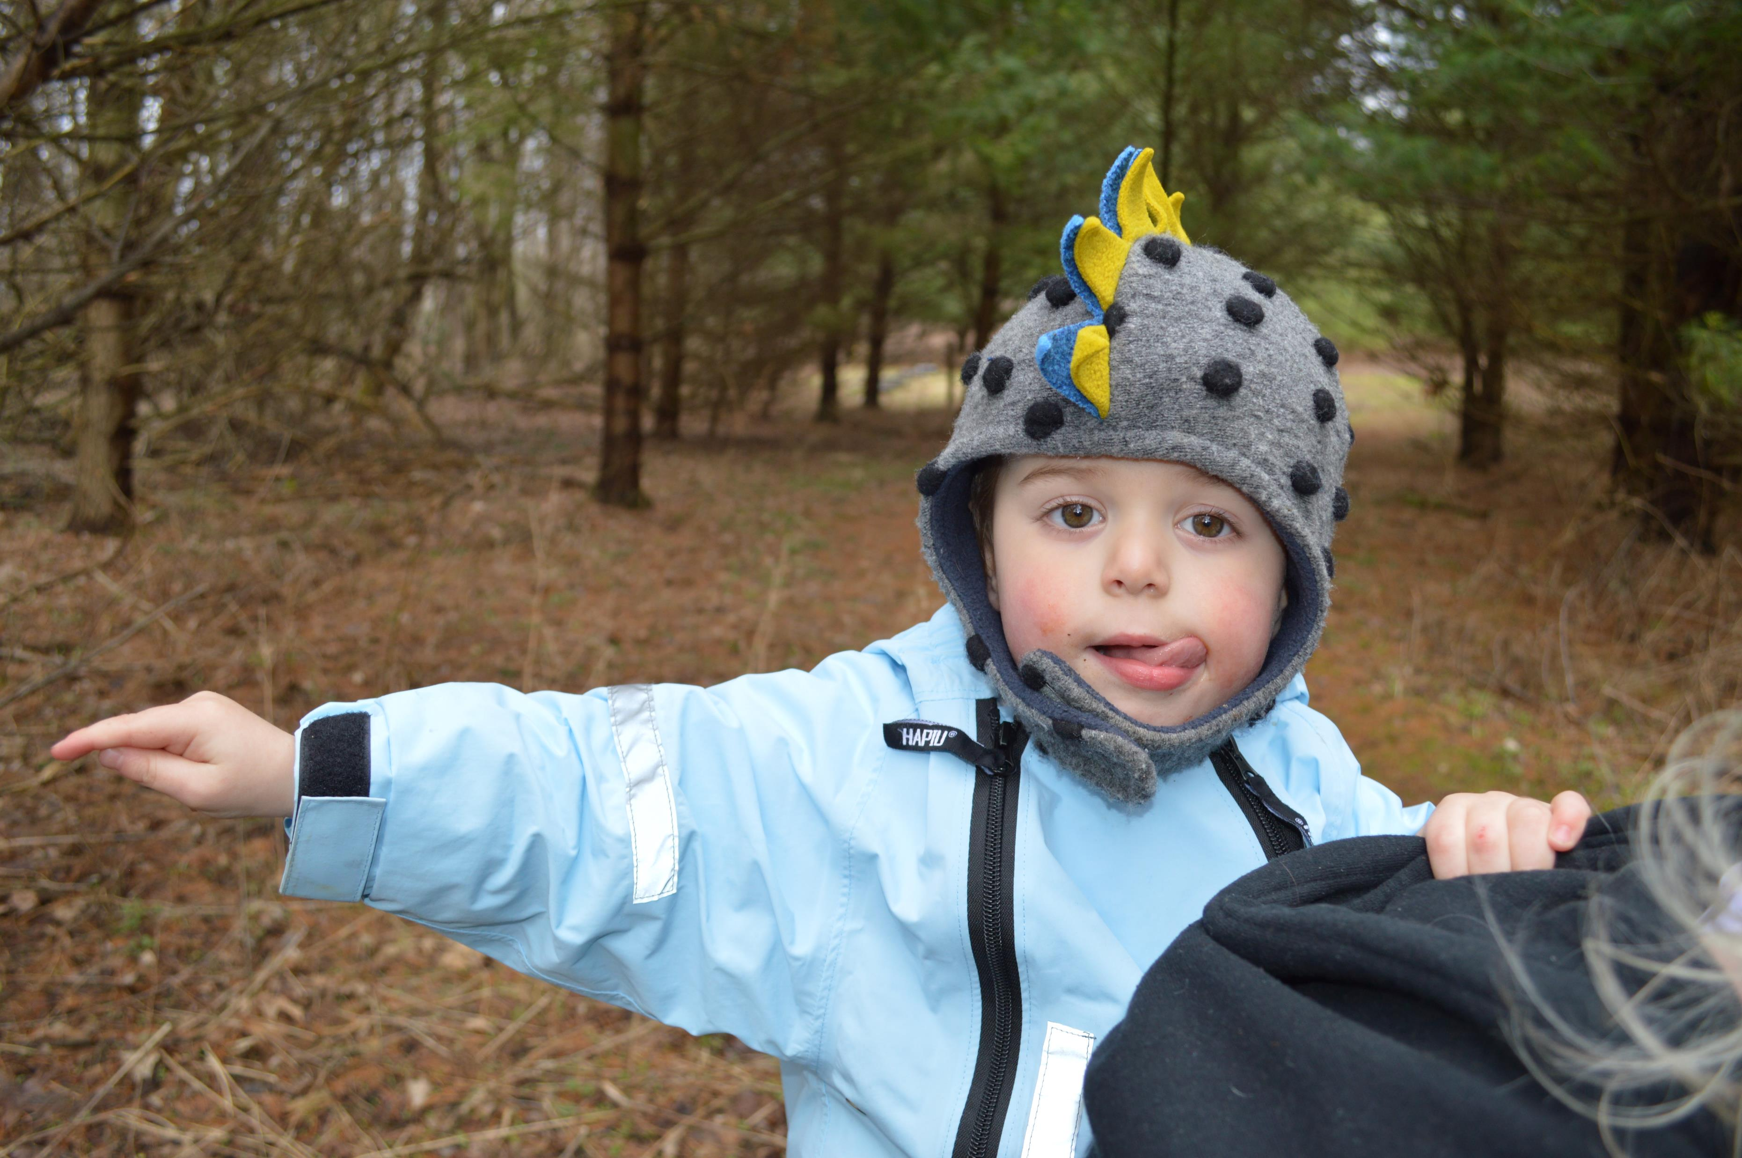
This is Moses
He is pointing to where the dinosaurs live.

Slide 10
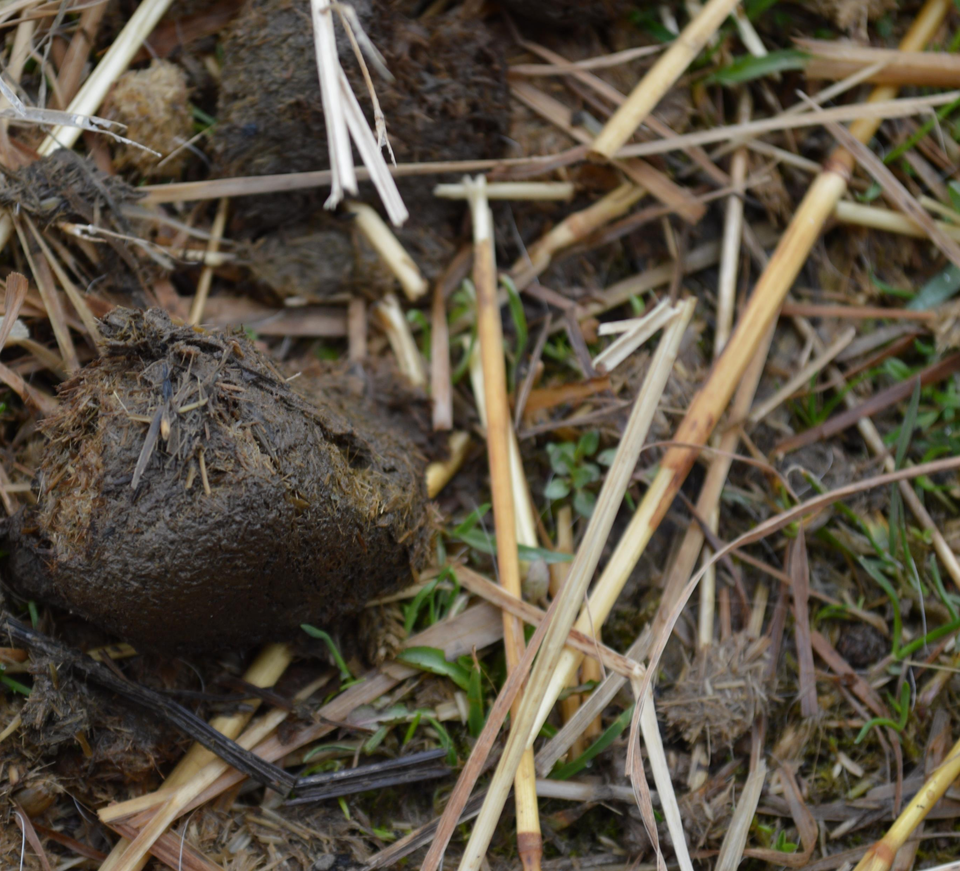
Everybody Poops! This poop is from a …
Deer
Buffalo
Horse
Mosquito

Slide 11
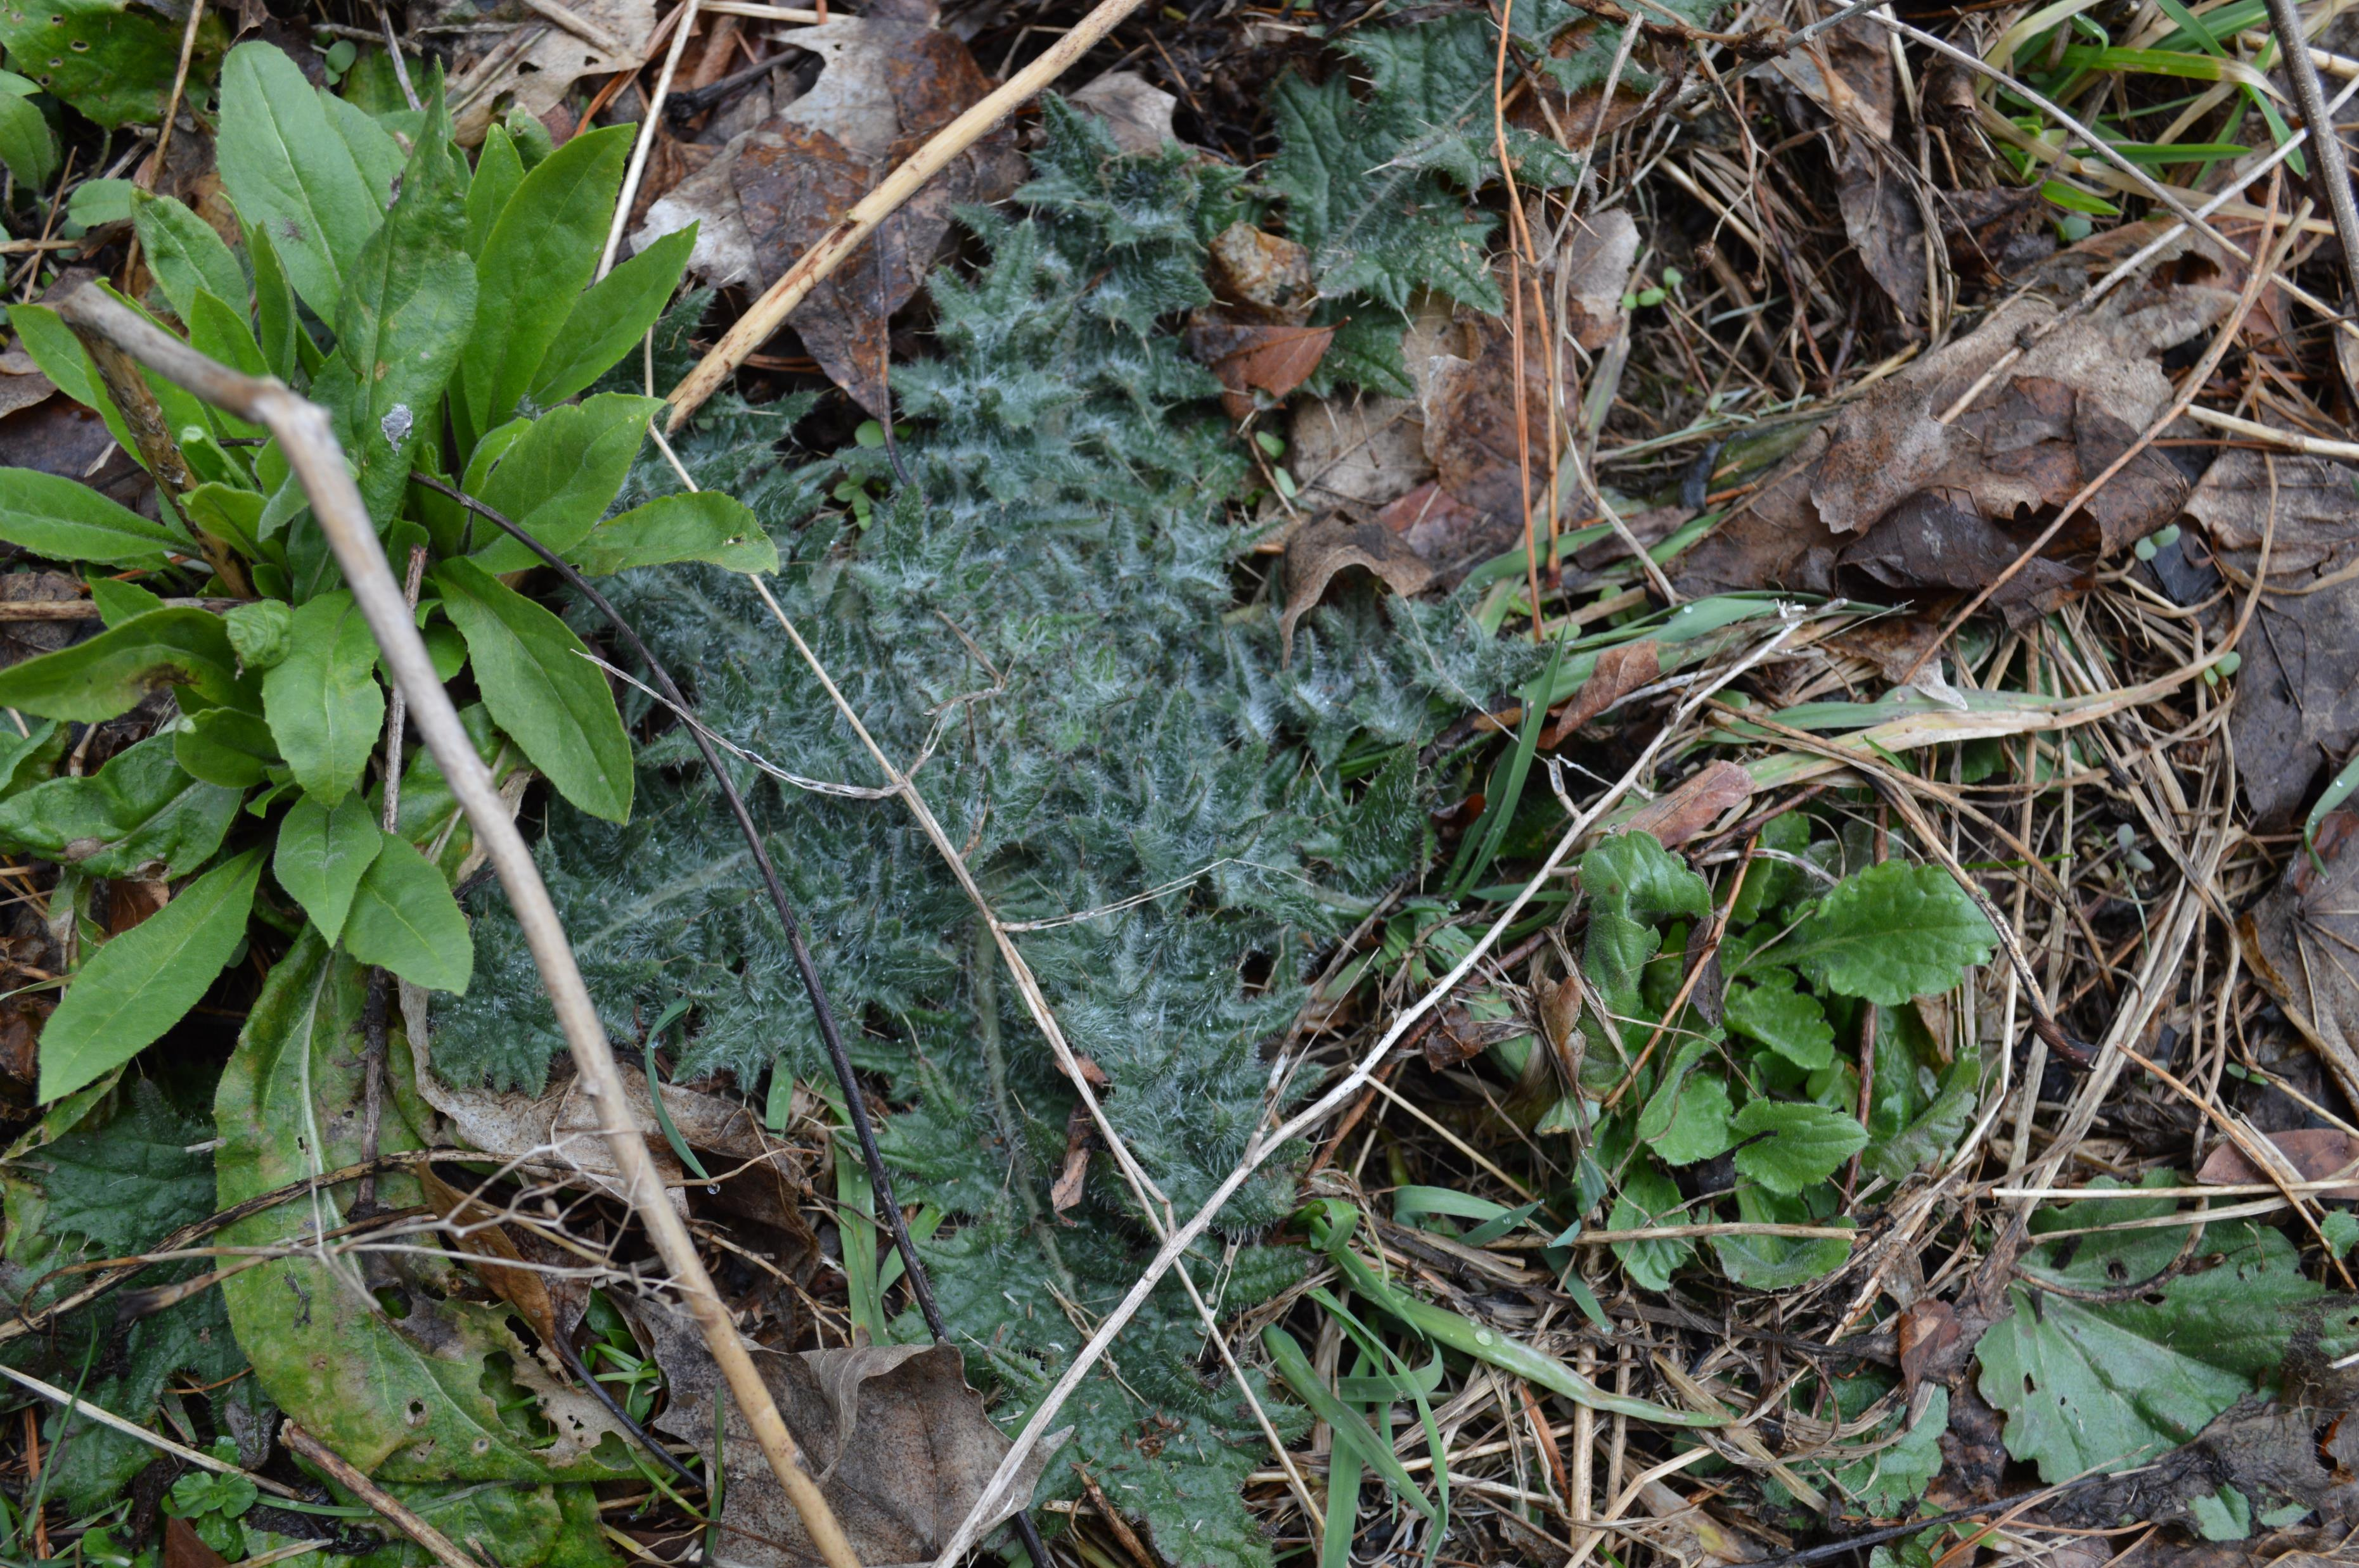
This plant stings.
Be careful if you touch it.

Slide 12
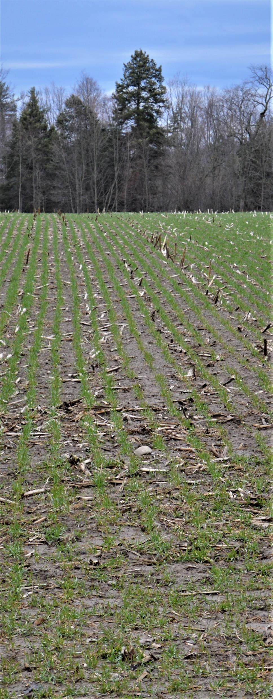
These are new shoots a farmer planted. Horses and cows like this plant. It is…
Sugar cane
Pumpkins
Alfalfa
Sunflowers

Slide 13
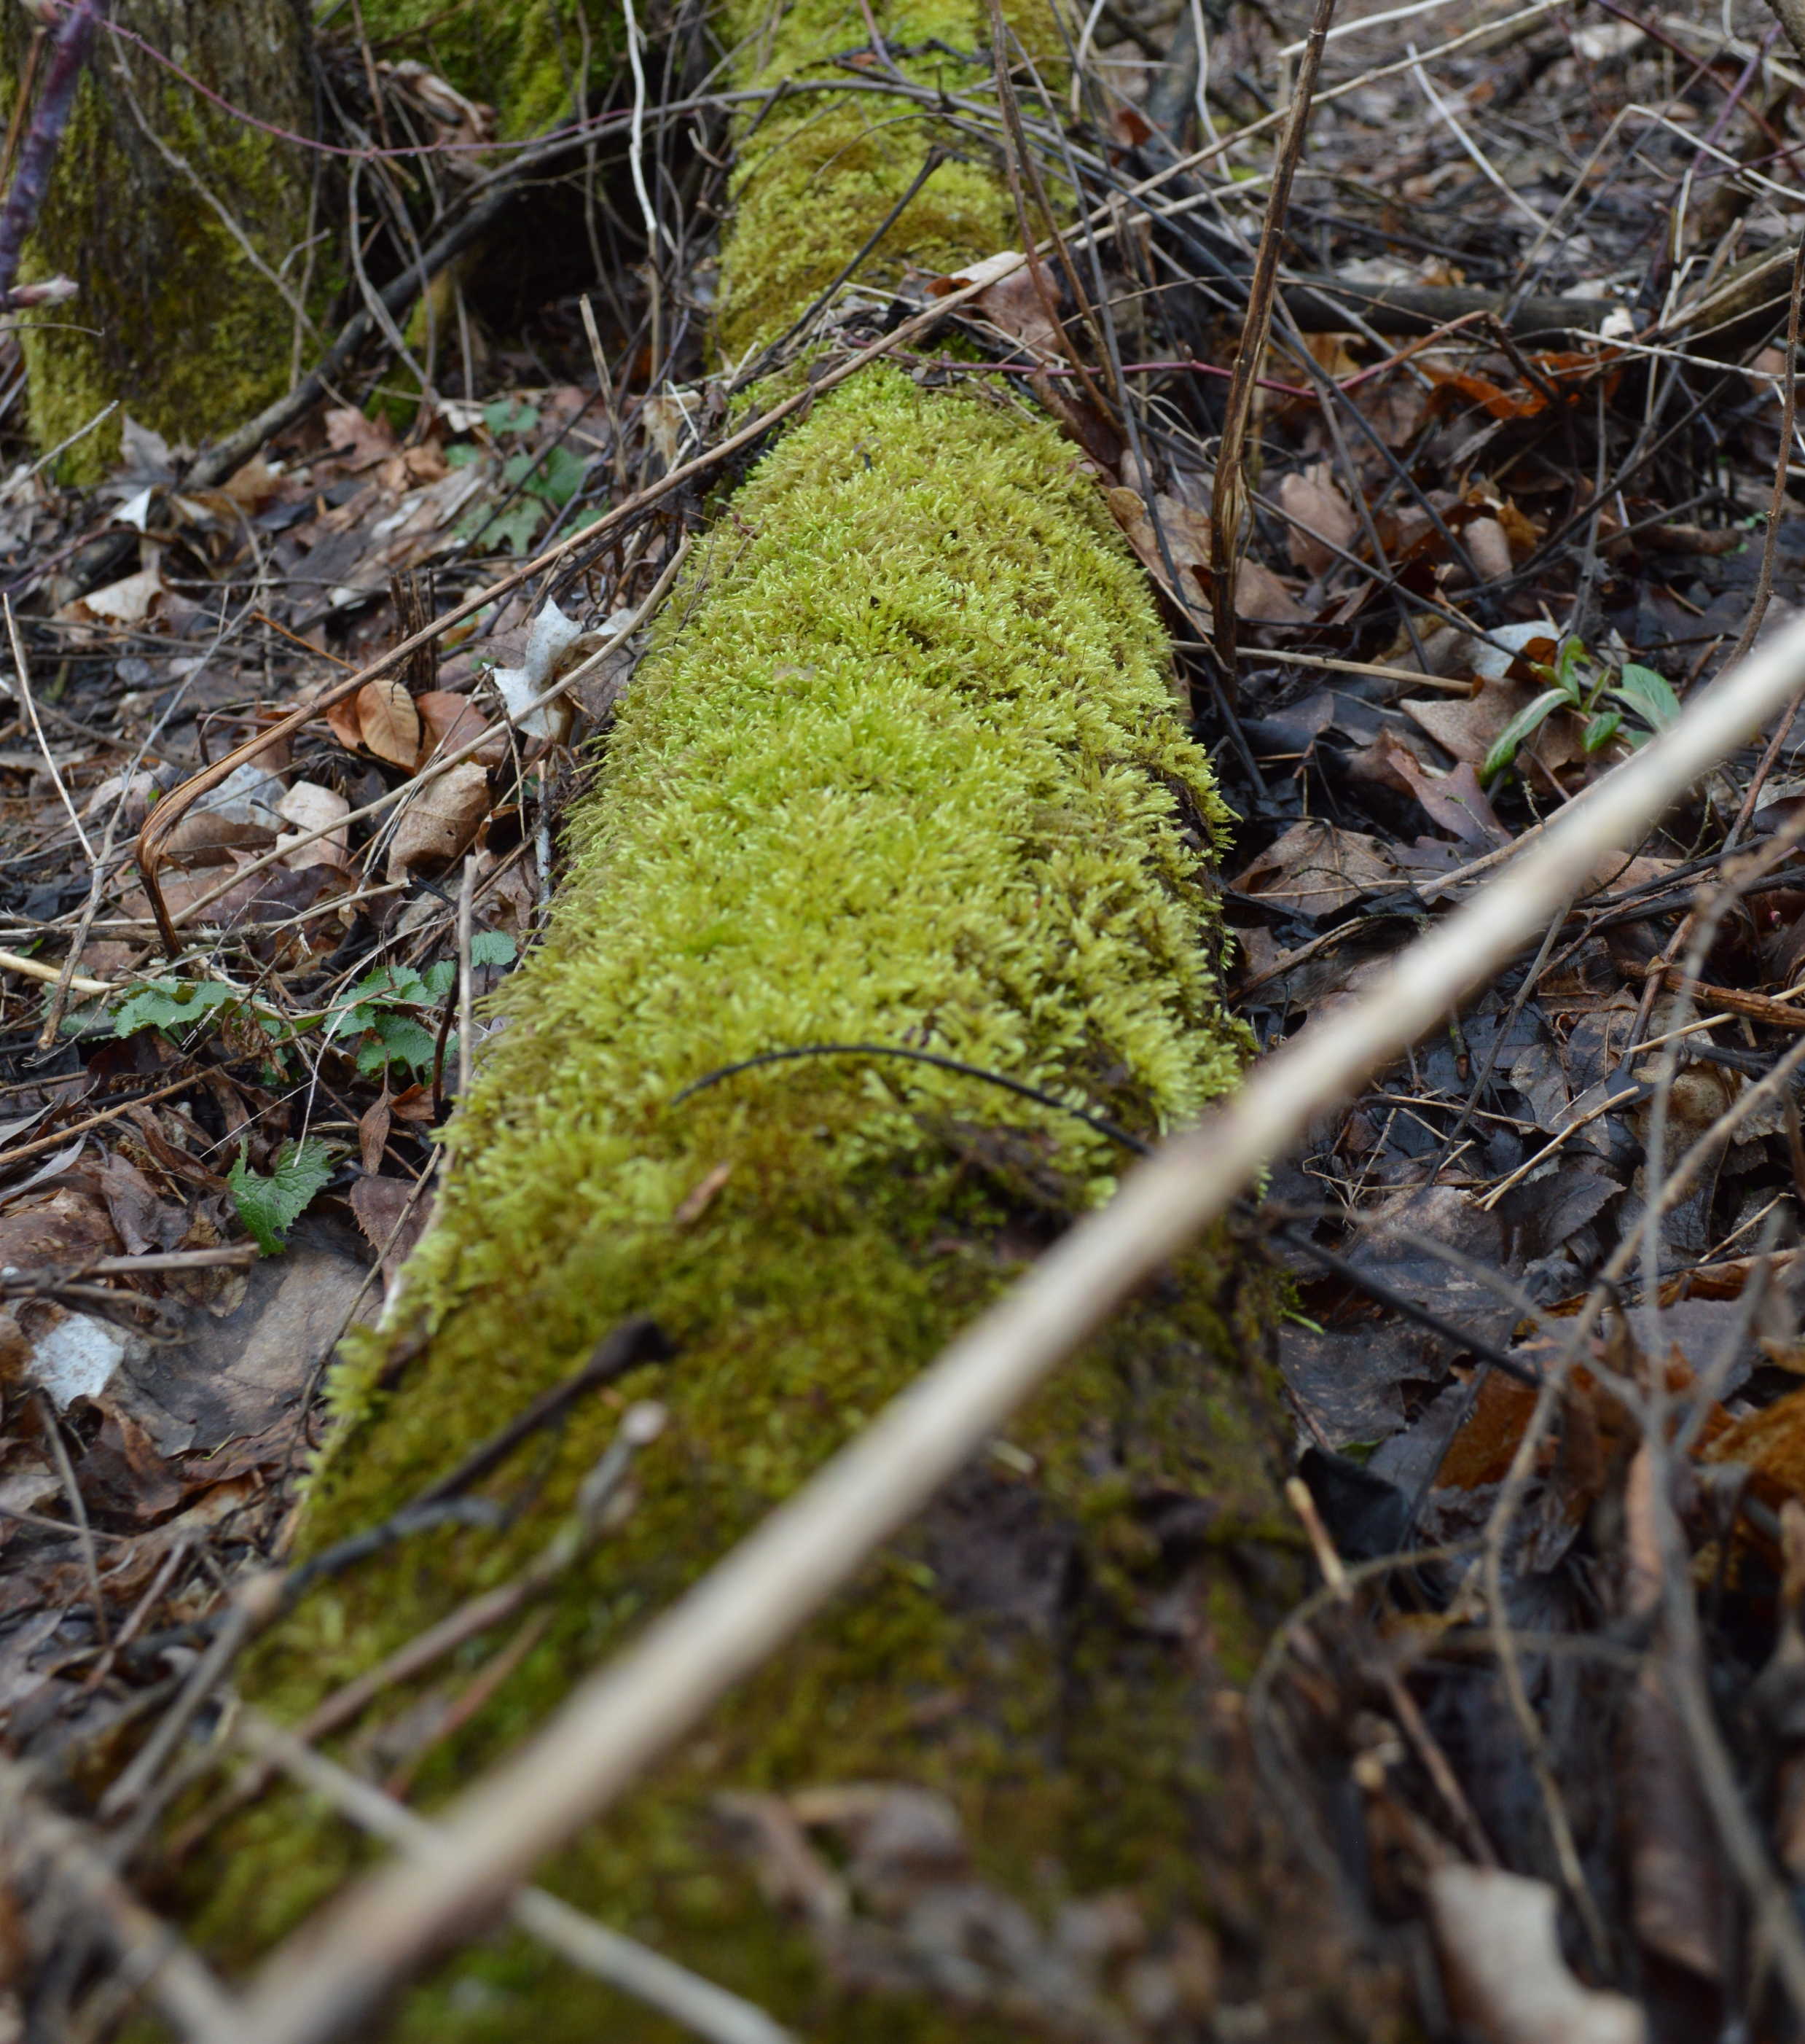
Something soft and velvety is growing on this tree. It is…
Grass
Moss
Leaves
Spiders

Slide 14
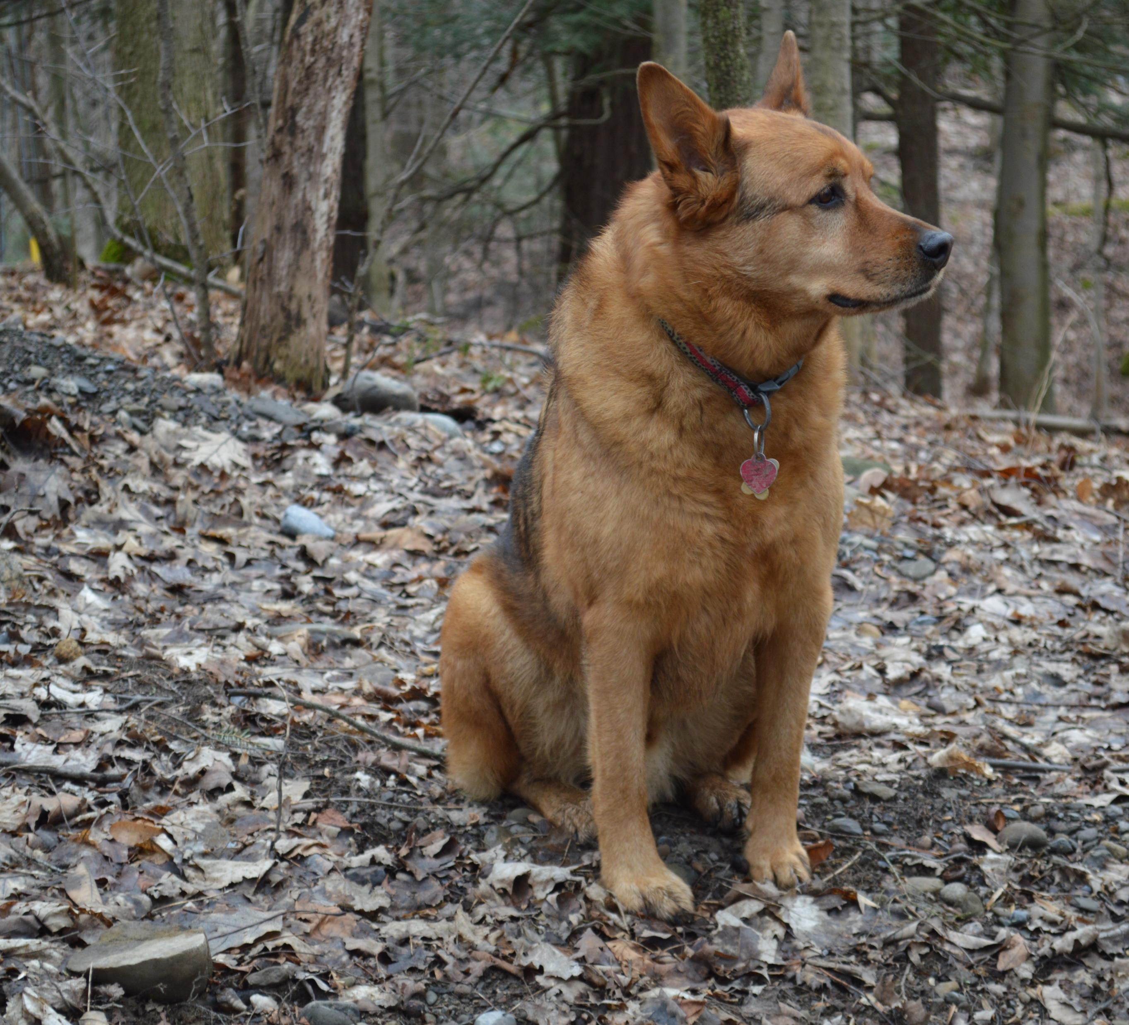
This is Nero. He is a …
Donkey
Cat
Dog
Horse

Slide 15
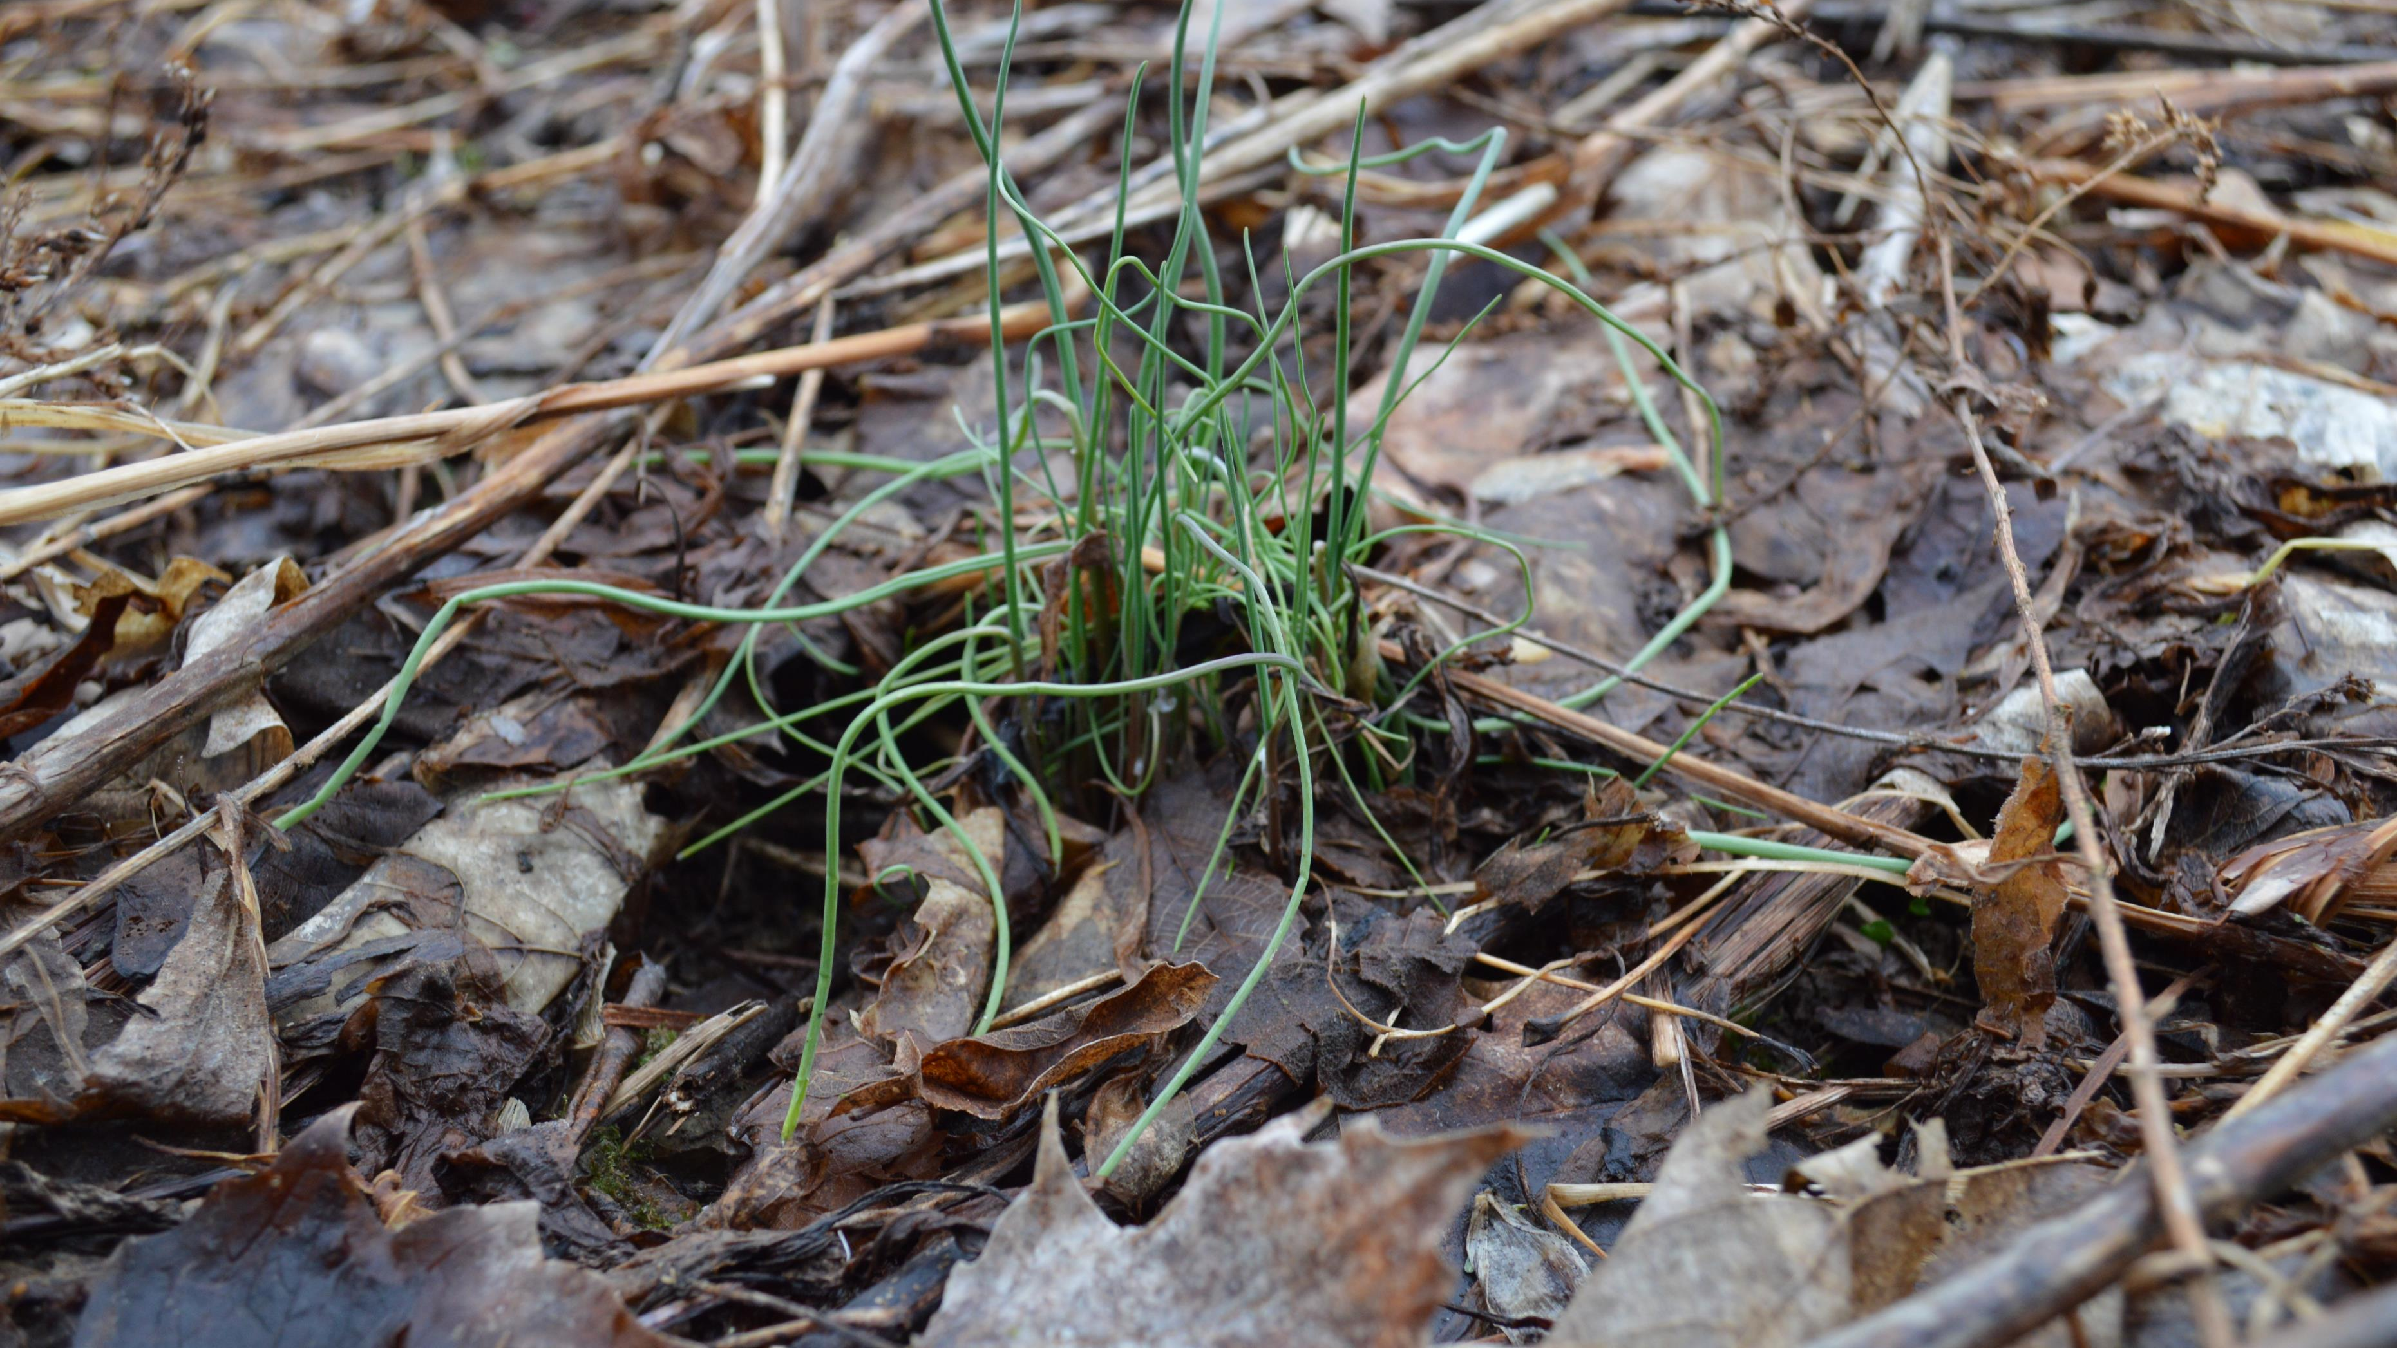
This is onion grass. You can really eat it.
True
False

Slide 16
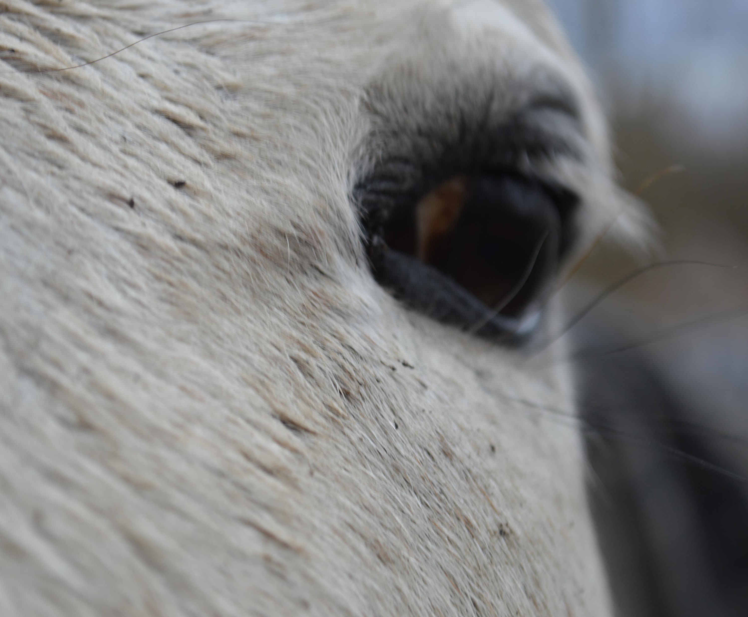
It was wonderful “seeing” you!

Slide 17
Answers:
“Q” is a horse
Tiger Lilys flower in the Spring
John is on a tractor
Fungus is growing in the tree
The poop is from a horse
The farmer planted alfalfa
Moss is growing on the tree
Nero is a dog
You can really eat onion grass

